Slide 1


Slide 2
Lecture 12: Reliable Storage
Prof. Seyed Majid Zahedi
https://ece.uwaterloo.ca/~smzahedi

Slide 3
Outline
Problem posed by machine/disk failures
Transaction concept (ASID properties)
Transactional file systems
  Journaling and logging
Copy-on-write file systems
Redundant arrays of independent disks (RAID)

Slide 4
Recall: Important “abilities”
Reliability: ability of system or component to perform its required functions under stated conditions for specified time
  System is not only “up”, but also working correctly
  Includes availability, security, fault tolerance/durability
  Data must survive system crashes, disk crashes, other problems
Availability: probability that system can accept and process requests
  Can build highly-available systems, despite unreliable components
    Involves independence of failures and redundancy
  Often as “nines” of probability. 99.9% is “3-nines of availability”
Durability: ability of system to recover data despite faults
  This idea is fault-tolerance applied to data
  Doesn’t necessarily imply availability: information on pyramids was very durable, but could not be accessed until discovery of Rosetta Stone

Slide 5
File System Reliability
Single logical file operation can involve updates to multiple physical storage blocks
  inode, indirect block, data block, bitmap, …
  With sector/page remapping, single update to physical storage block can require multiple (even lower-level) updates to sectors/pages
What can happen if disk loses power or software crashes?
  Some operations in progress may complete
  Some operations in progress may be lost
  Overwrite of block may only partially complete
How do we guarantee consistency regardless of when crash occurs?

Slide 6
Reliability Take1: Careful Ordering
Sequence operations in specific order
  Careful design to allow sequence to be interrupted safely
Post-crash recovery
  Read data structures to see if there were any operations in progress
  Clean up/finish as needed
Approach taken by
  FAT and FFS (fsck) to protect file-system structure/metadata
  Many app-level recovery schemes (e.g., Word, emacs autosaves)

Slide 7
Append Data to File in FAT
Normal operation
Allocate data block
Write data
Write new MFT entry to point to data block
Update file tail to point to new MFT entry
Update access time at head of file
Recovery
Scan MFT
If entry is unlinked, delete data block
If access time is incorrect, update

Slide 8
Create New File in FFS
Normal operation
Allocate data block
Write data block
Allocate inode
Write inode block
Update bitmap of free blocks
and inodes
Update directory with file name → inode number
Update modify time for directory
Recovery
Scan inode table
If any unlinked files
(not in any directory), delete or put in lost & found directory
Compare free block bitmap against inode trees
Scan directories for missing update/access times
Recovery time is proportional to storage size

Slide 9

Some General Rules for
Careful Ordering
Never write a pointer before initializing the block it points to (e.g., indirect block)
Never reuse resource (e.g., inode, disk block, etc.) before nullifying all pointers to it
Never clear last pointer to resource before setting new one (e.g., mv)

Slide 10
Careful Ordering: Discussion
+ Works with minimal support from storage drive
+ Works for most multi-step operations
– Time-consuming recovery after each failure
– Slow updates due to sync barriers between dependent operations
– Hard to turn every operation to safely-interruptible sequence of writes
– Hard to achieve consistency when multiple operations run concurrently

Slide 11
Reliability Take 2: Transaction Concept
Transaction is group of operations providing ACID properties
Atomicity: operations appear to logically happen as group, or not at all
  At physical level, only single disk/flash write is atomic
Consistency: transactions maintain data integrity
  Each transaction moves system from one legal state to another
    E.g., balance cannot be negative
    E.g., cannot reschedule meeting on February 30
Isolation: each transaction is not affected by other in-progress transactions
  If multiple transactions execute concurrently, for each pair of transactions A and B, it either appears that A executed entirely before B or vice versa
Durability: if transaction commits, its effects persist despite crashes

Slide 12
Typical Structure
Begin transaction – get transaction id
Do bunch of updates
  If any fail along the way, roll-back
  Or, if any conflicts with other transactions, roll-back
Commit the transaction

Slide 13
“Classic” Transaction Example
Transfer $100 from Tom’s account to Mike’s account
  BEGIN;
  UPDATE accounts SET balance = balance - 100.00 WHERE name = ‘Tom';
  UPDATE accounts SET balance = balance + 100.00 WHERE name = ‘Mike';
  COMMIT;

Slide 14
Atomicity and Durability: Redo Logging
Prepare: append all updates to log
Commit: append commit record to log
  Single disk write to make transaction durable
Redo: copy all updates to disk
Garbage collect: reclaim space in log
Recover: execute recovery routine if system crashes
  Scan sequentially through log, do the following for each type of record
    Update record: add to list of updates planned for this transaction
    Commit record: redo all planned updates for this transaction
    Roll-back record: discard list of updates planned for this transaction
  At the end of log, discard updates for transactions without commit record
  Garbage collect log

Slide 15
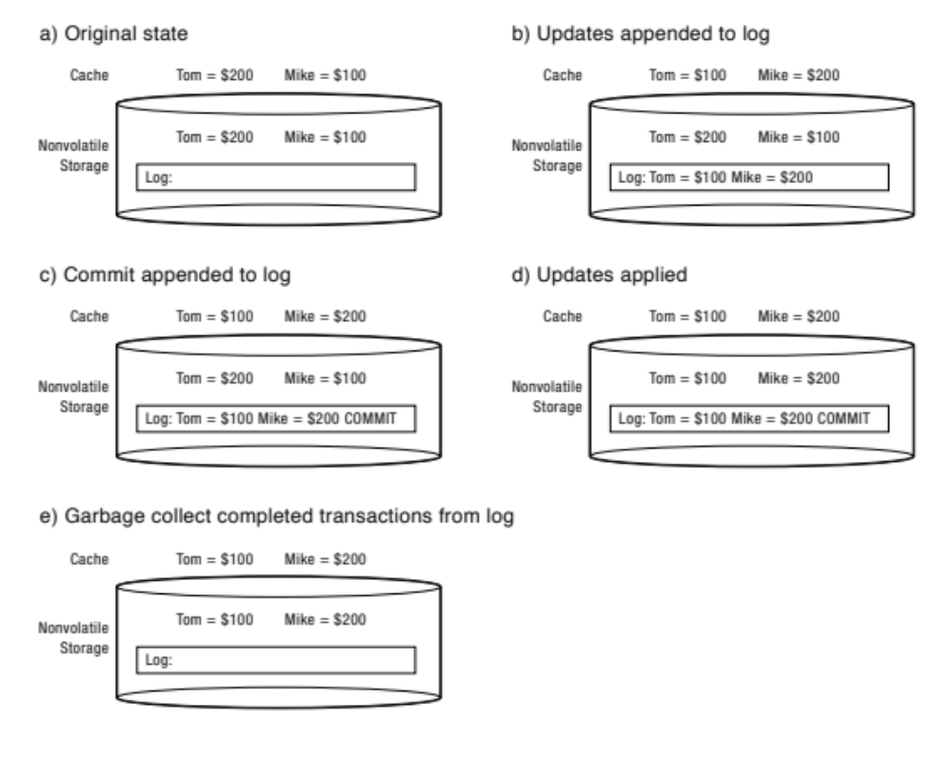
Redo Logging Example:
Before Transaction Start

Slide 16
Redo Logging Example:
After Updates Are Logged

Slide 17
Redo Logging Example:
After Commit Logged

Slide 18
Redo Logging Example: After Redo

Slide 19
Redo Logging Example:
After Garbage Collection

Slide 20
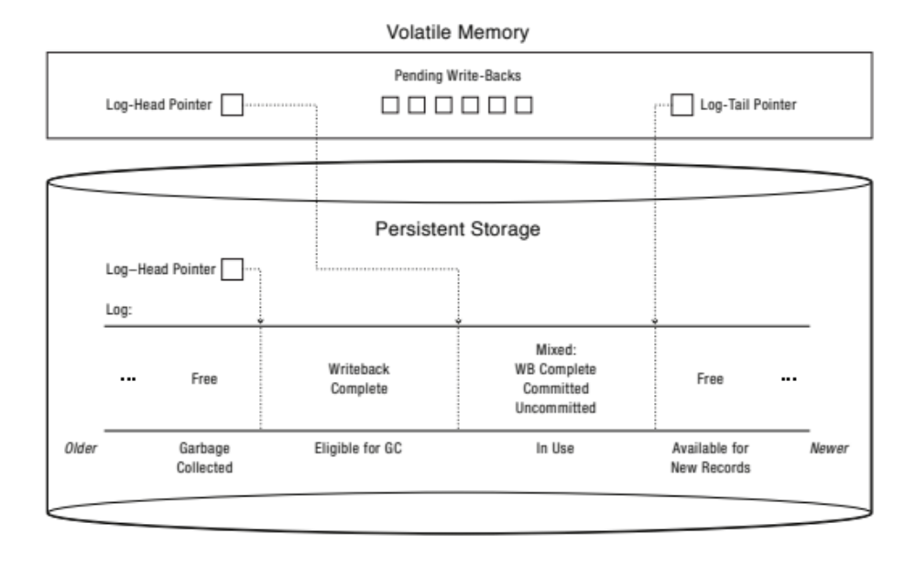
Redo Log Implementation
Volatile memory has pointers to head and tail log
New transaction records are appended to log’s tail and cached in volatile memory
Redo asynchronously writes pending updates for committed transactions
Garbage collector periodically advances persistent log-head pointer so that recovery can skip at least some of committed transactions

Slide 21
Isolation: Two-phase Locking
Expanding phase: locks may be acquired but not released
Contracting phase: locks may be released but not acquired
Transactions release locks only AFTER they commit
  Prevents transactions from seeing results of non-committed ones
  Could lead to deadlock
If set of transactions deadlocks, one or more can be forced to roll back, release their locks, and restart at some later time
Serializability: with two phase locking and redo logging, transactions appear to occur in sequential order

Slide 22
Transactional File Systems
Journaling: apply updates to system metadata using transactions, but updates to users’ files are done in place
  E.g., NTFS, Apple HFS+, Linux XFS, JFS,
  E.g., Ext3 and Ext4 use journaling by default
Logging: apply all updates (metadata & data) using transactions
  E.g., Ext3 and Ext4 can be configured to use logging

Slide 23
Example: Creating File
Find free data block(s)
Find free inode entry
Find dirent insertion point
Write map (i.e., mark used)
Write inode entry to point to block(s)
Write dirent to point to inode
Free space bitmap
Data blocks
…
Inode table
Directory
entries

Slide 24
Example: Creating File (as Transaction)
Find free data block(s)
Find free inode entry
Find dirent insertion point
[log] Write map (i.e., mark used)
[log] Write inode entry to point to block(s)
[log] Write dirent to point to inode
Free space bitmap
Data blocks
…
Inode table
Directory
entries
tail
head
done
pending
start
commit
Log in non-volatile storage (Flash or on Disk)

Slide 25
Example: Creating File (as Transaction)
Find free data block(s)
Find free inode entry
Find dirent insertion point
[log] Write map (i.e., mark used)
[log] Write inode entry to point to block(s)
[log] Write dirent to point to inode
Free space bitmap
Data blocks
…
Inode table
Directory
entries
tail
head
done
pending
start
commit
Log in non-volatile storage (Flash or on Disk)

Slide 26

Example: Recovery After Failure During Logging
Upon recovery scan the log
Detect transaction start with no commit
Discard log entries
Disk remains unchanged
Free space bitmap
Data blocks
…
Inode table
Directory
entries
tail
head
done
pending
start
Log in non-volatile storage (Flash or on Disk)

Slide 27
Copy-on-write (COW) File System
For each update, write new version of file system
  Never update in place
  Reuse existing unchanged disk blocks
Seems expensive! But …
  Updates can be batched
  Almost all disk writes can occur in parallel
Approach taken in network file server appliances
  NetApp’s Write Anywhere File Layout (WAFL)
  ZFS (Sun/Oracle) and OpenZFS

Slide 28
Recall: Traditional, Update-in-place File System
Inode
Array
Indirect
Blocks
Data
Blocks
Fixed
Location
Anywhere

Slide 29
Simple Copy-on-write File System
Root Inode
Slots
Inode File’s
Indirect Blocks
Inode Array
(in inode file)
Indirect
Blocks
Data
Blocks
Fixed
Location
Anywhere

Slide 30
Simple Copy-on-write File System
Root Inode
Slots
Inode File’s
Indirect Blocks
Inode Array
(in inode file)
Indirect
Blocks
Data
Blocks
Wirte
Make a copy
to write updates
Fixed
Location
Anywhere

Slide 31
Simple Copy-on-write File System
Root Inode
Slots
Inode File’s
Indirect Blocks
Inode Array
(in inode file)
Indirect
Blocks
Data
Blocks
Fixed
Location
Anywhere

Slide 32
Simple Copy-on-write File System
Root Inode
Slots
Inode File’s
Indirect Blocks
Inode Array
(in inode file)
Indirect
Blocks
Data
Blocks
Updating root inode is atomic action that commits set of updates
Keep small array of slots for current and recent root inodes
Include checksum and monotonically increasing version number in root inodes
After any crash, scan all slots to identify the newest root inode that includes correct checksum
Fixed
Location
Anywhere

Slide 33
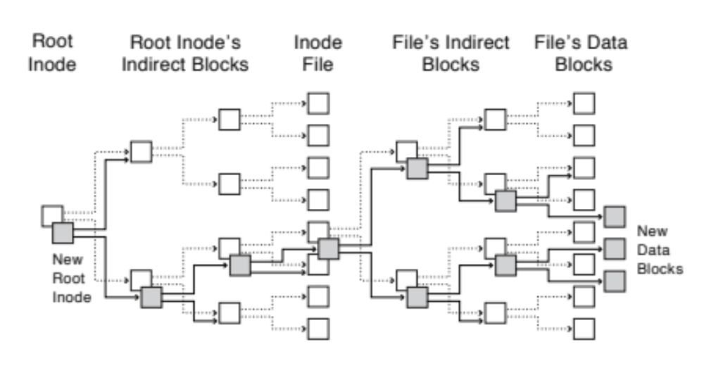
Copy-on-write Batch Update
Updates to file’s inode and indirect blocks may be amortized over multiple writes to different blocks of the file
Updates to the rood inode and root inode’s indirect blocks may be amortized over multiple writes to different files

Slide 34
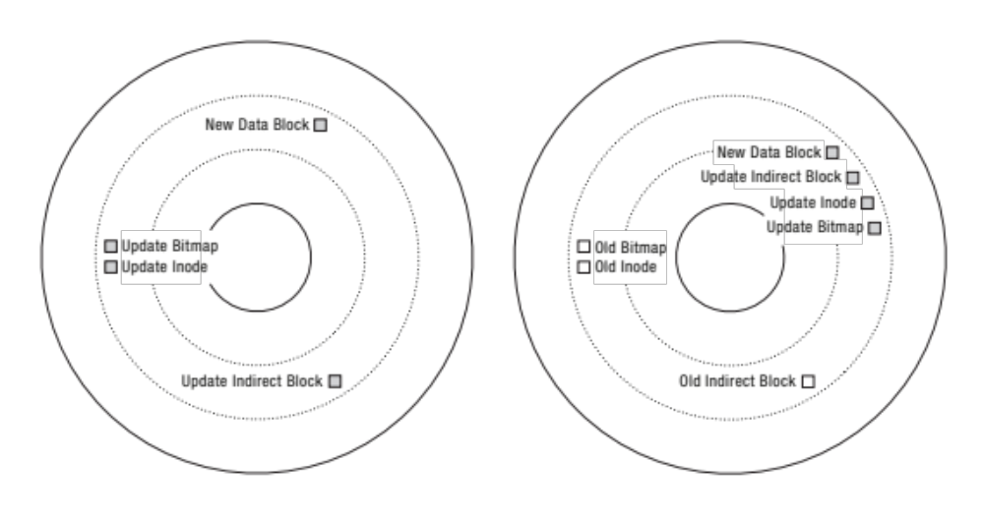
Update-in-place vs. Copy-on-write
File Systems
Update-in-place file system updates data and metadata in their existing locations
Copy-on-write file system makes new copies on every update
  Updates can be grouped into single write to free range of sequential blocks on disk
  Sequential writes are much faster than random ones → excellent write performance even though copy-on-write writes more data than update-in-place does

Slide 35
Copy-on-write File Systems:
Garbage Collection
Write efficiency requires contiguous sequences of free blocks
  Updates leave dead blocks scattered
Read efficiency requires data read together to be in the same block group
  Write anywhere leaves related data scattered
Solution: background coalescing of live/dead blocks

Slide 36
Copy-on-write File Systems: Discussion
+ Correct behavior regardless of failures
+ Fast recovery (root block array)
+ High throughput (best if updates are batched)
– Potential for high latency
– Small changes require many writes
– Garbage collection essential for performance

Slide 37
Outline
Problem posed by machine/disk failures
Transaction concept (ASID properties)
Transactional file systems
  Journaling and logging
Copy-on-write file systems
Redundant arrays of independent disks (RAID)

Slide 38
How to Make File System Durable?
Disk drives use error correcting codes (ECC) to deal with small defects
  Can allow recovery of data from small media defects
Writes should survive in short term
  Either abandon delayed writes or
  Use battery-backed RAM (non-volatile RAM - NVRAM) for dirty blocks in buffer cache
Data should survive in long term
  Need to replicate! Keep more than one copy of data!
  Important element: independence of failure
    Could put copies on one disk, but if disk head fails …
    Could put copies on different disks, but if server fails …
    Could put copies on different servers, but if building is struck by lightning …
    Could put copies on servers in different continents …

Slide 39
RAID: Redundant Arrays of Inexpensive Disks
Invented by David Patterson, Garth A. Gibson, and Randy Katz in 1987
Data stored on multiple disks (redundancy)
Implemented either in software or hardware
  In hardware case, done by disk controller; file system may not even know that there is more than one disk in use
Initially, five levels of RAID (more now!)

Slide 40
RAID 0: Striping
Multiple drives (at least 2) are used to store data
Data is split into blocks written across all drives
+ Offers great performance
  Read and write operations can be parallelized
  over multiple drives
+ Uses entire capacity and is easy to implement
– Not fault-tolerant
  If one drive fails, data cannot be restored
  (not suitable for mission-critical systems)
Drive 1
Drive 2
D₁
D₂
D₃
D₄
D₅
D₆
D₇
D₈
D₉
D₁₀

Slide 41
RAID 1: Mirroring
Data is stored twice
Each drive is fully duplicated onto its “shadow”
+ Offers low-overhead data recovery
  Disk failure ⇒ replace disk & copy data to new disk
  Hot spare: idle disk already attached to
  system to be used for immediate replacement
– 100% capacity overhead
– Bandwidth sacrificed on write
  Logical write = two physical writes
Drive 1
Drive 2
D₁
D₁
D₂
D₂
D₃
D₃
D₄
D₄
D₅
D₅

Slide 42
RAID 5: Striping With Parity
With G drives, for every G – 1 blocks, save one parity block (XOR of all data blocks)
  P = D₁ ⊕ D₂ ⊕ D₃ ⊕ … ⊕ D_{G-1}
  If D₁ is lost, it can be restored using P
  and other blocks: D₁ = P ⊕ D₂ ⊕ … ⊕ D_{G-1}
Parity for given set of blocks must be
updated each time any of blocks is updated
  To balance load, parity blocks are stored
  rotationally across all drives
+ Offers high availability with low capacity overhead
– High recovery overhead
– Complex implementation with high-overhead writes (requires 4 I/O operations)
  Read old data
  Read old parity
  Write new data
  Write new parity
    Remove old data from parity (P_{tmp} = P_{old} ⊕ D_{old})
    Calculate new parity (P_{new} = P_{tmp} ⊕ D_{new})
Drive 1
Drive 2
Drive 3
D₁
D₂
P₁
D₃
P₂
D₄
P₃
D₅
D₆
D₇
D₈
P₄
D₉
P₅
D₁₀

Slide 43
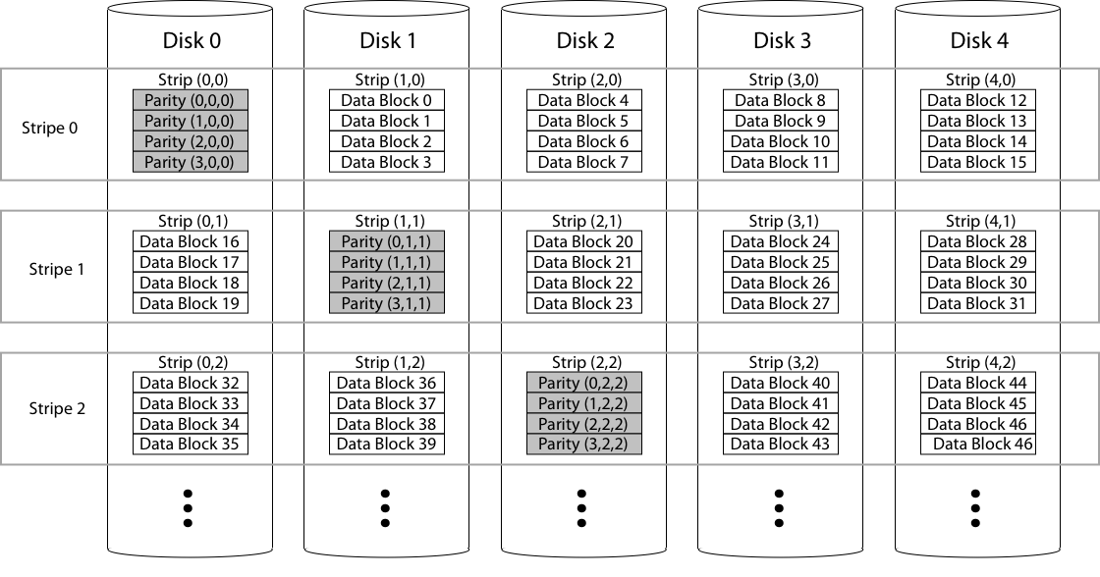
RAID 5: Closer Look
To balance parallelism versus sequential-access efficiency, single strip of several sequential blocks is placed on one drive before shifting to another
Set of G – 1 data strips and their parity strip is called stripe

Slide 44
RAID 6: Striping With Double Parity
With RAID 5, time to repair failed drive is too long, another drive might fail in process!
RAID 6 is like RAID 5, but with two parity data
  Simple XOR will no longer work
  We need something more complex
Example: with G drives and k-bit blocks, if G – 2 ≤ k
  P = D₁ ⊕ D₂ ⊕ D₃ ⊕ … ⊕ D_{G-2}
  Q = D₁ ⊕ shift(D₂) ⊕ shift²(D₃) ⊕ … ⊕ shift^{G-3}(D_{G-2})
  If D₁ is lost, recover it using P and other blocks (like RAID 5)
  If D₁ and P are lost, recover it using Q and other blocks
    D₁ = Q ⊕ shift(D₂) ⊕ shift²(D₃) ⊕ … ⊕ shift^{G-3}(D_{G-2})
  If D1 and D2 are lost, recover them using P, Q, and other blocks
    D₁ ⊕ D₂ = P ⊕ D₃ ⊕ … ⊕ D_{G-2}
    D₁ ⊕ shift(D₂) = Q ⊕ shift²(D₃) ⊕ … ⊕ shift^{G-3}(D_{G-2})
    System of 2k equations in 2k unknowns which uniquely determines the lost data
  If G – 2 > k or if we need more parity blocks, then general option is Reed-Solomon system
+ More reliable than RAID 5
  Tolerates two drive failures
– Even more slower writes than RAID 5
– Higher capacity overhead than RAID 5
Drive 1
Drive 2
Drive 3
Drive 4
D₁
D₂
P₁
Q₁
D₃
P₂
Q₂
D₄
P₃
Q₃
D₅
D₆
Q₄
D₇
D₈
P₄
D₉
D₁₀
P₅
Q₅

Slide 45
RAID 10: Combining RAID 1 & RAID 0
RAID 10: RAID 1 + RAID 0
+ Advantages of RAID 1 and RAID 0
– Higher capacity overhead than RAID 5 and 6
Drive 1
Drive 2
Drive 3
Drive 4
D₁
D₁
D₂
D₂
D₃
D₃
D₄
D₄
D₅
D₅
D₆
D₆
D₇
D₇
D₈
D₆
D₉
D₉
D₁₀
D₁₀

Slide 46
Summary
Transactions
  ACID properties: atomicity, consistency, isolation, and durability
  Redo logging and two-phase locking
Transactional file systems
  Journaling and logging
Copy-on-write file systems
  Write new version of file system on each update
Redundant arrays of inexpensive disks (RAID)
  RAID 0, 1, 5, 6, and 10

Slide 47

Questions?
globaldigitalcitizen.org

Slide 48
Acknowledgment
Slides by courtesy of Anderson, Culler, Stoica, Silberschatz, Joseph, and Canny

