Slide 1


Slide 2
Lecture 1: Introduction
Prof. Seyed Majid Zahedi
https://ece.uwaterloo.ca/~smzahedi

Slide 3
Outline
How do things work in SE 350?
What is an operating system?
What makes operating systems so exciting?

Slide 4
Useful Links
Course webpage
      https://ece.uwaterloo.ca/~smzahedi/crs/se350
Course on Piazza
      https://piazza.com/uwaterloo.ca/winter2022/se350
Anonymous feedback form
      https://forms.gle/cR93sRrzTERZVtXN8

Slide 5
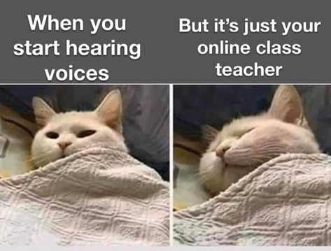
Class is Entirely Online!
Lectures will be delivered on Teams
  Links are provided on course webpage
  Recordings will be available afterwards
Office hours will be on Teams
  Links are provided on course webpage
  There will be no recordings
  No office hours during week 1 and reading week
Lab tutorials will be delivered on Teams
  Links are provided on course webpage

Slide 6
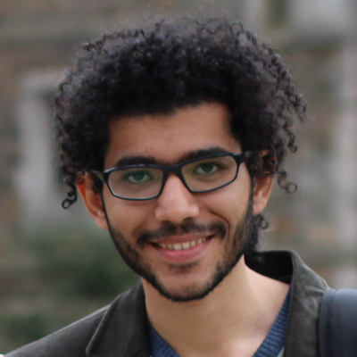
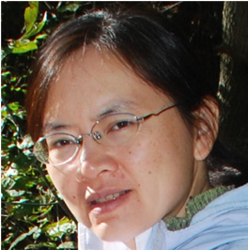
Who Are We?
Instructor: Prof. Seyed Majid Zahedi
zahedi@uwaterloo.ca
https://ece.uwaterloo.ca/~smzahedi
Lab instructor: Irene Huang
yqhuang@uwaterloo.ca

Slide 7

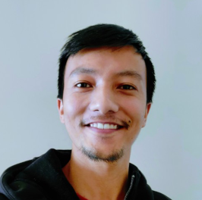
SE 350 GTAs
Karim Walid Abdelazim Elhammady kwamelhammady@uwaterloo.ca
Sulav Shrestha
slshrestha@uwaterloo.ca

Slide 8
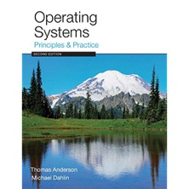

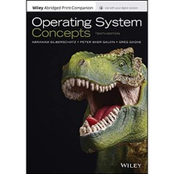
Readings
Main textbook
  Operating Systems: Principles and Practice (2nd Edition)
Optional references
  Operating Systems: Three Easy Pieces (Freely Available)
  Operating System Concepts (10th Edition)

Slide 9
SE 350 is a Class About…
Design of key systems abstractions that have emerged over time
  Processes, threads, events, address spaces, file systems, sockets, transactions, key-value stores, etc.
Tradeoffs surrounding these designs
Their efficient implementation
  Including hardware support that makes them possible and practical
And how to use them effectively

Slide 10
Why Take SE 350?
Why Learn About OS?
Some of you will design and build parts of operating systems
Many of you will create systems that use OS concepts
  Whether you build hardware or software
  Concepts and design patterns appear at many levels
All of you will write programs that use OS abstractions
  The better you understand them, the better you use them

Slide 11


Slide 12
Evaluation
In-person final: 30%
Lab projects: 50%
  3 projects (more on this later)
Quizzes: 20%
  9 quizzes (highest 7 will be considered)
  All online on LEARN
  Quizzes are open book
    You may consult your textbook, course notes, and materials posted on course webpage
    Use of any other resource (including online services such as stackexchange.com) is prohibited
    You may not communicate directly or indirectly with any person except course instructors (you can email course instructors if you have any questions or need any clarification)
    You may not discuss nor disclose quiz questions with anyone

Slide 13
Contingency Proviso
Course outline presents intended weights, and due dates
As best as possible, we will keep to the outline
We reserve the right to modify topics and/or assessments and/or weight and/or deadlines with due and fair notice
In the event of such challenges, we will work with the Department/Faculty to find reasonable and fair solutions

Slide 14
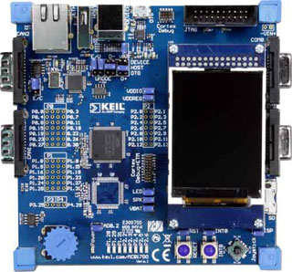
Lab Project
You will design, implement, and test
real-time executive (RTX) on Keil MCB1700 boards

Slide 15
Groups
Groups should have 4 members
  Never 5! 3 requires serious justification
  Sign up on LEARN by 23:00 on Jan.11th EST
Only one split-up is allowed
  One-week notice in writing before nearest deadline
  All students involved lose their group sign-up points

Slide 16
Milestones
Project | Weight | Due Date
Group sing-up | 3% | 8:30 Jan 11
Memory and task management (P1) | 33% | 8:30 Feb 1
Message passing and timing (P2) | 32% | 8:30 Mar 1
I/O and stress testing (P3) | 32% | 8:30 Mar 29
All times are Eastern Standard Time

Slide 17
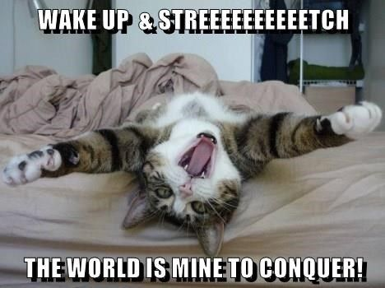
Start Early!
Time/work estimation is hard
  Programmers are eternal optimists
  (it will only take two days)!
    This is why we bug you about
    starting the project early
Can a project be efficiently partitioned?
  Partitionable task decreases in time as you add people
  But … what about communication?
    Time reaches a minimum bound
    With complex interactions, time increases!

Slide 18
Techniques for Partitioning Tasks
Functional
  Person A implements threads, Person B implements semaphores, Person C implements locks…
  Problem: Lots of communication across APIs
    If B changes the API, A may need to make changes
Task
  Person A designs, Person B writes code, Person C tests
  May be difficult to find right balance, but can focus on each person’s strengths (Theory vs systems hacker)
  Since debugging is hard, Microsoft has two testers for each programmer

Slide 19
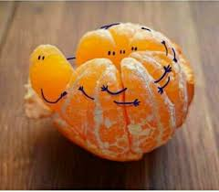
Communication
More people means more communication
  Changes have to be propagated to more people
  Think about person writing code for most fundamental
  component of system: everyone depends on them!
Miscommunication is common
  “Index starts at 0? I thought you said 1!”
Who makes decisions?
  Individual decisions are fast but trouble
  Group decisions take time
  Centralized decisions require a big picture view
  (someone who can be the “system architect”)
Often designating someone as system architect can be a good thing
  Better not be clueless
  Better have good people skills
  Better let other people do work
dopl3r.com

Slide 20

Coordination
Many are in different time zones ⇒ some cannot make all meetings!
  They miss decisions and associated discussion
  Why do we limit groups to 4 people?
    You would never be able to schedule meetings otherwise
  Why do we require 3 people minimum?
    You need to experience groups to get ready for real world
People have different work styles
  Some people work in the morning, some at night
  How do you decide when to meet or work together?
What about project slippage?
  Everyone busy but not talking, one is way behind, but no one will know until very end!
Hard to add people to existing group
  Members have already figured out how to work together

Slide 21
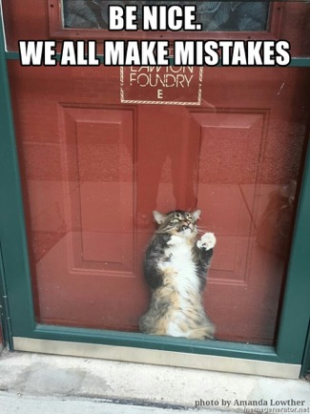
How to Make it Work?
People are human … get over it!
  People will make mistakes, miss meetings,
  miss deadlines, etc.
  You need to live with it and adapt
  It is better to anticipate problems than
  clean up afterwards
Document, document, document
  Why Document?
    Expose decisions and communicate to others
    Easier to spot mistakes early
    Easier to estimate progress
  What to document?
    Everything (but don’t overwhelm people or no one will read)

Slide 22

Suggested Documents for You to Maintain
Project objectives: goals, constraints, and priorities
Specifications
  This should be the first document generated and the last one finished
Meeting notes
  Document all decisions
Schedule
  This document is critical!
Organizational chart
  Who is responsible for what task?

Slide 23
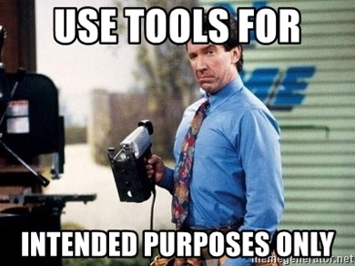
Use Software Tools
Source revision control software (CVS, SVN, git)
  Easy to go back and see history
  Figure out where and why bugs got introduced
  Communicates changes to everyone
  (use RCS’s features)
Use automated testing tools
  Write scripts for non-interactive software
Use E-mail and instant messaging consistently to leave history trail

Slide 24
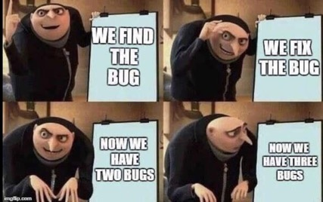
Test Continuously
Integration tests all the time, not at 8pm on due date!
  Write dummy stubs with simple functionality
  Schedule periodic integration tests
    Get everyone code, build, and test … don’t wait until it is too late!
Testing types
  Unit tests: white-/black-box check each module in isolation
  Daemons: subject code to exceptional cases
  Random testing: subject code to random timing changes
Test early, test later, test again
  What if something changes in some other part of code?

Slide 25
Late Submissions
3 grace days (including weekends) without penalty
15% per day late submission penalty afterwards
  1-hour-late submission = 15-hour-late submission
Lat submissions are not accepted after three days

Slide 26


Collaboration Policy
Explaining concepts to someone in another group
Discussing algorithms/testing strategies with other groups
Helping debug someone else’s code (in another group)
Searching online for generic algorithms (e.g., hash table)
Sharing code or test cases with another group
Open-sourcing code (e.g., on GitHub) even after this term
Copying OR reading another group’s code or test cases
Copying OR reading online code or test cases from prior years
Zero tolerance policy for plagiarism
  We use Moss and follow UW Policy 71 for any single incident

Slide 27
Seeking Help
Lab Q&A on Piazza discussion forum
  Looking for group partners
  Lab/Project administration
  Project Q&A
  Target response time: one business day
  Do not wait till the last minute to ask questions
Individual emails
  Only for questions containing confidential information
Office hours
Appointment

Slide 28
Important Near-term Task
Sign up for project groups on LEARN by
23:00 on January 11th , 2022 EST

Slide 29


Slide 30
What is an Operating System?
No universally accepted definition
“Everything vendors ship when you order OS” is
good approximation, but varies wildly
“The one program running at all times on computer” is kernel
  Everything else is either system program (ships with OS) or application program

Slide 31
What is an Operating System? (cont.)
Special layer of software that provides applications access to hardware resources
  Abstract view of complex hardware devices
  Protected access to shared resources
  Security and authentication
  Communication amongst logical entities
App1
App2
App3
OS
Hardware

Slide 32

What is an Operating System? (cont.)
Illusionist
  Provide clean, easy-to-use abstractions of physical resources
    Infinite memory, dedicated machine
    Higher level objects: files, users, messages
    Masking limitations, virtualization

Slide 33
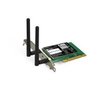



Hardware/Software Interface
Running Program
Software
Instruction Set Architecture (ISA)
Hardware
Memory
PgTbl
& TLB
ECE 222 and ECE 320: Machine structures (and C)
OS abstracts these hardware details from the application
Processor
Cache
OS Memory
Ctrlr
Networks
Storage
Inputs
Displays

Slide 34

OS Basics: Virtualizing Hardware
Compiled
Program
System Libs
Process
Execution environment with restricted rights provided by OS
Threads
Address Spaces
Files
Sockets
Operating System
ISA
Hardware
Processor
PgTbl
& TLB
Memory
Storage
Networks
OS Mem
I/O Ctrlr

Slide 35

What is an Operating System? (cont.)
Illusionist
  Provide clean, easy-to-use abstractions of physical resources
    Infinite memory, dedicated machine
    Higher level objects: files, users, messages
    Masking limitations, virtualization
Referee
  Provide protection, isolation, and sharing of resources
    Resource allocation and communication

Slide 36

OS Basics: Switching Processes
Compiled
Program 1
Compiled
Program 2
System Libs
System Libs
Process 1
Process 2
Threads
Address Spaces
Files
Sockets
Threads
Address Spaces
Files
Sockets
Operating System
ISA
Hardware
Processor
PgTbl
& TLB
Memory
Storage
Networks
OS Mem
I/O Ctrlr

Slide 37
OS Basics: Switching Processes
Compiled
Program 1
Compiled
Program 2
System Libs
System Libs
Process 1
Process 2
Threads
Address Spaces
Files
Sockets
Threads
Address Spaces
Files
Sockets
Operating System
ISA
Hardware
Processor
PgTbl
& TLB
Memory
Storage
Networks
OS Mem
I/O Ctrlr

Slide 38
OS Basics: Switching Processes (cont.)
Compiled
Program 1
Compiled
Program 2
System Libs
System Libs
Process 1
Process 2
Threads
Address Spaces
Files
Sockets
Threads
Address Spaces
Files
Sockets
Operating System
ISA
Hardware
Processor
PgTbl
& TLB
Memory
Storage
Networks
OS Mem
I/O Ctrlr

Slide 39
OS Basics: Switching Processes (cont.)
Compiled
Program 1
Compiled
Program 2
System Libs
System Libs
Process 1
Process 2
Threads
Address Spaces
Files
Sockets
Threads
Address Spaces
Files
Sockets
Operating System
ISA
Hardware
Processor
PgTbl
& TLB
Memory
Storage
Networks
OS Mem
I/O Ctrlr

Slide 40
OS Basics: Protection
Segmentation fault (core dumped)
Compiled
Program 1
Compiled
Program 2
System Libs
System Libs
Process 1
Process 2
Threads
Address Spaces
Files
Sockets
Threads
Address Spaces
Files
Sockets
Operating System
Operating System
ISA
Hardware
Processor
PgTbl
& TLB
Memory
Storage
Networks
OS Mem
I/O Ctrlr

Slide 41

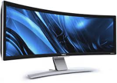
OS Basics: Protection (cont.)
Process 1
Process 2
Process 3
Software
OS Hardware Virtualization
Hardware
ISA
Memory
OS isolates processes from each other
OS isolates itself from other processes
… even though they run on the same HW!
Processor
Protection Boundary
OS Memory
Ctrlr
Displays
Storage
Networks
Inputs

Slide 42

What is an Operating System? (cont.)
Illusionist
  Provide clean, easy-to-use abstractions of physical resources
    Infinite memory, dedicated machine
    Higher level objects: files, users, messages
    Masking limitations, virtualization
Referee
  Provide protection, isolation, and sharing of resources
    Resource allocation and communication
Glue
  Provide common services
    Storage, window system, networking, sharing, authorization
    Look and feel

Slide 43
OS Basics: I/O
Process 1
Process 2
Process 3
Software
OS Hardware Virtualization
Hardware
ISA
Memory
Processor
Protection Boundary
OS Memory
OS provides common services in the form of I/O
Ctrlr
Displays
Storage
Networks
Inputs

Slide 44

OS Basics: Look and Feel
Compiled
Program
System Libs
Process
Execution environment with restricted rights provided by OS
Threads
Address Spaces
Files
Sockets
Windows
OS
ISA
HW
Processor
PgTbl
& TLB
Memory
Storage
Networks
Displays
OS Mem
I/O Ctrlr

Slide 45

OS Basics: Background Management
Compiled
Program
System Libs
Process
Execution environment with restricted rights provided by OS
Threads
Address Spaces
Files
Sockets
Windows
OS
Network Manager
Power Manager
ISA
HW
Processor
PgTbl
& TLB
Memory
Storage
Networks
Displays
Battery
OS Mem
I/O Ctrlr

Slide 46
OS Basics: Hardware Support
OS bottom line is to support applications!
  OS itself is incidental
  Ideally, OS should have very low performance overhead over raw hardware
OS relies on HW support to provide abstractions efficiently
  Dual-mode operation, interrupts, traps, precise exceptions, memory management unit, translation lookaside buffer, etc.
HW support and OS design continue to co-evolve…
  … as hardware performance improves (e.g., faster storage/network), …
  … and application requirements change
  What we study in this class is result of decades of co-evolution!

Slide 47
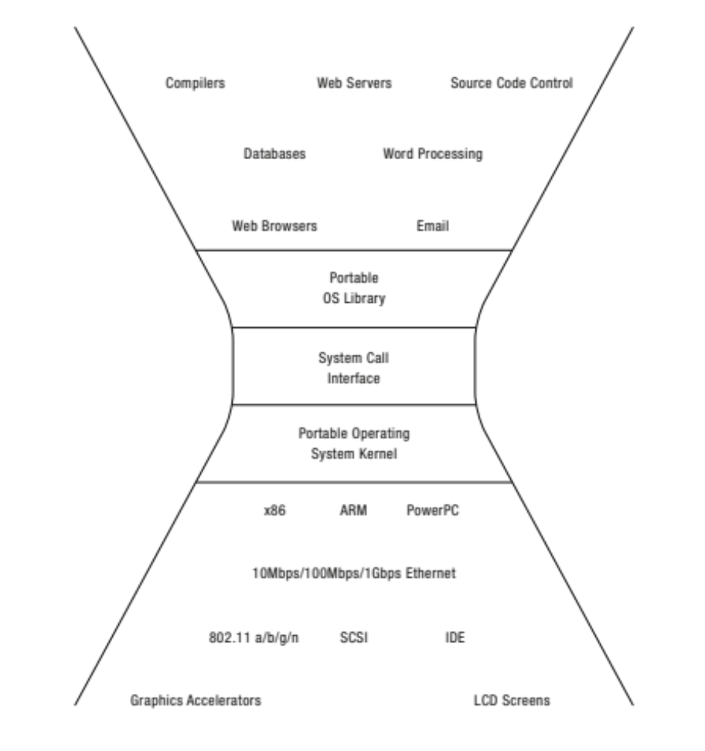


















What do Operating Systems do?
Provide abstractions to applications
  File systems
  Processes, threads
  Virtual memory
  Naming system, …
Manage diverse resources
  Memory, CPU, storage, . . .
Achieves above by implementing specific algorithms and techniques
  Scheduling
  Concurrency
  Transactions
  Security, …

Slide 48
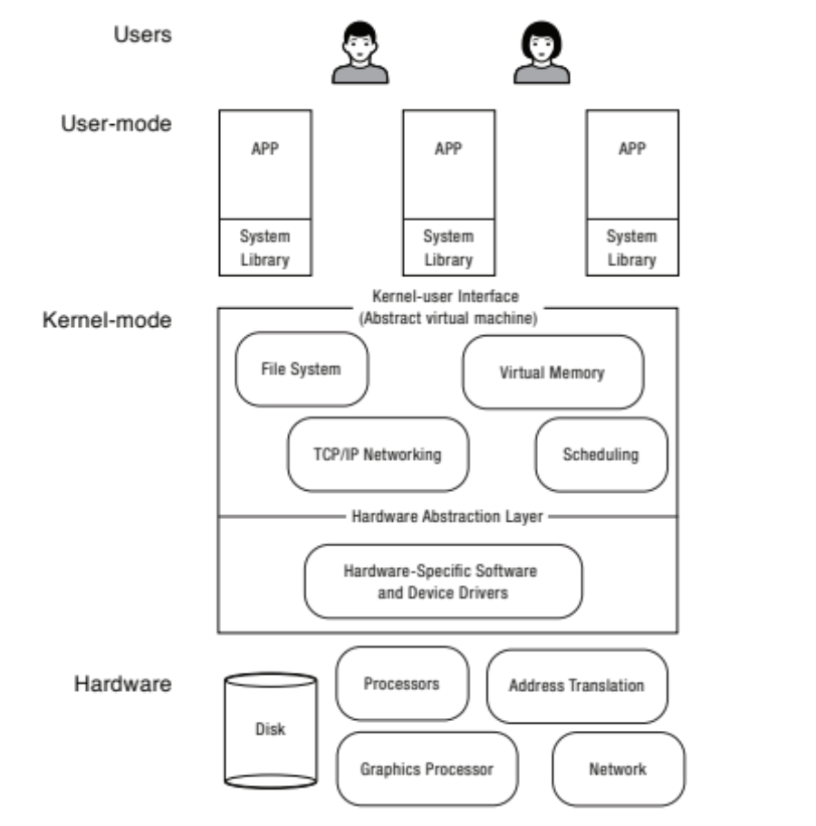
What do Operating Systems do? (cont.)
Manage hardware resources for users and applications
Convert what hardware gives into something that application programmers want
For any OS component, begin by asking two questions
  What is hardware interface? (physical reality)
  What is application interface?
  (virtual machine)
Notes:
In some sense, OS is just a software engineering problem
The first interface is an abstract virtual machine – an abstraction that allows programmers to ignore the OS.
And under all of that is another abstraction, that allows the OS to run on a variety of different hardware .
That way, you can change the underlying hardware, without changing (much of) the OS.

Slide 49
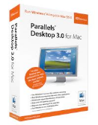



Virtual Machines (VMs)
Software that emulates physical machine
  Gives programs illusion that they run on physical machine
  Provides platform that is independent of actual underlying hardware
  Makes it look like hardware has features programs want
Two types of virtual machines
  Process VM: supports execution of single program (e.g., Java)
  System VM: supports execution of entire OS (e.g., VMWare Fusion, Virtual box, Parallels Desktop, Xen)

Slide 50
Process VMs
Runs processes
  Abstracts underlying OS and hardware
  Provides platform-independent environment
  E.g., Java virtual machine, .NET framework
Proc.
Proc.
Proc.
Proc.
Virtual ABI & ISA
Virtual Machine
Actual ABI
Host OS
Actual ISA
Hardware

Slide 51
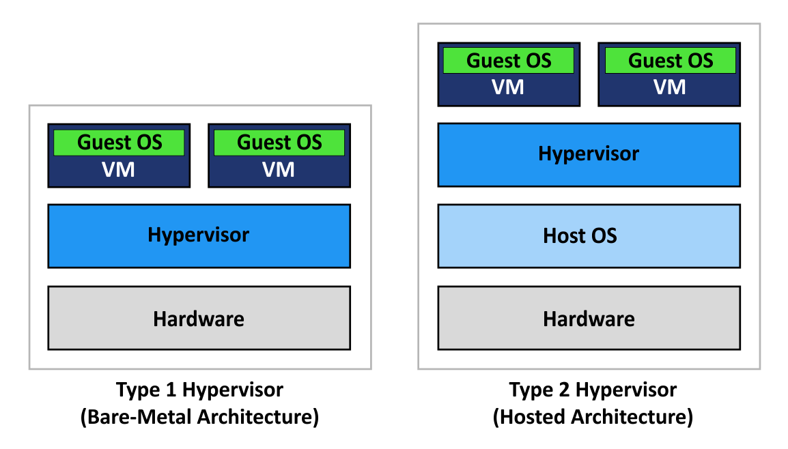
System Virtual Machines:
Layers of OSes
Runs OSes
  Useful for OS development and testing programs on other OSes
Hypervisors create and run virtual machines
Type-1 hypervisors allocate HW to VMs in addition to managing them
  E.g., Xen, VMWare ESXi
Type-II hypervisors rely on host OS for HW management
  E.g., Virtual Box, VMWare Workstation, KVM
www.nakivo.com
Notes:
Example of system vm layout!

Slide 52
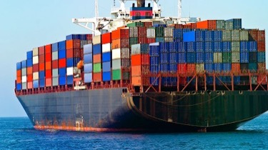
Containers: Low-weight Alternatives to Full-system Virtualization
Provide OS virtualization above single shared kernel
  Do not provide full-machine virtualization
  Each VM has illusion of running on isolated machine
  Each container has illusion of running on isolated OS
Use OS constructs to provide sand boxes for execution
  E.g., Linux cgroups, namespaces, etc.
Can run on bare metal OS, or atop of OS running in VM
OS containers: multiple applications run in same container
  E.g., LXC, OpenVZ, FreeBSD Jail
Application containers: each application has its own container
  E.g., Docker, rkt

Slide 53
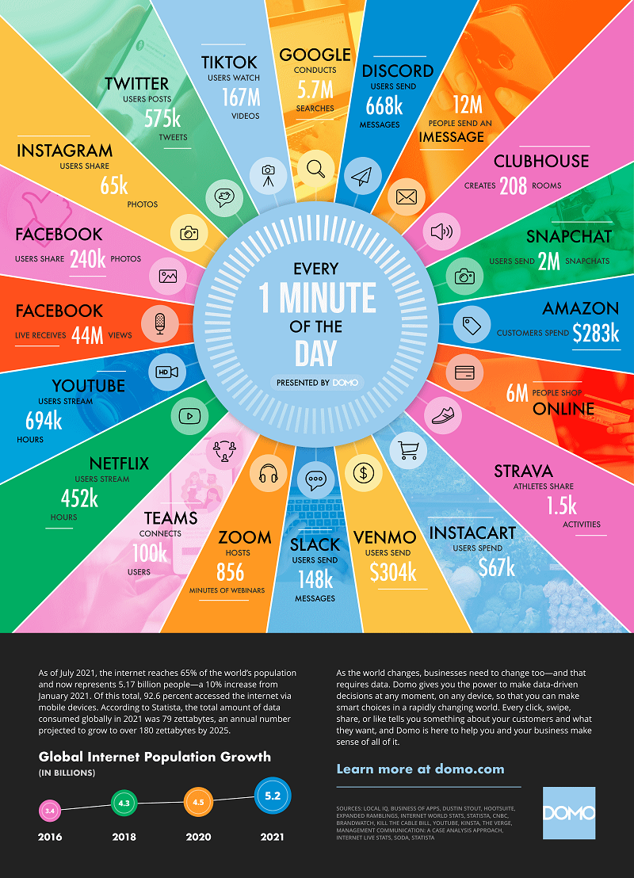
What Makes Operating Systems so Exciting and Challenging?
Operating systems are at the heart of it all …
Challenges
  Keeping up with evolving HW
  Managing ever-growing complexity of SW

Slide 54
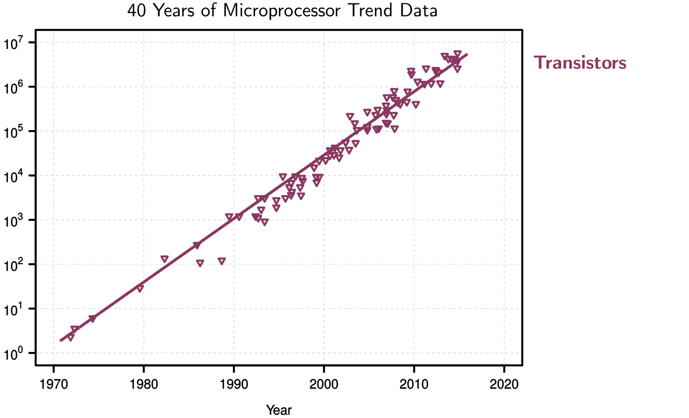
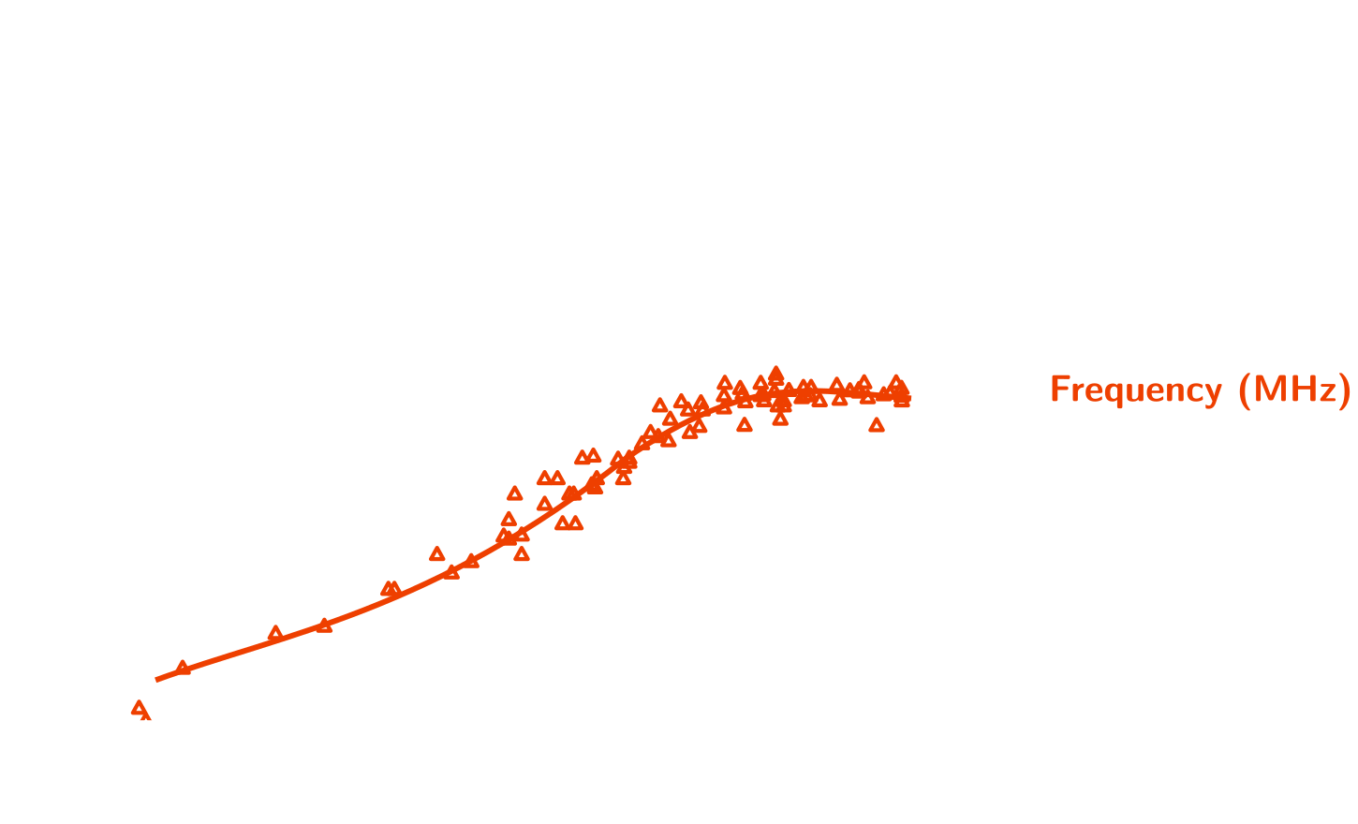
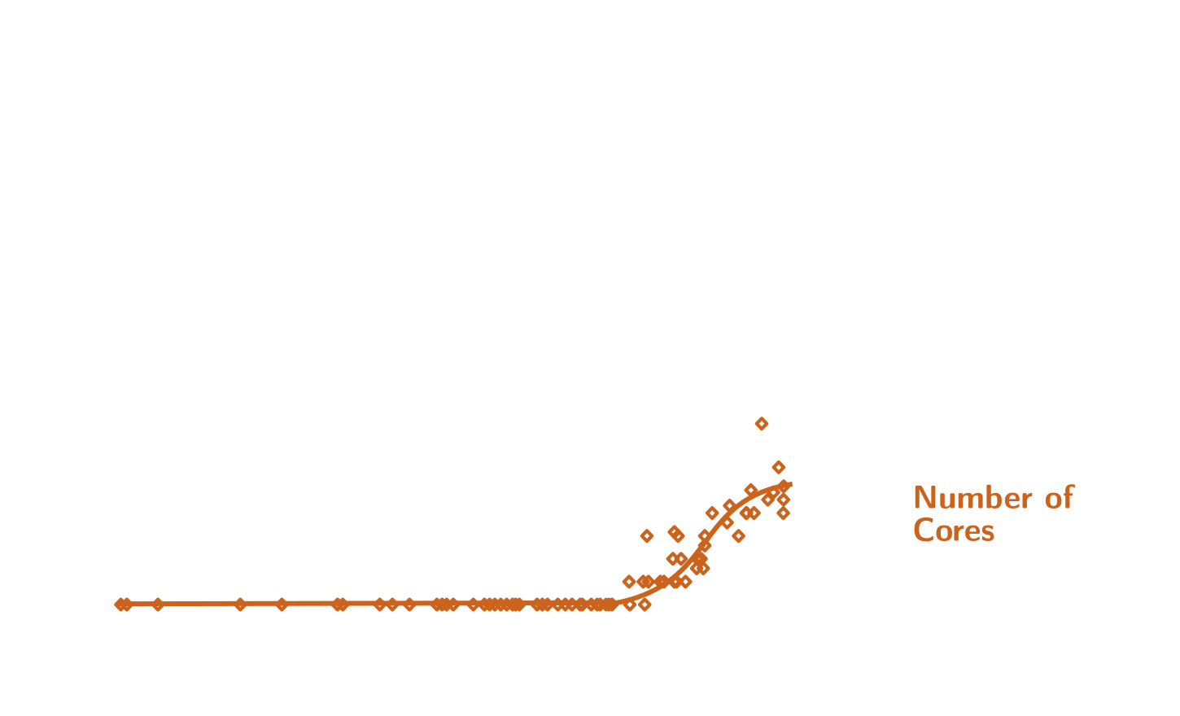
Technology Trends
How do we program these?
Parallelism must be exploited at all levels
[Moore’s Law 1965]
Dark Silicon [Esmaeilzadeh et al. 2011]
Multiprocessor melts if all cores
simultaneously run at full capacity
End of Dennard Scaling
[R. Dennard et al. 1974]
Notes:
If we want our designed system to last for a decade, we better design them knowing what’s coming. That’s why we need to study trends in computing technologies.

Slide 55
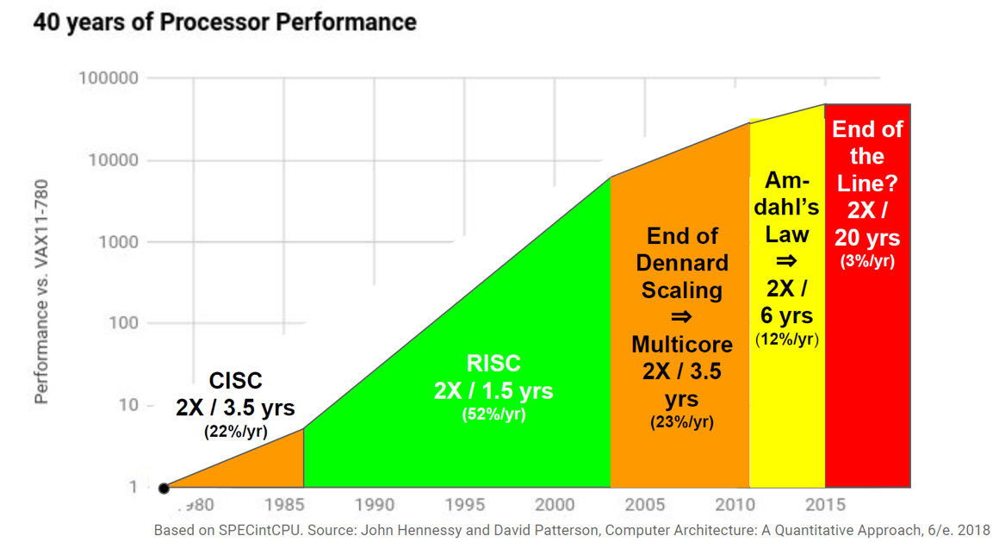
End of Growth of
Single Program Speed
From John Hennessy and David Patterson’s 2017 ACM A.M. Turing Award Lecture

Slide 56
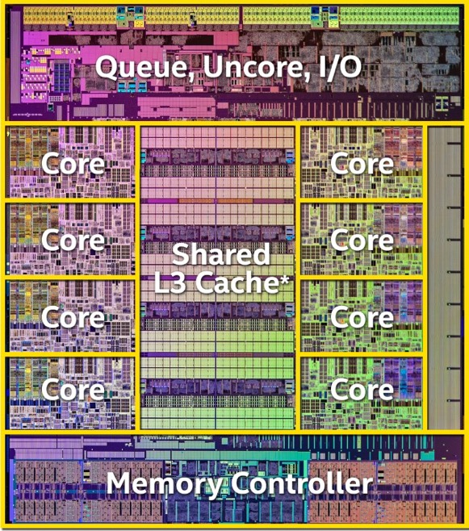
Modern Processors
Intel Haswell E
Intel Xeon Platinum 9282
  14nm processor
  56 cores, 112 threads
  1.75MB data and ins. L1 cache
  56MB L2 cache
  77MB shared L3 cache
  8B transistors
AMD EPYC 7H12
  7nm processor
  64 cores, 128 threads
  2MB data and ins. L1 cache
  32MB L2 cache
  256MB shared L3 cache
  4.8B transistors
www.extremetech.com
Notes:
How to program these?
- Use 2 CPUs for video/audio
- Use 1 for word processor, 1 for browser
- 61 for virus checking???
Parallelism must be exploited at all levels

Slide 57
Memory Hierarchy
Smaller
Faster
Costlier (per byte)
Reg.
L1 cache
SRAM
L2 cache
SRAM
L3 cache
SRAM
Main memory
DRAM
Local secondary storage
Remote secondary storage
(e.g., distributed file systems)
Larger
Slower
Cheaper (per byte)
Notes:
As a system programmer and designer, we need to know how much it costs to access data depending on where it’s stored.

Slide 58
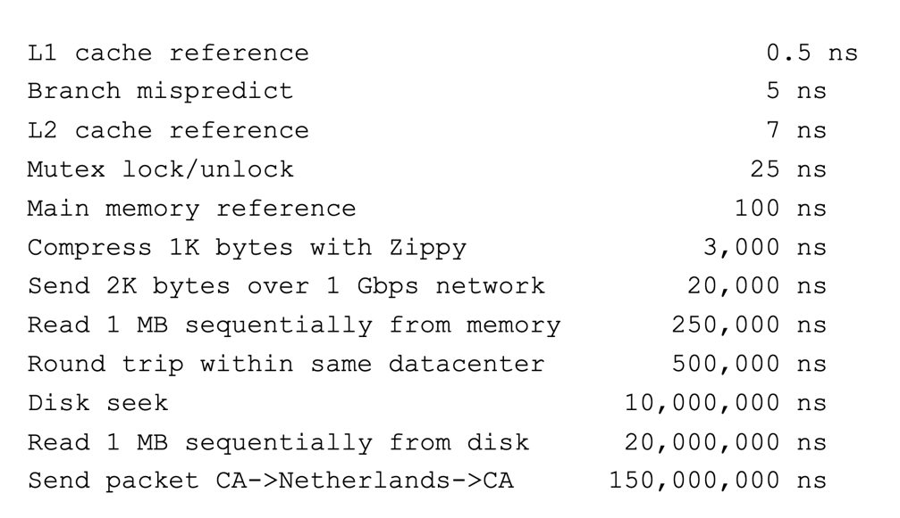
Numbers Everyone Should Know [Jeff Dean, 2009]
Key stroke ~100 ms

Slide 59
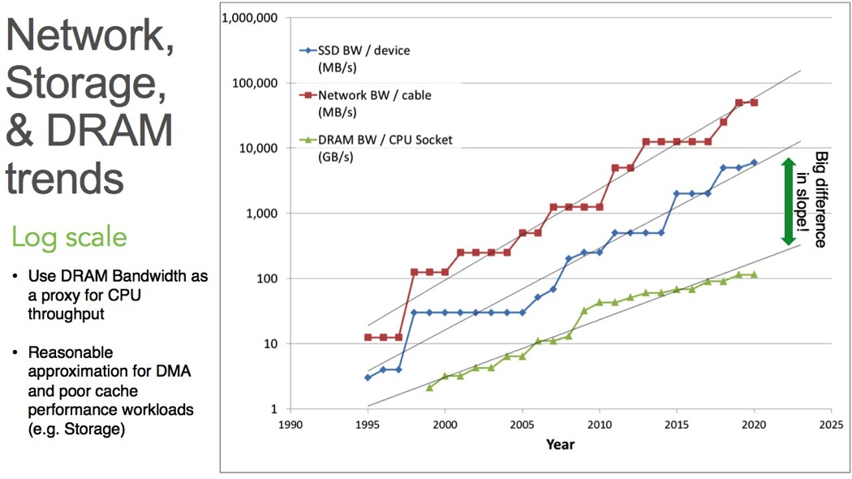
Network, IO, and Memory Bandwidth Trends
twiki.cern.ch

Slide 60
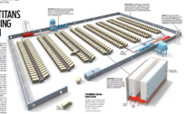
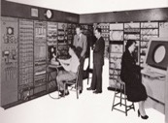
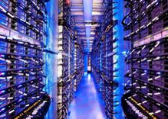
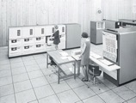
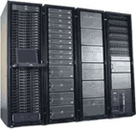










People to Computer Ratio Trend
Computers
Per Person
Number crunching, Data Storage, Massive Inet Services,
ML, …
01:10⁶
Mainframe
01:10³
Mini
Workstation
Productivity,
Interactive
PC
Laptop
01:01
PDA
Cell
Streaming from/to physical world
10³:01
years
Internet of Things!
Bell’s Law: new computer class per 10 years

Slide 61
Complexity
Applications consisting of…
  … a variety of software modules that …
  … run on a variety of devices (machines) that
    … implement different hardware architectures
    … run competing applications
    … fail in unexpected ways
    … can be under a variety of attacks
Not feasible to test software for all possible environments and combinations of components and devices
  Question is not whether there are bugs but how serious are bugs!

Slide 62
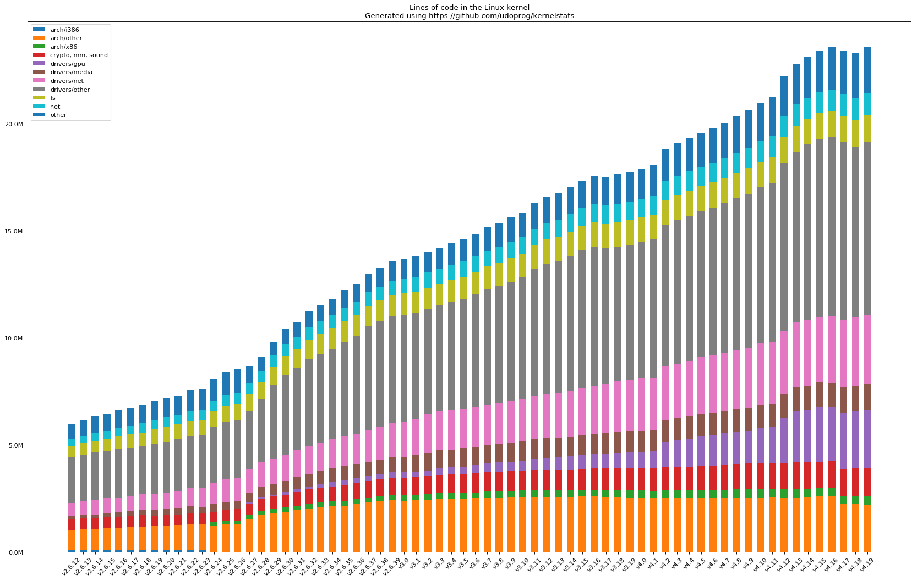
Kernel Complexity
20M
15M
Lines of Code in Linux Kernel
10M
05M
Kernel Versions
Notes:
This shows the growth in the complexity of the Linux kernel. Along this growth, the amount of patches and fixes has generally grown as well.

Slide 63
How do We Tame Complexity?
Every piece of computer hardware different
  Different CPUs
    Pentium, ARM, PowerPC, ColdFire
  Different amounts of memory, disk, …
  Different types of devices
    Mice, keyboards, sensors, cameras, fingerprint readers, touch screen
  Different networking environment
    Cable, DSL, Wireless, …
Questions
  Does programmer need to write single program that performs many independent activities?
  Does every program have to be altered for every piece of hardware?
  Does one faulty program crash everything?
  Does every program have access to all hardware?

Slide 64
Summary
OS provides VM abstraction to handle diverse HW
  OS simplifies application development by providing standard services
OS coordinates resources and protect users from each other
  OS can provide fault containment, fault tolerance, and fault recovery
SE 350 combines ideas and concepts from many other areas of computer science and engineering
  Languages, data structures, hardware, and algorithms

Slide 65

Questions?
globaldigitalcitizen.org

Slide 66
Acknowledgment
Slides by courtesy of Anderson, Culler, Stoica, Silberschatz, Joseph, Canny, and Kumar (Sam)

