Slide 1


Slide 2
Lecture 5:
Uniprocessor Scheduling
Prof. Seyed Majid Zahedi
https://ece.uwaterloo.ca/~smzahedi

Slide 3
Outline
History
Definitions
  Response time, throughput, scheduling policy, …
Uniprocessor scheduling policies
  FCFS, SJF/SRTF, RR, …

Slide 4
A Bit of History on Scheduling
By year 2000, scheduling was considered a solved problem
  “And you have to realize that there are not very many things that have aged as well as the scheduler. Which is just another proof that scheduling is easy.”
  Linus Torvalds, 2001^{[1]}
End to Dennard scaling in 2004, led to multiprocessor era
  Designing new (multiprocessor) schedulers gained traction
  Energy efficiency became top concern
In 2016, it was shown that bugs in Linux kernel scheduler could cause up to 138x slowdown in some workloads with proportional energy waist ^{[2]}
[1] L. Torvalds. The Linux Kernel Mailing List. http://tech-insider.org/linux/research/2001/1215.html, Feb. 2001.
[2] Lozi, Jean-Pierre, et al. "The Linux scheduler: a decade of wasted cores." Proceedings of the Eleventh European Conference on Computer Systems. 2016.

Slide 5
Definitions
Task, thread, process, job: unit of work
  E.g., mouse click, web request, shell command, etc.)
Workload: set of tasks
Scheduling algorithm: takes workload as input, decides which tasks to do first
Overhead: amount of extra work that is done by scheduler
Preemptive scheduler: CPU can be taken away from a running task
Work-conserving scheduler: CPUs won’t be left idle if there are ready tasks to run
  For non-preemptive schedulers, work-conserving is not always better (why?)
Only preemptive, work-conserving schedulers to be considered in this lecture!

Slide 6
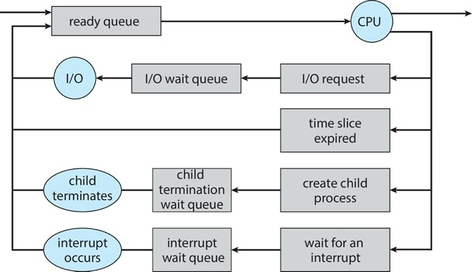
Recall: CPU Scheduling
Earlier, we talked about life-cycle of threads
  Threads work their way from ready to running to various waiting queues
Question: how does OS decide which thread to dequeue?
  Obvious queue to worry about is ready queue
  Others can be scheduled as well, however
Scheduling: deciding which thread gets resource from moment to moment

Slide 7
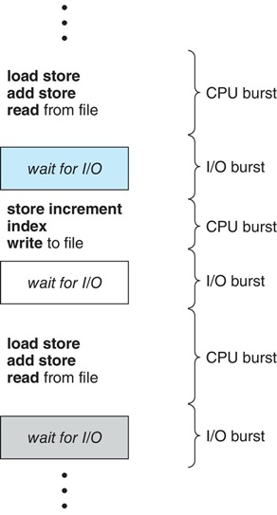
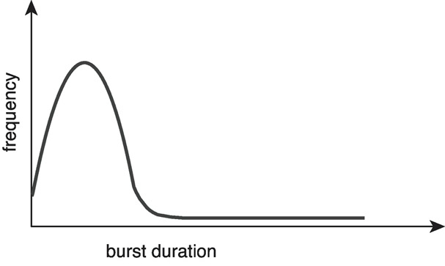
Execution Model
Weighted toward small bursts
Programs alternate between bursts of CPU and I/O
  Use CPU for some period, then do I/O, then use CPU again, etc.
CPU scheduling is about choosing thread which gets CPU for its next CPU burst
With preemption, thread may be forced to give up CPU before finishing its burst

Slide 8
CPU Scheduling Assumptions
There are many implicit assumptions for CPU scheduling
  One program per user
  One thread per program
  Programs are independent
These may not hold in all systems, but they simplify the problem
High-level goal is to divide CPU time to optimize some desired properties

Slide 9

Performance
Minimize average response time
  Minimize avg. elapsed time to finish tasks
  Response time is what users see
    E.g., time to echo a keystroke in editor
    E.g., time to compile a program
    Real-time tasks must meet deadlines
    (more on this later)
Maximize throughput
  Maximize tasks per time unit (e.g., tasks per second)
  Related to response time, but not identical
    Minimizing response time could lead to more context switching which will than
    hurt throughput (more on this later)
  Two parts to maximizing throughput
    Minimize overhead (e.g., context-switching)
    Efficient use of resources (e.g., CPU, disk, memory, etc.)

Slide 10

Fairness
Share CPU time among users in some equitable way
What does equitable mean?
  Equal share of CPU time?
    What if some tasks don’t need their full share?
  Minimize variance in worst case performance?
    What if some tasks were running when no one else was running?
Who are users? Actual users or programs?
  If A runs one thread and B runs five, B could get
  five times as much CPU time on many OS’s
Fairness is not minimizing average response time
  Improving average response time could make system less fair
  (more on this later)

Slide 11
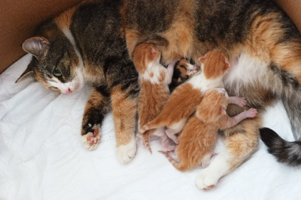
First-Come, First-Served (FCFS) Scheduling
First Come
First Served
First-come, first-served (FCFS)
  Also “first-in, first-out” (FIFO)
  In early systems, FCFS meant one program
  scheduled until done (including its I/O activities)
  Now, it means that program keeps CPU
  until the end of its CPU burst
Example Thread CPU Burst Time
T₁ 24
T₂ 3
T₃ 3
  Suppose threads arrive in order: T₁ , T₂ , T₃
T₁
T₂
T₃
0
24
27
30

Slide 12
FCFS Scheduling (cont.)
Example continued
  Wait time for T₁ is 0, for T₂ is 24, and for T₃ is 27
  Average wait time is (0 + 24 + 27)/3 = 17
  Average response time is (24 + 27 + 30)/3 = 27
T₁
T₂
T₃
0
24
27
30

Slide 13
FCFS Scheduling (cont.)
If threads arrive in order: T₂ , T₃ , T₁, then we have
  Wait time for T1 is 6, for T2 is 0, and for T3 is 3
  Average wait time is (6 + 0 + 3)/3 = 3
  Average response time is (3 + 6 + 30)/3 = 13
  Average wait time is much better (before it was 17)
  Average response time is better (before it was 27)
Pros and cons of FCFS
  + Simple
  − Short tasks get stuck behind long ones
T₂
T₃
T₁
0
3
6
30

Slide 14
Convoy Effect
With FCFS, convoys of small tasks tend to build up when a large one is running
Scheduled Task
Time
Scheduling queue
Arrivals

Slide 15

Round Robin (RR) Scheduling
FCFS is potentially bad for short tasks!
  Depends on submit order
  If you are first in line at supermarket with milk,
  you don’t care who is behind you, on the other hand…
Round robin
  Each thread gets small unit of CPU time, called time quantum
  (usually 10-100 milliseconds)
  Once quantum expires, thread is preempted and added to
  end of ready queue
  N threads in ready queue and time quantum is q ⇒
    Each thread gets 1/N of CPU time in chunks of at most q time units
    No thread waits more than (N-1)q time units
Photo: Pinterest.ca

Slide 16
Example: RR with Time Quantum of 20
Example Thread Burst Time
T₁ 53
T₂ 8
T₃ 68
T₄ 24
  Wait time for T₁ = (68 - 20) + (112 - 88) = 72
  T₂ = (20 - 0) = 20
  T₃ = (28 - 0) + (88 - 48) + (125 - 108) = 85
  T₄ = (48 - 0) + (108 - 68) = 88
  Average wait time is (72 + 20 + 85 + 88) / 4 = 66¼
  Average response time is (125 + 28 + 153 + 112) / 4 = 104½
T₁
T₂
T₃
T₄
T₁
T₃
T₄
T₁
T₃
T₃
0
20
28
48
68
88
108
112
125
145
153

Slide 17

Round Robin Discussion
Pros and cons of RR
  + Better for short tasks, fair
  − Context-switching time adds up for long tasks
How does performance change with time quantum?
  What if it’s too long?
    Response time suffers!
  What if it’s too short?
    Throughput suffers!
  What if it’s infinite (∞)?
    RR ⇒ FCFS
  Time quantum must be long compared to context switching time, otherwise overhead will be too high

Slide 18
Round Robin Time Quantum
Assume there is no context switching overhead
What happens when we decrease Q?
  Avg. response time always decreases or stays the same
  Avg. response time always increases or stays the same
  Avg. response time can increase, decrease, or stays the same

Slide 19
Decrease Response Time
T₁: burst time 10
T₂: burst time 1
Q = 10
  Average response time = (10 + 11)/2 = 10.5
Q = 5
  Average response time = (6 + 11)/2 = 8.5
T₁
T₂
0
10
11
T₁
T₂
T₁
0
5
6
11

Slide 20
Same Response Time
T₁: burst time 1
T₂: burst time 1
Q = 10
  Average response time = (1 + 2)/2 = 1.5
Q = 1
  Average response time = (1 + 2)/2 = 1.5
T₁
T₂
0
1
2
T₁
T₂
0
1
2

Slide 21
Increase Response Time
T₁: burst time 1
T₂: burst time 1
Q = 1
  Average response time = (1 + 2)/2 = 1.5
Q = 0.5
  Average response time = (1.5 + 2)/2 = 1.75
T₁
T₂
0
1
2
0
2

Slide 22
Round Robin Discussion (cont.)
Actual choices of time quantum
  Initially, UNIX time quantum was one second
    Worked ok when UNIX was used by one or two users
    What if you use text editor while there are three compilations going on?
      It takes 3 seconds to echo each keystroke!
  Need to balance short-task performance and long-task throughput
    Typical time quantum today is between 10ms – 100ms
    Typical context-switching overhead is 0.1ms – 1ms
    Roughly 1% overhead due to context-switching

Slide 23
FCFS vs. RR
Assuming zero-cost context-switching time, is RR always better than FCFS?
Suppose there are 10 tasks, each take 100s of CPU time, RR quantum is 1s
Completion times
FCFS
T₁
T₂
…
T₉
T₁₀
0
100
200
800
900
1000
RR
…
…
…
…
…
0
10
20
980
990
1000
991
999
Task # | FCFS | RR
1
2
…
9
10
100
200
…
900
1000
991
992
…
999
1000

Slide 24
FCFS vs. RR (cont.)
Completion times
Both RR and FCFS finish at the same time
Average response time is much worse under RR!
  Bad when all threads have the same length
Also, cache must be shared between all tasks with RR but can be devoted to each task with FIFO
  Total time for RR is longer even for zero-cost context switching!
Task # | FCFS | RR
1
2
…
9
10
100
200
…
900
1000
991
992
…
999
1000

Slide 25
Earlier Example: RR vs. FCFS,
Effect of Different Time Quanta
Best
FCFS
T₂ (8)
T₄ (24)
T₁ (53)
T₃ (68)
0
8
32
85
153
 | Quantum | T1 | T2 | T3 | T4 | Average
Wait Time | Best FCFS
 | 1
 | 5
 | 8
 | 10
 | 20
 | Worst FCFS
Response Time | Best FCFS
 | 1
 | 5
 | 8
 | 10
 | 20
 | Worst FCFS
32 | 0 | 85 | 8 | 31¼
85 | 8 | 153 | 32 | 69½

Slide 26
Earlier Example: RR vs. FCFS,
Effect of Different Time Quanta (cont.)
Worst
FCFS
T₃ (68)
T₁ (53)
T₄ (24)
T₂ (8)
0
68
121
145
153
 | Quantum | T1 | T2 | T3 | T5 | Average
Wait Time | Best FCFS
 | 1
 | 5
 | 8
 | 10
 | 20
 | Worst FCFS
Response Time | Best FCFS
 | 1
 | 5
 | 8
 | 10
 | 20
 | Worst FCFS
32 | 0 | 85 | 8 | 31¼
68 | 145 | 0 | 121 | 83½
85 | 8 | 153 | 32 | 69½
121 | 153 | 68 | 145 | 121¾

Slide 27
Earlier Example: RR vs. FCFS,
Effect of Different Time Quanta (cont.)
P₁
P₂
P₃
P₄
P₁
P₃
P₄
P₁
P₃
P₄
P₁
P₃
P₁
P₃
P₁
P₃
P₁
P₃
P₃
P₃
0
8
16
24
32
40
48
56
64
72
80
88
96
104
112
120
128
133
141
149
153
 | Quantum | T1 | T2 | T3 | T5 | Average
Wait Time | Best FCFS
 | 1
 | 5
 | 8
 | 10
 | 20
 | Worst FCFS
Response Time | Best FCFS
 | 1
 | 5
 | 8
 | 10
 | 20
 | Worst FCFS
32 | 0 | 85 | 8 | 31¼
84 | 22 | 85 | 57 | 62
82 | 20 | 85 | 58 | 61¼
80 | 8 | 85 | 56 | 57¼
82 | 10 | 85 | 68 | 61¼
72 | 20 | 85 | 88 | 66¼
68 | 145 | 0 | 121 | 83½
85 | 8 | 153 | 32 | 69½
137 | 30 | 153 | 81 | 100½
135 | 28 | 153 | 82 | 99½
133 | 16 | 153 | 80 | 95½
135 | 18 | 153 | 92 | 99½
125 | 28 | 153 | 112 | 104½
121 | 153 | 68 | 145 | 121¾

Slide 28
Shortest Task First (SJF) Scheduling
Could we always mirror best FCFS?
Shortest task first (SJF)
  Run task that has least amount of computation to do
  Sometimes called “Shortest Time to Completion First” (STCF)
Shortest remaining time first (SRTF)
  Preemptive version of SJF: if task arrives and has shorter time to completion than remaining time on current task, immediately preempt current task
  Sometimes called “shortest remaining time to completion first” (SRTCF)
These can be applied to whole program or current CPU burst
  Key idea: get short tasks out of system
  Big effect on short tasks, only small effect on long ones
  Better average response time
Notes:
Rich gets richer, and poor gets poorer = short tasks get through the system faster, long tasks take even longer

Slide 29
SJF/SRTF Optimality
SJF/SRTF minimize average response time! Why?
  Consider alternative policy P (not SJF/SRTF) that is optimal
  At some point, P chooses to run task that is not the shortest
  Keep order of tasks the same, but run the shorter task first
  This reduces average response time ⇒ contradiction!

Slide 30
SJF/SRTF Discussion
SJF/SRTF are best you can do to minimize average response time
  Provably optimal (SJF among non-preemptive, SRTF among preemptive)
  Since SRTF is always at least as good as SJF, we can just focus on SRTF
Comparison of SRTF with FCFS
  What if all tasks are the same length?
    SRTF ⇒ FCFS (i.e., FCFS is best we can do if all tasks have the same length)
  What if tasks have varying length?
    Unlike FCFS, with SRTF, short tasks do not get stuck behind long ones

Slide 31
Mix of CPU and I/O Bound Tasks:
FCFS vs. RR vs. SRTF
Computation
Computation
A and B :
C :
I/O
Example: suppose there are three tasks
  A and B are both CPU bound with CPU bursts that last for a week
  C is I/O bound with iterations of 1ms CPU burst followed by 9ms I/O burst
  If A or B run by themselves, CPU utilization is 100% and I/O utilization is 0%
  If C runs by itself, CPU utilization is 10% and I/O utilization is 90%
With happens under FCFS scheduling policy?
  Once A or B get in, keep CPU for two weeks ⇒ poor avg. response time
What about RR or SRTF?
  Easier to see with a timeline

Slide 32
Mix of CPU and I/O Bound Tasks:
FCFS vs. RR vs. SRTF (cont.)
RR with 40ms time quantum
I/O Utilization: ~11%
CPU
A
B
A
B
I/O
RR with 1ms time quantum
C,A,B,A,B,A,B,A,B,A, B
,C,A,B,A,…
I/O Utilization: ~82%
CPU
I/O
SRTF
I/O Utilization: ~90%
CPU
A
A
A
A
A
A
A
A
A
A
A
A
A
A
A
A
I/O

Slide 33

Problems with SRTF
Starvation: large tasks may never run if short ones keep coming
Overhead: short tasks preempt long ones ⇒ too many context switches
Unfair: large tasks are penalized, there is high variance in response time
Impractical: we need to somehow predict future
  Some systems ask users
    When you submit your task, you have to say how long it will take
    Users could maliciously misreport length of their task
    E.g., would it work if a supermarket uses SJF?
      Customers could game the system: come with one item at a time
    To prevent cheating, systems may kill tasks if they take too long
  It’s hard to predict task’s runtime even for non-malicious users

Slide 34
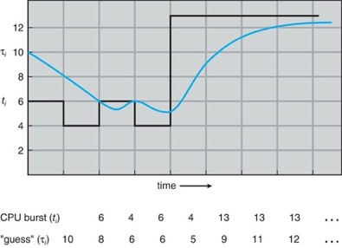
Predicting Length of Next CPU Burst
Adaptive: dynamically make predictions based on past behavior
  Works because programs have predictable behavior
    If program was I/O bound in past, it’ll likely be I/O bound in future
    If behavior were random, this approach wouldn’t help
Example: use estimator function on previous bursts
  Let t_{n-1}, t_{n-2}, t_{n-3}, …, t₁ be previous CPU burst lengths
  Estimate next burst τ_{n} = f(t_{n-1}, t_{n-2}, t_{n-3}, …)
  Function f could be any time series estimator (e.g., Kalman filters, etc.)
  For instance, exponential averaging τ_{n} = αt_{n-1}+(1-α)τ_{n-1} with (0 < α ≤ 1)

Slide 35
Aside: Application Types
Can we use past burst times to identify application types?
Consider mix of interactive and high-throughput programs
  How to best schedule them?
  How to recognize one from the other?
    Do you trust applications to say that they are “interactive”?
  Should you schedule the set of applications identically on servers, workstations, pads, and cellphones?

Slide 36
Aside: Application Types (cont.)
Assumptions encoded into many schedulers (e.g., O(1) Scheduler)
  Applications that sleep a lot and have short bursts must be interactive
    Give them high priority
  Applications that compute a lot must be high-throughput apps
    Give them lower priority, since they won’t notice intermittent bursts from interactive apps
In general, it is hard to characterize applications
  What about apps that sleep for a long time, and compute for a long time?
  What about applications that must run under all circumstances

Slide 37
SRTF Final Notes
Bottom line, we can’t really know how long tasks will take
  However, we can use SRTF as yardstick for measuring other policies
  Optimal, so we can’t do any better
Pros & cons of SRTF
  + Optimal (average response time)
  − Hard to predict future
  − Too many context switches
  − Unfair

Slide 38
Strict-priority Scheduling
Priority 3
Task 1
Task 2
Task 3
Priority 2
Task 4
Priority 1
Priority 0
Task 5
Task 6
Task 7
Execution plan
  Always execute highest-priority runnable tasks to completion
  Each queue can be threaded in RR with some time-quantum
Notice any problems?
  Starvation
    Lower-priority tasks may never run because of higher-priority tasks
  Priority inversion
    Low-priority task delays high-priority task by holding resources needed by high-priority task (more on this later)

Slide 39
Fairness
Strict fixed-priority scheduling between queues is unfair
(run highest, then next, etc.)
  long running tasks may never get any CPU time
  In Multics, shut down machine, found 10-year-old task
One approach: give each queue some fraction of CPU
  What if there are 100 short tasks and only one long task?
    Like express lanes in a supermarket, sometimes express lanes get so long, get better service by going into one of other lines
Another approach: increase priority of tasks that don’t get service
  What is done in some variants of UNIX
  This is ad hoc; what rate should you increase priorities?
  And, as system gets overloaded, no task gets CPU time, so everyone increases in priority ⇒ Interactive tasks suffer
Tradeoff: fairness is usually gained by hurting average response time!

Slide 40
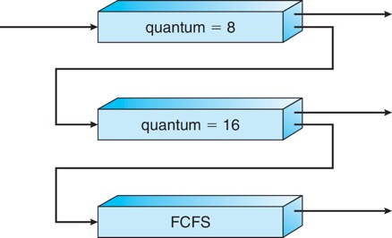
Multi-level Feedback Queue
Long-Running compute
tasks are demoted to
lower priority queues
Another method for exploiting past behavior (first use in CTSS)
  Multiple queues, each with different priority
    Higher priority queues often considered “foreground” tasks
  Each queue has its own scheduling algorithm
    E.g. foreground – RR, background – FCFS
    Sometimes multiple RR priorities with quantum increasing exponentially
    (highest:1ms, next: 2ms, next: 4ms, etc.)
Adjust each task’s priority as follows (details vary)
  Task starts in highest priority queue
  If timeout expires, drop one level
  If timeout doesn’t expire, push up one level (or to top)

Slide 41
Multi-level Feedback Queue (cont.)
Result approximates SRTF
  CPU bound tasks drop like a rock
  Short-running I/O bound tasks stay near top
Scheduling must be done between queues
  Fixed priority scheduling
    Serve all from highest priority, then next priority, etc.
  Time slicing
    Each queue gets fraction of CPU time
    E.g., 70% to highest, 20% next, 10% lowest

Slide 42
Multi-level Feedback Queue (cont.)
Countermeasure: user action that foil intent of OS designers
  For multilevel feedback, put simple I/O’s to keep task’s priority high
  Example of MIT Othello Contest
    Cheater put printf’s, ran much faster than competitors!
    Of course, if everyone did this, wouldn’t work!

Slide 43

Lottery Scheduling
Give each task i some number of lottery tickets N_{i}
On each time slice, randomly pick a winning ticket
Lottery scheduling achieves proportional-share allocations
  On average, CPU time is proportional to # of tickets given to task
How to assign tickets?
  Give tasks tickets proportional to their priorities
  To approximate SRTF, give short tasks more and long tasks fewer
  To avoid starvation, give every task at least one ticket (everyone makes progress)
Compared to strict priority, lottery scheduling behaves gracefully as load changes
  Adding or deleting one task affects all tasks proportionally, independent of how many tickets each task possesses

Slide 44
Lottery Scheduling Example
Assume short tasks get 10 tickets, long tasks get 1 ticket
What if too many short tasks to give reasonable response time?
  If load average is 100, hard to make progress
  One approach is to log some users out
# short tasks/ # long tasks | % of CPU each short tasks gets | % of CPU each long tasks gets
1/1 | 91% | 9%
0/2 | N/A | 50%
2/0 | 50% | N/A
10/1 | 9.9% | 0.99%
1/10 | 50% | 5%

Slide 45
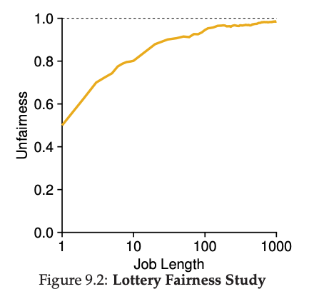
Unfairness of Lottery Scheduling
Define unfairness for two tasks with the same burst time as
  Unfairness = finish time of first one / finish time of last one
As function of burst time

Slide 46
Stride Scheduling
Achieves proportional-share scheduling without resorting to randomness
Defines stride for each thread to be Big#W/N_{i}
  The larger your share of tickets, the smaller your stride
  E.g., with W = 10,000, and A, B, and C each having 100, 50, and 250 tickets, strides for A, B, and C are 100, 200, and 40, respectively
Maintains pass counter for each thread
Runs thread with lowest pass and adds its stride to its pass
  Low-stride threads (lots of tickets) run more often
  Thread with twice the tickets gets to run twice as often
  Some messiness of counter wrap-around, new threads, …

Slide 47
Max-min Fair (MMF) Scheduling
Always choose thread with lowest accumulated CPU time
  If chosen thread doesn’t have CPU burst, schedule second lowest …
  Break ties randomly if multiple threads equally have lowest CPU time
Goal is to give each thread equal share of CPU time
  With N runnable threads, each thread should get 1/N^{th} of CPU time
At any time t we want to have
t/N
T₁
T₂
T₃
Accumulated CPU Time

Slide 48
MMF Scheduling (cont.)
Strict MMF causes too many context switches
  It effectively turns to running one instruction of each thread
Relaxed MMF runs thread with lowest accumulated CPU time for fixed time quantum before choosing next thread
Notice any problem?
  Fixed quantum leads to poor response time as # of threads increases
T₁
Accumulated CPU Time
T₃
T₂

Slide 49
MMF Scheduling (cont.)
Solution: dynamically change time quantum
Target latency: interval during which all threads should run at least once
Time quantum = Target latency / N
  E.g., with 20ms target latency and 4 threads, time quantum is 5ms
Notice any problem?
  With 20ms target latency and 200 threads, time quantum becomes 0.1ms
  Recall RR: large context switching overhead if time quantum gets to small
Minimum granularity: minimum length of any time quantum
  E.g., with target latency 20ms, 1ms minimum granularity, and 200 processes, time quantum is1ms

Slide 50
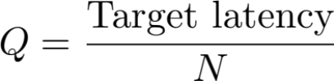
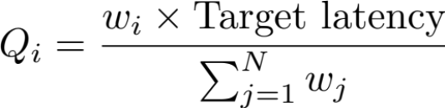
Weighted Max-min Fair Scheduling
What if we want to give more to some and less to others (proportional share)?
Key Idea: assign weight w_{i} to each thread i
MMF uses single time quantum for all threads
Weighted MMF uses different time quanta for different threads
E.g., with 20ms target latency, 1ms minimum granularity, and 2 threads: A with weight 1 and B with weight 4
  Time quantum for A is 4 ms
  Time quantum for B is 16 ms

Slide 51
Weighted MMF Scheduling (cont.)
Also track threads’ virtual runtime rather than their true wall-clock runtime
Higher weight: virtual runtime increases more slowly
Lower weight: virtual runtime increases more quickly
Linux completely fair scheduler deploys very similar ideas
  Ready queue is implemented as red-black tree, in which threads are sorted in increasing order of their virtual runtime
16
1
1
B
B
A
Actual CPU Time
Virtual CPU Time
4
A

Slide 52
How to Evaluate Scheduling Algorithms?
Deterministic modeling
  Pick workload and compute performance of each algorithm
Queueing models
  Mathematical approach for handling stochastic workloads
  (more on this later)
Simulations/Implementations
  Build system which allows actual algorithms to be run against actual data – most flexible/general

Slide 53
Starvation and Sample Bias
Suppose you want to compare scheduling policies
  Create some infinite sequence of arriving tasks
  Start measuring
  Stop at some point
  Compute ART for finished tasks between start and stop
Is this valid or invalid?
  SJF and FCFS would complete different sets of tasks
    Their ARTs are not directly comparable
    E.g., suppose you stopped at any point in FCFS vs. SJF slide
Notes:
Solution?

Slide 54
Solutions for Sample Bias
For both systems, measure for long enough that
# of completed tasks >> # of uncompleted tasks
Start and stop system in idle periods
  Idle period: no work to do
  If algorithms are work-conserving, both will complete the same set of tasks

Slide 55
Choosing Right Scheduling Algorithm
If you care about | Then choose
CPU throughput | FCFS
Avg. response time | SRTF approximation
I/O throughput | SRTF approximation
Fairness (CPU time) | Linux CFS
Fairness – wait time to get CPU | RR
Favoring important threads | Priority
Proportional sharing | Lottery and stride scheduling

Slide 56
Summary
First-come, first-served (FCFS)
  Threads are served in the order of their arrival
Round robin (RR)
  Give each thread a small amount of CPU time when it executes; cycle between all ready threads
Shortest task first (SJF) / shortest remaining time first (SRTF)
  Run whatever thread that has the least amount of computation to do/least remaining amount of computation to do
Multi-level feedback queue (MFQ)
  Multiple queues of different priorities and scheduling algorithms
Lottery and stride scheduling
  Give each thread a priority-dependent number of tickets
Max-min fair (MMF)
  Give each thread equal share of CPU time

Slide 57

Questions?
globaldigitalcitizen.org

Slide 58
Acknowledgment
Slides by courtesy of Anderson, Culler, Stoica, Silberschatz, Joseph, Canny

