Slide 1


Slide 2
Lecture 9: I/O Subsystem and Storage Devices
Prof. Seyed Majid Zahedi
https://ece.uwaterloo.ca/~smzahedi

Slide 3
Outline
I/O subsystem
I/O performance
  Some queueing theory
Storage devices
  Magnetic storage
  Flash memory

Slide 4
What’s Next?
So far in this course
  We have learned how to manage CPU and memory
What about I/O?
  Without I/O, computers are useless (disembodied brains?)
  But … there is incredible variety of I/O devices
    Accelerator (e.g., GPU, TPU), storage (e.g., SSD, HDD), transmission (e.g., NIC, wireless adaptor), human-interface (e.g., keyboard, mouse)
    How can we standardize interfaces to these devices?
  Devices are unreliable: media failures and transmission errors
    How can we make them reliable?
  Devices are unpredictable and/or slow
    How can we manage them if we don’t know
    what they will do or how they will perform?

Slide 5
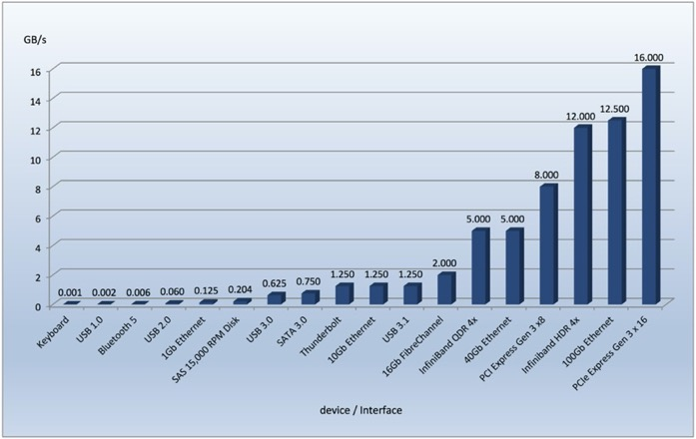
Example:
Wide Range of I/O Transfer Rates
Transfer rates vary over 7 orders of magnitude!
  System better be able to handle this wide range
  Better not have high overhead/byte for fast devices!
  Better not waste time waiting for slow devices

Slide 6
Goal of I/O Subsystem
Provide uniform interfaces, despite wide range of different devices
  This code works on many different devices:
  FILE fd = fopen("/dev/something", "rw");
  for (int i = 0; i < 10; i++) {
  fprintf(fd, "Count %d\n", i);
  }
  close(fd);
  Why? Because device drivers implement standard interface
We will get a flavor for what is involved in controlling devices in this lecture
  We can only scratch the surface!

Slide 7
I/O Devices: Operational Parameters
Data granularity: byte vs. block
  Some devices provide single byte at a time (e.g., keyboard)
  Others provide whole blocks (e.g., disks, networks, etc.)
Access pattern: sequential vs. random
  Some devices must be accessed sequentially (e.g., tape)
  Others can be accessed “randomly” (e.g., disk, cd, etc.)
    Fixed overhead to start transfers
Notification mechanisms: polling vs. interrupt
  Some devices require continual monitoring
  Others generate interrupts when they need service

Slide 8
I/O Devices: Data Access
Character/byte devices: e.g., keyboards, mice, serial ports, some USB devices
  Access single characters at a time
  Commands include get(), put()
  Libraries layered to allow line editing
Block devices: e.g., disk drives, tape drives, DVD-ROM
  Access blocks of data
  Commands include open(), read(), write(), seek()
Network devices: e.g., ethernet, wireless, Bluetooth
  Different enough from block/character to have its own interface
  Unix and Windows include socket interface

Slide 9
I/O Devices: Timing
Blocking interface: “wait”
  When request data (e.g., read() system call), put to sleep until data is ready
  When write data (e.g., write() system call), put to sleep until device is ready
Non-blocking interface: “don’t wait”
  Return quickly from read or write with count of bytes successfully transferred
  Read may return nothing, write may write nothing
Asynchronous interface: “tell me later”
  When request data, take pointer to user’s buffer, return immediately; later kernel fills buffer and notifies user
  When send data, take pointer to user’s buffer, return immediately; later kernel takes data and notifies user

Slide 10

I/O Devices: Notification Mechanisms
Polling: CPU periodically checks device-specific status register
  E.g., I/O device puts completion information in status register
  + CPU is not frequently interrupted by unpredictable events
  – CPU time is wasted if it polls for infrequent or unpredictable I/O events
Interrupt-driven: device generates interrupt whenever it needs service
  + CPU time could be spent on other things rather than polling for I/O
  – Interrupt handling could introduce unpredictability
Hybrid: combination of polling and interrupt-driven
  E.g., high-bandwidth network adapter
    Interrupt for first incoming packet
    Poll for following packets until hardware queues are empty

Slide 11
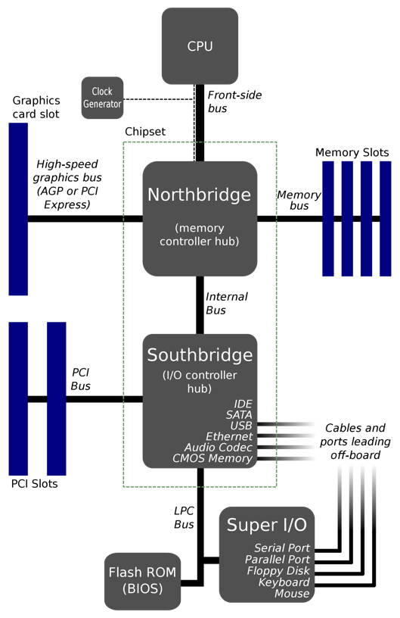


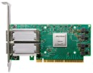



Typical North/Southbridge Layout
wikipedia.org and pngall.com and cdw.com

Slide 12
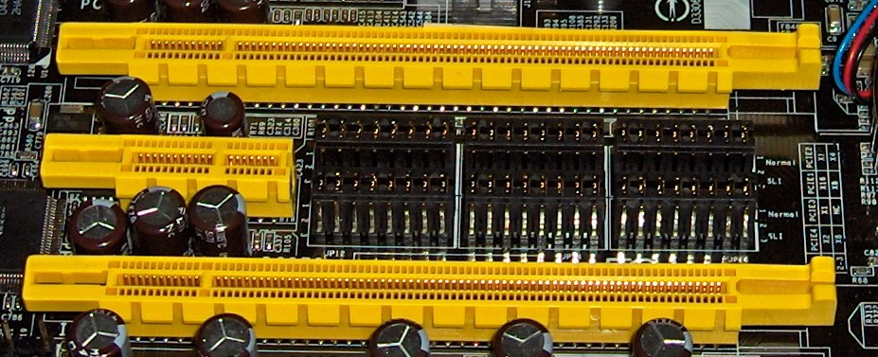
PCI Evolution
PCI started life out as parallel bus
But parallel bus has many limitations
  Multiplexing address/data for many requests
  Slowest devices must be able to tell what’s happening (e.g., for arbitration)
    Bus speed is set to that of the slowest device
wikimedia.org

Slide 13
PCI Express (PCIe)
PCIe turned conventional PCI bus from parallel bus architecture into serial, packet-switched, point-to-point architecture
  Each device is connected to PCIe switch with dedicated, bi-directional link
  PCIe bus is very similar to packet-switched networks
Devices can use as many lanes as they need to achieve desired bandwidth
  Slow devices don’t have to share with fast ones
Device abstraction in Linux seamlessly migrated from PCI to PCIe
  Physical interconnect changed completely, but old API still worked
  PCIe added new features but kept the same standardized API
  Drivers written for older PCI devices still worked on new PCIe buses
    Without being able to use new features of course

Slide 14
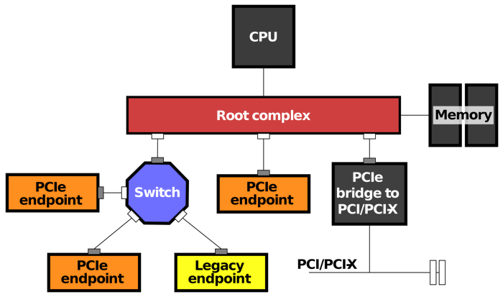
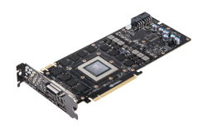
I/O Device Controller
Device Controller
Hardware
Controller
PCIe
Interface
command
Command queues
Data queues
status
base address
…
Registers
Buffers
Device controller (may) contains set of registers and memory buffers
  CPU communicate with devices by reading from and writing to registers and buffers
  PCI devices have configuration space registers used to perform auto configuration
    E.g., during device enumeration, base address register (BAR) is used by PCI device to specify how much memory it needs
wikipedia.org and pcworld.com

Slide 15
Accessing I/O Devices
Port-mapped: I/O devices have separate address space from physical memory
  Port-mapped I/O is also called isolated I/O
  Entire bus could be dedicated to I/O devices
  CPU performs I/O operations using special I/O instructions
    Example: in/out instructions used in some Intel microprocessors (e.g., out 0x21,al)
Memory-mapped: I/O devices use the same address space as physical memory
  I/O devices listen to the same address bus that is connected to memory
  Addresses reserved for I/O should not be available to physical memory
  I/O devices are accessed like they are part of memory using
    Example: load/store instructions

Slide 16

Example:
Memory-mapped Display Controller
Map registers and/or buffers into physical address space
  Addresses are set by HW jumpers, BIOS, or OS at boot time
Change image on screen by writing to display memory
  Also called the “frame buffer”
  E.g., address range of 0x8000F000-0x8000FFFF
Write graphics description to command-queue area
  E.g., write set of triangles that describe some scene
  to address range of 0x80010000-0x8001FFFF
Send command to graphics HW by writing to command register
  E.g., write to address 0x0007F004
  to render triangles in above example
Protect mapped addresses using address translation
  Set them read only or write only, and typically non-cacheable
0x80020000
Graphics
Command
Queue
0x80010000
Display
Memory
0x8000F000
0x0007F004
Command
0x0007F000
Status
Physical Address
Space

Slide 17
Recall: I/O Data Transfer
Programmed I/O
  Each byte transferred via processor in/out or load/store
  + Simple hardware, easy to program
  − Consumes processor cycles proportional to data size
Direct memory access (DMA)
  Give controller access to memory bus
  Ask it to transfer data blocks to/from memory directly

Slide 18
DMA for PCIe Devices
PCIe enables point-to-point communication between all endpoints
Each device contains its own, proprietary DMA engine
  Unlike ISA, there is no central DMA controller
Device driver programs DMA engine and signals it to begin DMA transfer
DMA engine sends packets directly to memory controller
Once transfer is over, DMA engine raises interrupts (using same PCIe bus)

Slide 19
I/O Devices: Memory Protection
Typically, I/O devices can only read/write from contiguous range of memory addresses
  E.g., after device enumeration, BAR holds base address of mapped memory block
In old computers, I/O devices could directly access physical memory
  + Fast memory access: devices can transfer data at maximum speed possible
  – Reduced flexibility: OS must reserve contiguous physical memory regions for devices
  – No memory protection: malicious devices can compromise system (e.g., DMA attack)
New architectures provide address translation for I/O devices
  I/O memory management unit (IOMMU) maps virtual addresses to physical address for I/O devices
  E.g., AMD Vi and Intel VT-d
CPU
Memory Hub
Memory
MMU
IOMMU
Device
PCIe
I/O Hub
LPC
PCIe
PCI
Device
SATA

Slide 20
Memory Translation for PCIe Devices
Problem 1: address translation services (ATS) allows PCIe devices to bypass IOMMU
  PCIe devices can implement address translation cache (ATC) similar to TLB
  Using ATS protocol, any device can claim it is using addresses that have already been translated
  For trusted devices, this is useful performance improvement
  For untrusted devices, this introduces security threat
  ATS protocol could allow malicious device to write to places it should not have access to
Problem 2: PCIe packets do not reach IOMMU when devices communicate with each other
  PCIe allows peer-to-peer communication between devices
  Malicious devices can compromise other devices by reading from or writing to their registers/buffers
Solution: access control services (ACS) disables ATS and prevents peer-to-peer transactions
  ACS acts as gate-keeper, forcing all packets to go up to root complex and pass through IOMMU
  Without ACS, PCIe endpoints can accidentally or intentionally write to invalid or illegal area on peer endpoints and physical memory

Slide 21
I/O Performance Concepts
Device
Driver
Request
I/O Controller
and Device
Data
Transfer
Queue
Latency: time to serve I/O request (response time)
  From when it is placed in queue until its data is completely transferred
Throughput: rate of serving I/O requests
  To measure highest possible throughput, device should never become idle
  (queue should not become empty)
Overhead: time to initiate data transfer for I/O request
  From when it is placed in queue until data transfer starts

Slide 22

I/O Performance Concepts (cont.)
Peak bandwidth: maximum rate of data transfer
  Depends on bus bandwidth
    E.g., PCIe v5.0: 3.93GBps (per lane)
  Also depends on device bandwidth
    E.g., rotational speed of disk
    E.g., write/read rate of NAND flash
  Whichever is the bottleneck …
Effective bandwidth: rate of data transfer for I/O request
  Latency degrades bandwidth
  For most I/O requests, latency is roughly linear in size of transferred data
  Latency(n) = overhead + n / peak bandwidth
  Effective bandwidth(n) = n / latency(n)

Slide 23
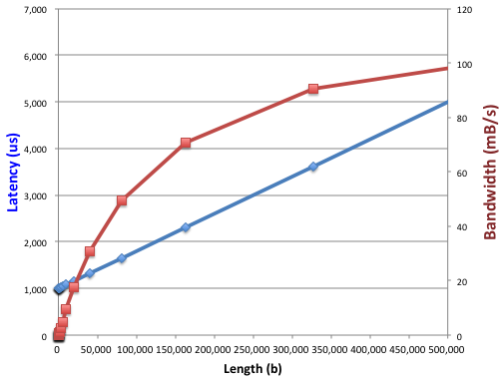
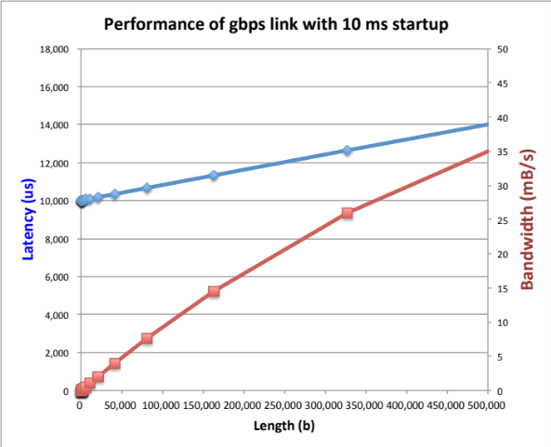
How Does Overhead Affect Effective Bandwidth?
Latency(n) = O + n/P (O for overhead and P for peak bandwidth)
Effective bandwidth = n/(O + n/P) = P/(P x O/n + 1)
  E.g., effective bandwidth is half of peak bandwidth when n = O x P
Suppose that peak bandwidth is 1Gbps
  If overhead is 1ms, then n = 125,000 bytes
  If overhead is 10ms, then n = 1,250,000 bytes

Slide 24
Contributing Factors to Overhead
Device
Driver
Request
I/O Controller
and Device
Data
Transfer
Queue
Overhead = wait time in queue + controller and device service time
Queuing behavior can lead to big increases of latency as utilization increases
Wait Time in Queue
0%
100%
Utilization (Percentage of
Maximum Possible Throughput)

Slide 25
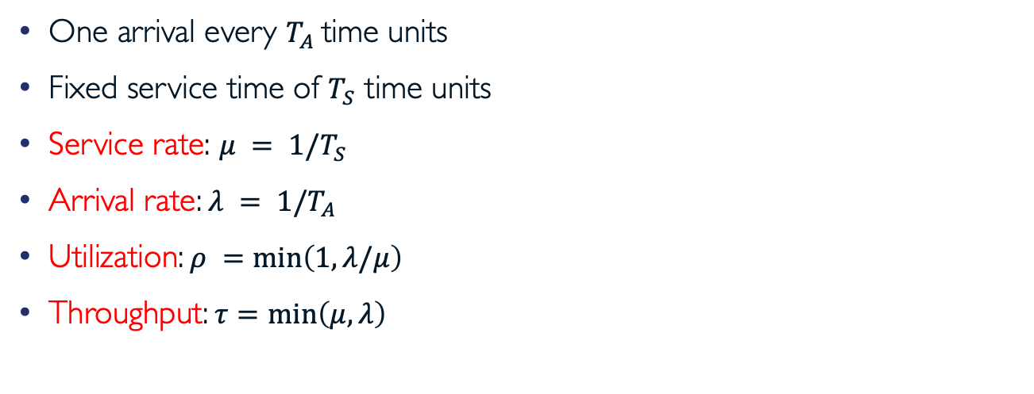
A Simple Deterministic World
Server
Arrivals
Queue
Departures
One arrival every $T_{A}$ time units
Fixed service time of $T_{S}$ time units
Service rate: $μ = 1/T_{S}$
Arrival rate: $λ = 1/T_{A}$
Utilization: $ρ =\min\left(1,λ/μ\right)$
Throughput: $τ=\min\left(μ,λ\right)$

Slide 26


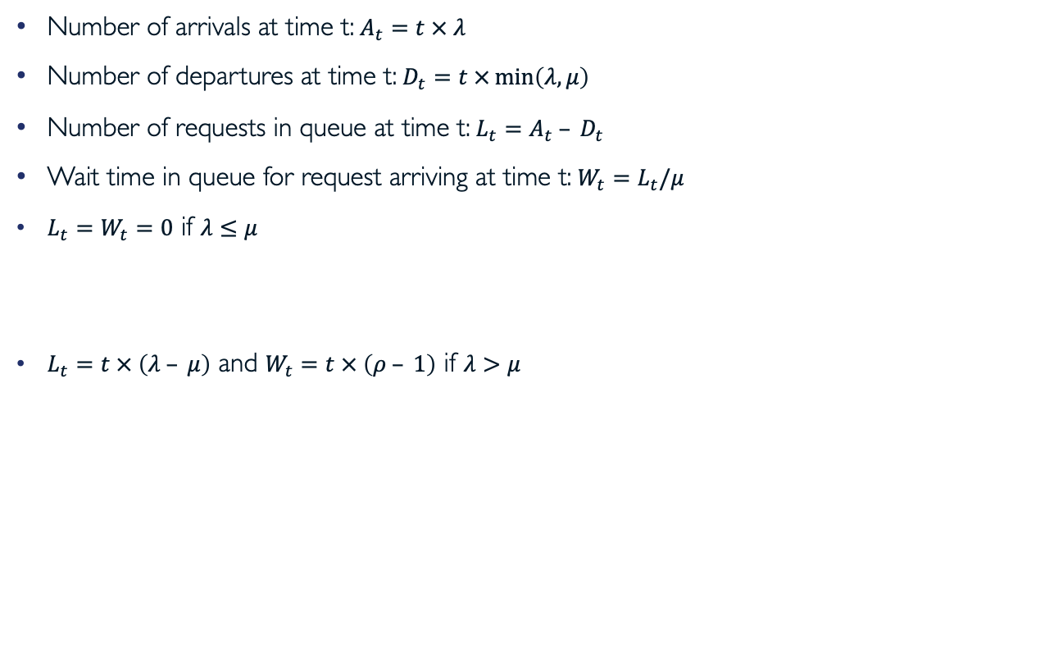



A Simple Deterministic World (cont.)
Number of arrivals at time t: $A_{t}=t × λ$
Number of departures at time t: $D_{t}=t ×\min\left(λ, μ\right)$
Number of requests in queue at time t: $L_{t}=A_{t} – D_{t}$
Wait time in queue for request arriving at time t: $W_{t}=L_{t}/μ$
$L_{t}=W_{t}=0$ if $λ≤μ$
$L_{t}=t × \left(λ – μ\right)$ and $W_{t}=t × \left(ρ – 1\right)$ if $λ>μ$
T_{A}
T_{A}
T_{A}
T_{S}
T_{S}
T_{S}
Request
Arrivals
$$W_{t}$$
Departures
$$t × λ$$
$$L_{t}$$
$$t × μ$$
$$t$$
Time

Slide 27
A Bursty World
Server
Arrivals
Queue
Departures
Requests arrive in burst, must queue up till served
Same average arrival time, but requests experience large queue delays
Even though average utilization is low
Arrivals
Length of
Queue
Server

Slide 28
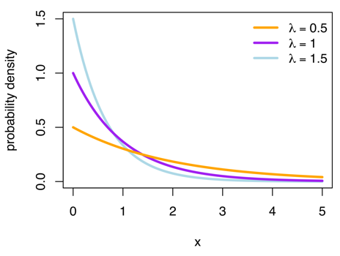
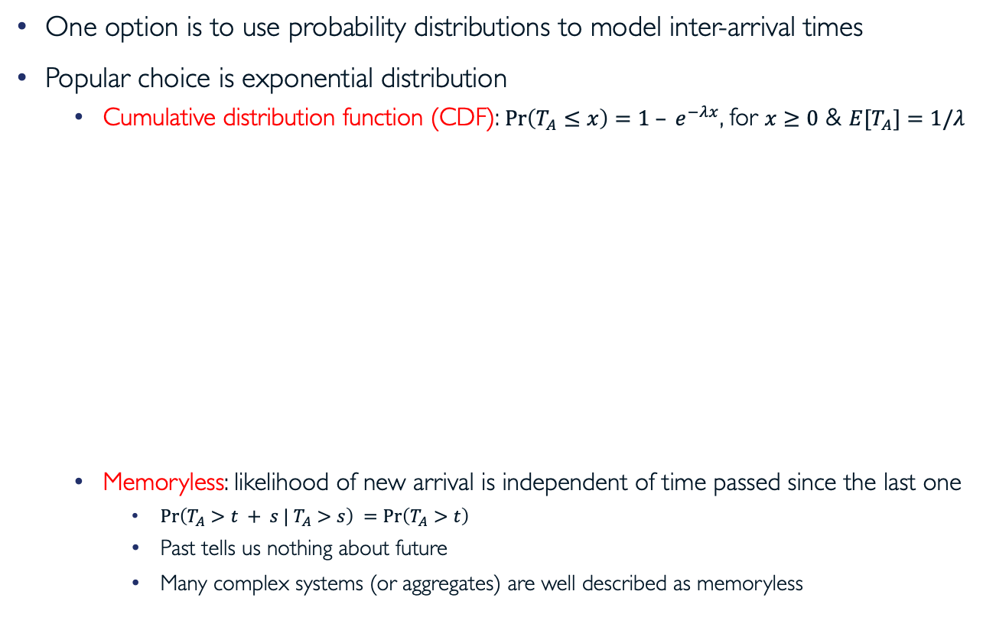
How Do We Model Burstiness?
One option is to use probability distributions to model inter-arrival times
Popular choice is exponential distribution
  Cumulative distribution function (CDF): $\operatorname{Pr}\left(T_{A}≤x\right)=1 – e^{−λx}$, for $x≥0$ & $E[T_{A}]=1/λ$
  Memoryless: likelihood of new arrival is independent of time passed since the last one
    $\operatorname{Pr}\left(T_{A}>t + s | T_{A}>s\right) =\operatorname{Pr}\left(T_{A}>t\right)$
    Past tells us nothing about future
    Many complex systems (or aggregates) are well described as memoryless
Lots of short
inter-arrival time
Few long gaps
wikipedia.org

Slide 29
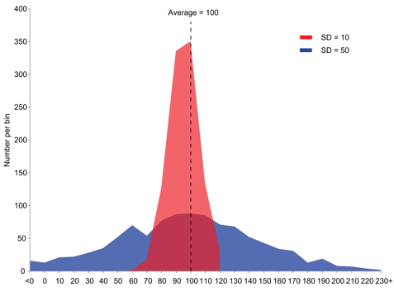
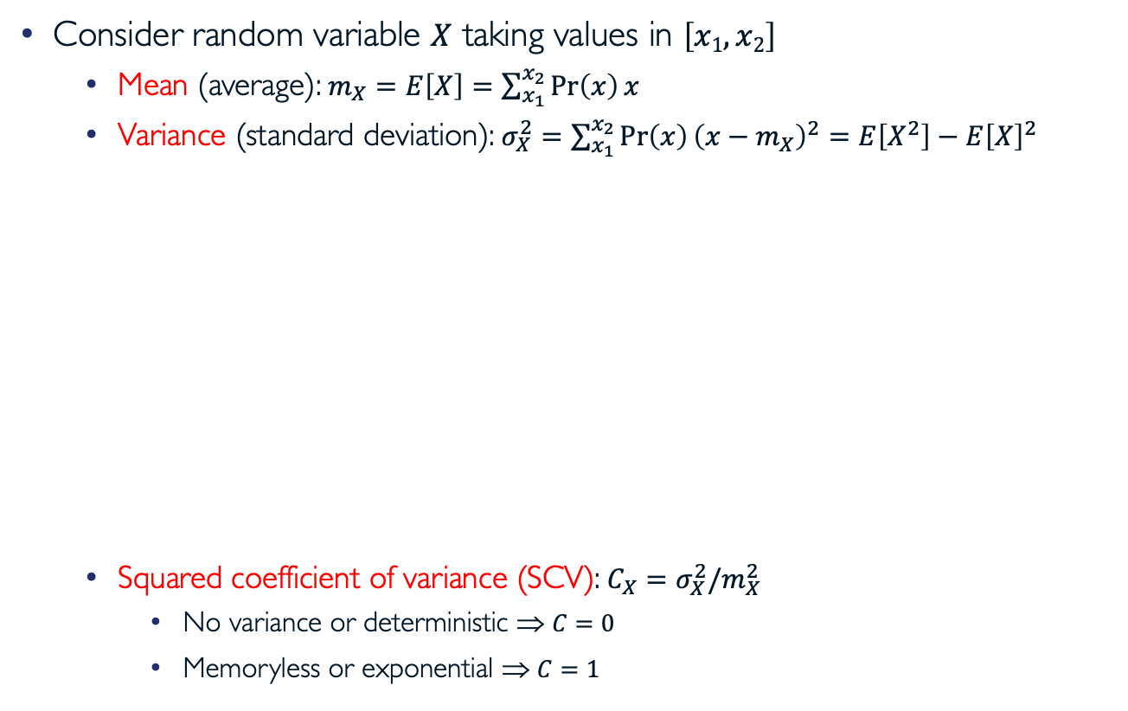
Background: Properties of Random Variables
Consider random variable $X$ taking values in $\left[x1,x2\right]$
  Mean (average): $m_{X}=E\left[X\right]=\sum_{x_{1}}^{x_{2}}{\operatorname{Pr}\left(x\right)x}$
  Variance (standard deviation): $σ_{X}^{2}=\sum_{x_{1}}^{x_{2}}{\operatorname{Pr}\left(x\right){\left(x−m_{X}\right)}^{2}}=E\left[X^{2}\right]−{E\left[X\right]}^{2}$
  Squared coefficient of variance (SCV): $C_{X}=σ_{X}^{2}/m_{X}^{2}$
    No variance or deterministic ⇒ $C=0$
    Memoryless or exponential ⇒ $C=1$

Slide 30

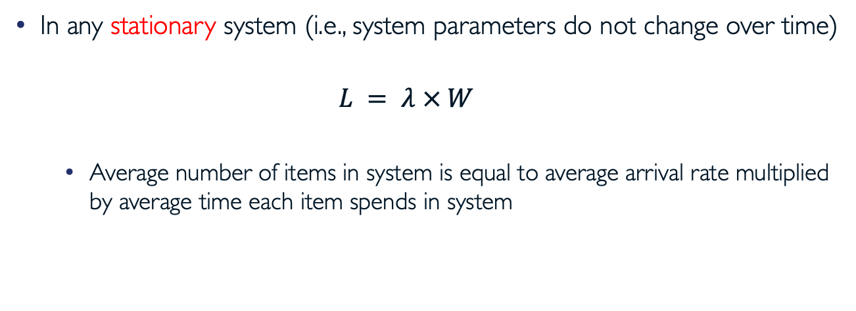
Little’s Law [John Little, 1961]
In any stationary system (i.e., system parameters do not change over time)
  $$L = λ × W$$
  Average number of items in system is equal to average arrival rate multiplied by average time each item spends in system
shutterstock.com

Slide 31
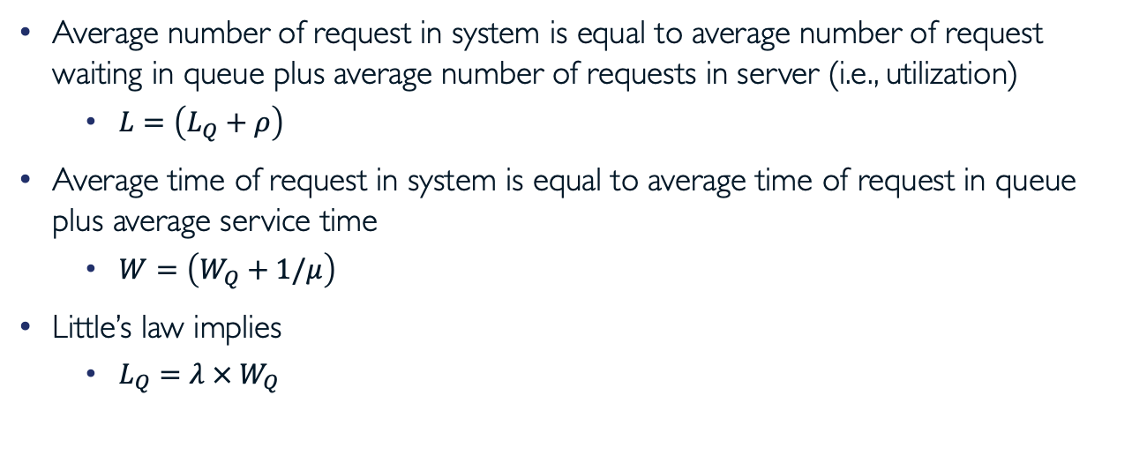
Little’s Law Applied to Queues
Server
Arrivals
Queue
Departures
Average number of request in system is equal to average number of request waiting in queue plus average number of requests in server (i.e., utilization)
  $L=\left(L_{Q}+ρ\right)$
Average time of request in system is equal to average time of request in queue plus average service time
  $W=\left(W_{Q}+1/μ\right)$
Little’s law implies
  $L_{Q}=λ{ × W}_{Q}$

Slide 32
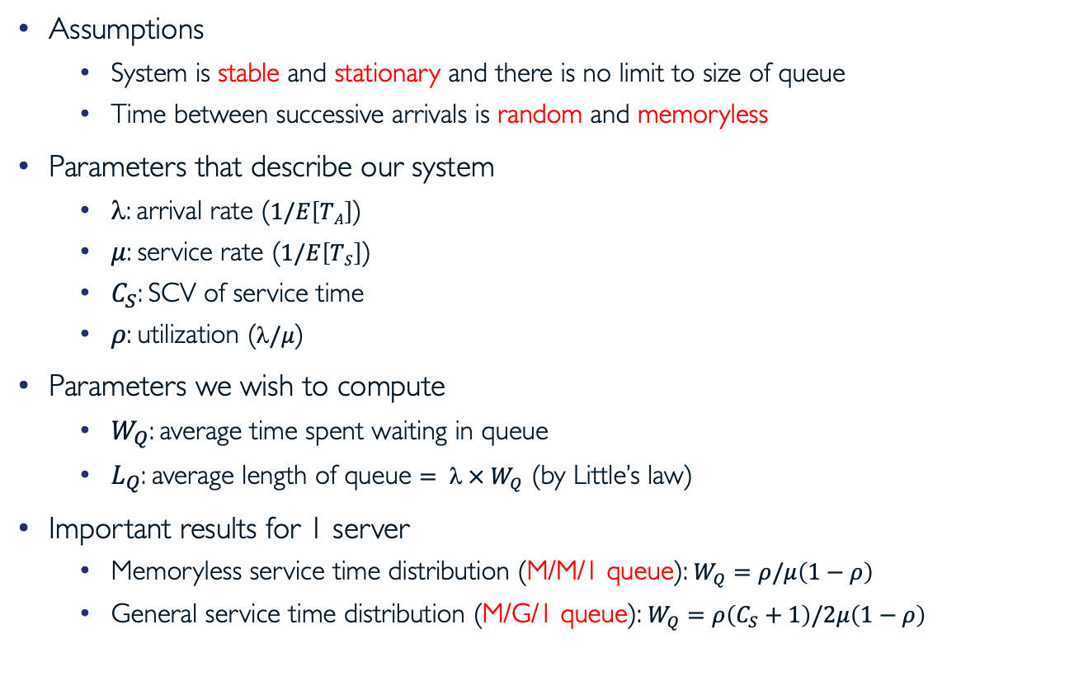
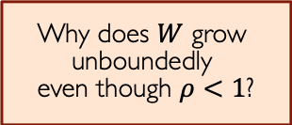
A Little Queuing Theory
Assumptions
  System is stable and stationary and there is no limit to size of queue
  Time between successive arrivals is random and memoryless
Parameters that describe our system
  $$: arrival rate ($1/E\left[TA\right]$)
  $μ$: service rate ($1/E\left[TS\right]$)
  $C_{S}$: SCV of service time
  $ρ$: utilization ($/μ$)
Parameters we wish to compute
  $W_{Q}$: average time spent waiting in queue
  $L_{Q}$: average length of queue $=  × W_{Q}$ (by Little’s law)
Important results for 1 server
  Memoryless service time distribution (M/M/1 queue): $W_{Q}=ρ/μ\left(1−ρ\right)$
  General service time distribution (M/G/1 queue): $W_{Q}=ρ\left(C_{S}+1\right)/2μ\left(1−ρ\right)$
Why does $W$ grow
unboundedly
even though $ρ<1$?
Wait Time in Queue
0%
Utilization
100%

Slide 33
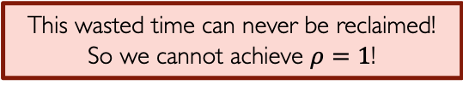
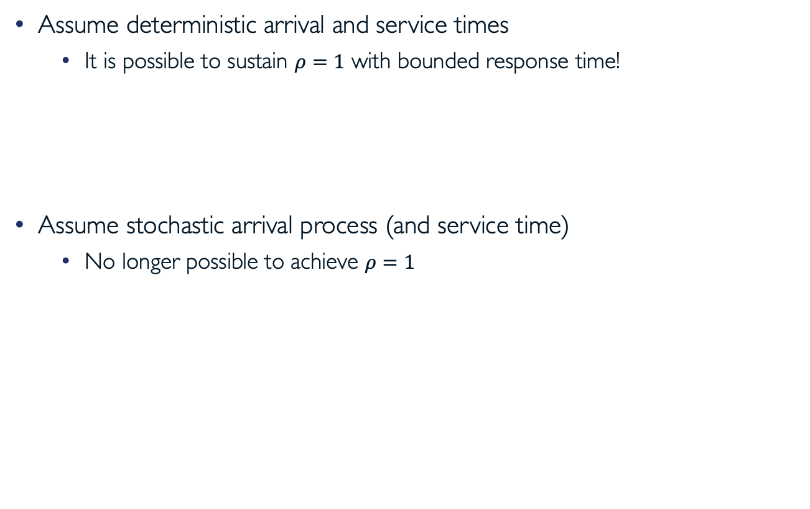
Why Unbounded Response Time?
Assume deterministic arrival and service times
  It is possible to sustain $ρ=1$ with bounded response time!
Assume stochastic arrival process (and service time)
  No longer possible to achieve $ρ=1$
Time
Service time = inter-arrival time
This wasted time can never be reclaimed!
So we cannot achieve $ρ=1$!
Time

Slide 34
How Do Real-world Systems Avoid Unbounded Queueing Delays?
Open system
Closed system
Clients adjust request rate based on response time of previous requests
As system saturates delay increases, request rate is limited by service rate
Many protocols are designed to have self-limited behavior
(e.g., TCP congestion control)
Client
Server
Client
Queue
Client
Client
Server
Client
Queue
Client

Slide 35
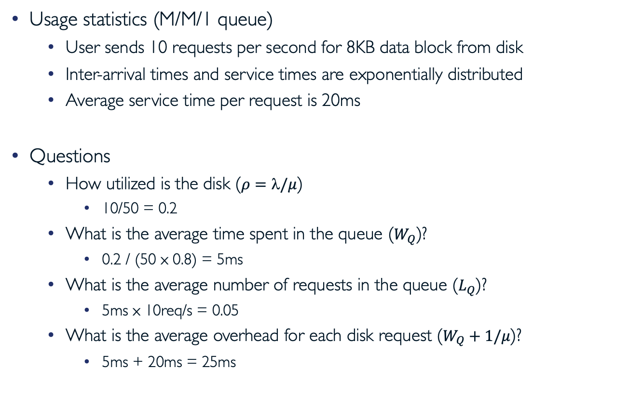
Example: M/M/1 Queue and Disk
Usage statistics (M/M/1 queue)
  User sends 10 requests per second for 8KB data block from disk
  Inter-arrival times and service times are exponentially distributed
  Average service time per request is 20ms
Questions
  How utilized is the disk ($ρ=/μ$)
    10/50 = 0.2
  What is the average time spent in the queue ($W_{Q}$)?
    0.2 / (50 x 0.8) = 5ms
  What is the average number of requests in the queue ($L_{Q}$)?
    5ms x 10req/s = 0.05
  What is the average overhead for each disk request ($W_{Q}+1/μ$)?
    5ms + 20ms = 25ms

Slide 36
Where are we?
I/O subsystem
I/O performance
  Some queueing theory
Storage devices
  Magnetic storage
  Flash memory

Slide 37
Storage Devices
Magnetic disks
  Storage that rarely becomes corrupted
  Large capacity at low cost
  Block level random access (except for Shingled Magnetic Recording (SMR))
  Slow performance for random access
  Better performance for sequential access
Flash memory
  Storage that rarely becomes corrupted
  Capacity at intermediate cost (5-20x disk)
  Block level random access
  Good performance for reads; worse for random writes
  Erasure requirement in large blocks
  Wear patterns issue

Slide 38
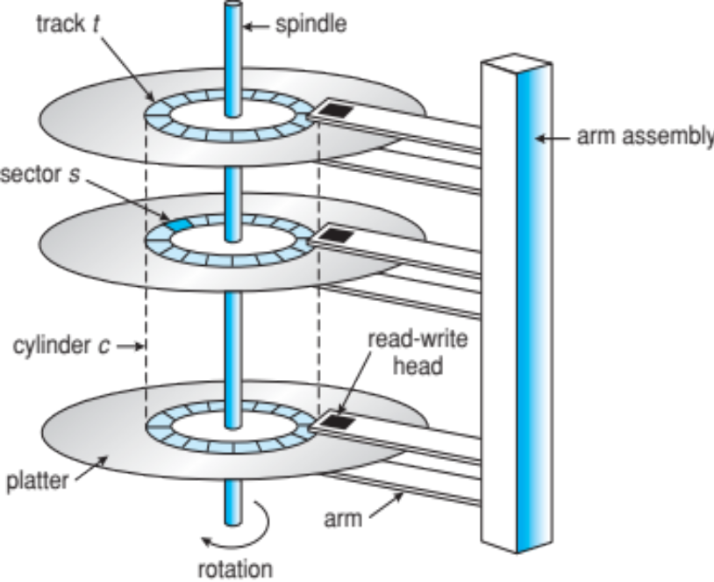
The Amazing Magnetic Disk
Unit of transfer: sector
  Ring of sectors form track
  Stack of tracks form cylinder
  Heads position on cylinders
Disk tracks ~ 1µm (micron) wide
  Wavelength of light is ~ 0.5µm
  Resolution of human eye: 50µm
  100K tracks on a typical 2.5” disk
Separated by unused guard regions
  Reduces likelihood neighboring
  tracks are corrupted during writes
  (still small non-zero chance)

Slide 39
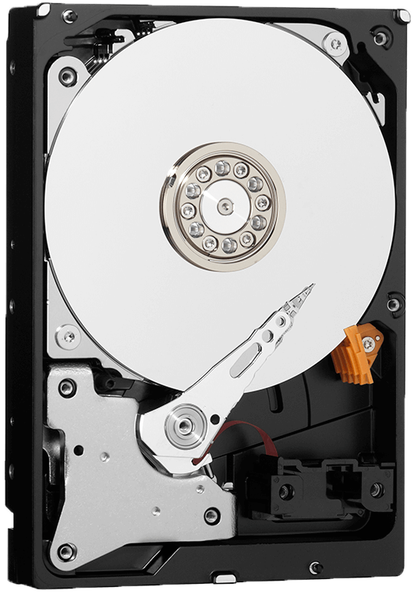
The Amazing Magnetic Disk (cont.)
Track length varies across disk
  Outside: more sectors per track,
  higher bandwidth
  Disk is organized into regions of
  tracks with same # of sectors/track
  Only outer half of radius is used
    Most of disk area in outer regions of disk
Disks are so big that some companies
(like Google) reportedly only use
part of disk for active data
  Rest is archival data
www.lorextechnology.com

Slide 40
Magnetic Disks
Recall: cylinder is all tracks under head at any given point on all surface
Read/write data includes three stages
  Seek time: position r/w head over proper track
  Rotational latency: wait for desired sector to rotate under r/w head
  Transfer time: transfer block of bits (sector) under r/w head
Seek
time
Original
position
Disk Latency = Queuing Time + Controller time +
Seek Time + Rotation Time + Transfer Time
Rotational
latency
Request
Software queue
(device driver)
Hardware
Controller
Media Time
(Seek+Rot+Xfer)
Result
Desired
data

Slide 41
Disk Performance Example
Assumptions
  Ignoring queuing and controller times for now
  Average seek time of 5ms
  7200RPM ⇒ time for rotation: 60000 (ms/minute) / 7200 (rotation/minute) ≅ 8ms
  Transfer rate of 4 MiB/s, sector size of 1KiB ⇒ 2¹⁰ B / 2²² (B/s) = 2⁻¹² s ≅ 0.24ms
Read sector from random place on disk
  Seek (5ms) + rotational delay (4ms) + transfer (0.24ms)
  Approximately 10ms to fetch/put data: 100KiB/s
Read sector from random place in same cylinder
  Rotational delay (4ms) + transfer (0.24ms)
  Approximately 5ms to fetch/put data: 200 KiB/s
Read next sector on same track
  Transfer (0.24ms): 4 MiB/s
Key to using disk effectively (especially for file systems) is to minimize seek & rotational delays

Slide 42
More Examples
How long to complete 500 random disk reads (in FIFO order)?
  500 x 9.24ms = 4.12s
How long to complete 500 sequential disk reads (starting from random sector)?
  Seek (5ms) + rotational delay (4ms) + transfer (500 x 0.24ms) = 0.129s
    Might need an extra head or track switch
    Track buffer may allow some sectors to be read off disk out of order
How large transferred data should be to achieve 80% of max disk transfer rate
(zero track-to-track seek time)?
  Assume R rotations are needed, then solve for R
  Recall: effective bandwidth = data size/latency = peak bandwidth x transfer time/latency
  Transfer time / latency = 0.8
    Transfer time = R x rotation time = R x 8ms
    Latency = Seek (5ms) + transfer time (R x 8ms)
      Note that rotational delay is zero because entire track is transferred
    R = 2.5 ⇒ transferred data size = 2.5 x 8ms x 4 MB/s ≅ 8KiB

Slide 43

(Lots of) Intelligence in Controller
Sectors contain sophisticated error correcting codes
  Disk head magnet has field wider than track
  Hide corruptions due to neighboring track writes
Sector sparing
  Remap bad sectors transparently to spare
  sectors on the same surface
Slip sparing
  Remap all sectors (when there is a bad sector)
  to preserve sequential behavior
Track skewing
  Offset sector numbers to allow for
  disk head movement to achieve sequential operations
…

Slide 44
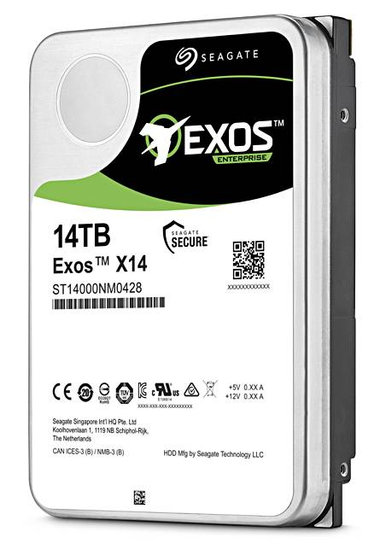
Example of Current HDDs
Seagate EXOS X14 (2018)
  14 TB hard disk
  8 platters, 16 heads
  4.16 ms average seek time
  4 KB physical sectors
  7200 RPMs
  6 Gbps SATA / 12Gbps SAS interface
  261 MB/s MAX transfer rate
  Cache size: 256 MB
IBM Personal Computer/AT (1986)
  30 MB hard disk
  30-40 ms seek time
  0.7-1 MB/s (est.)

Slide 45
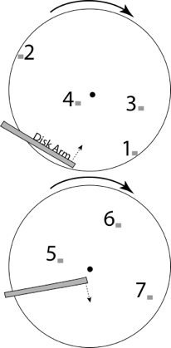
Disk Scheduling
FCFS: schedule requests in order they arrive
  + Fair among requests
  – Poor performance for sequence of requests
  that alternate between outer and inner tracks
Shortest seek time first (SSTF): pick the request that is closest to head
  + Avoid frequent long seeks
  – May lead to starvation!
SCAN: move disk arm in one direction,
take the closest request in direction of travel,
then reverse direction also called “elevator scheduling”)
  + No starvation
  + Low seek
  – Favoring middle tracks

Slide 46
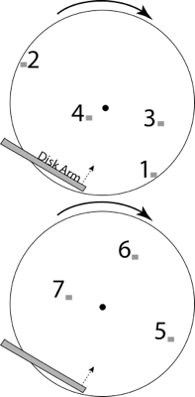
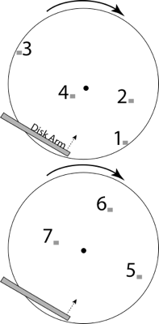
Disk Scheduling (cont.)
CSCAN: move disk arm in one direction,
take the closest request in direction of travel,
then start again from farthest request
  + Fairer than SCAN
  – Longer seeks on the way back
R-CSCAN: CSCAN but consider that
short track switch has rotational delay

Slide 47
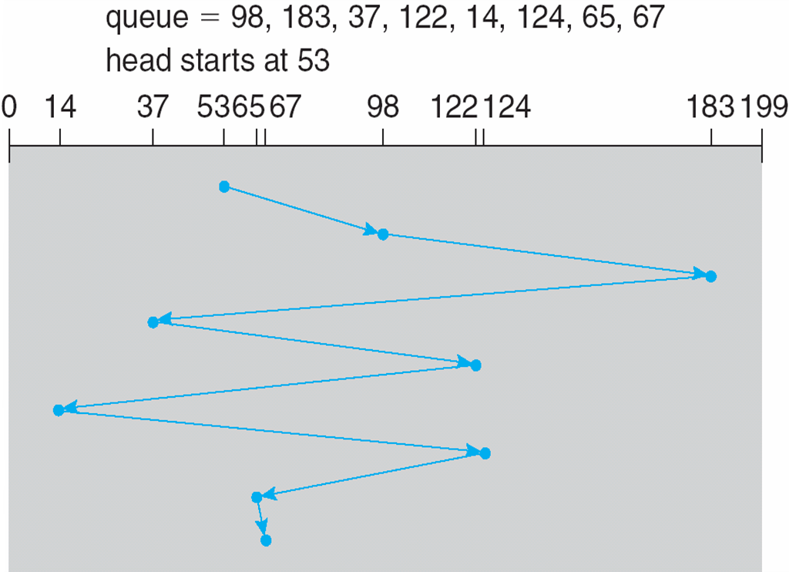
Example: FCFS

Slide 48
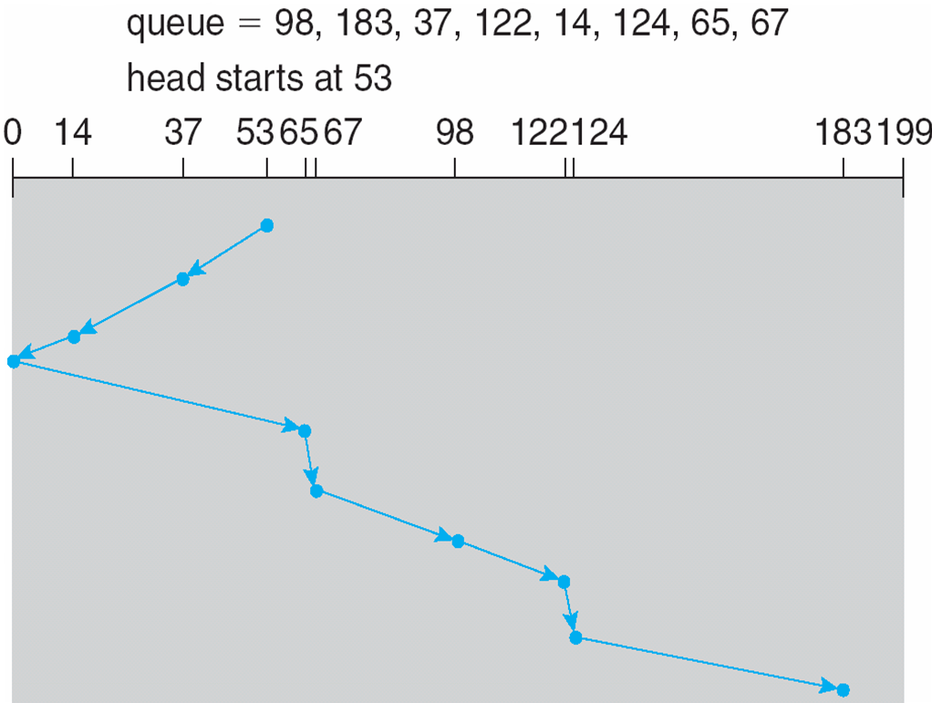
Example: SCAN

Slide 49
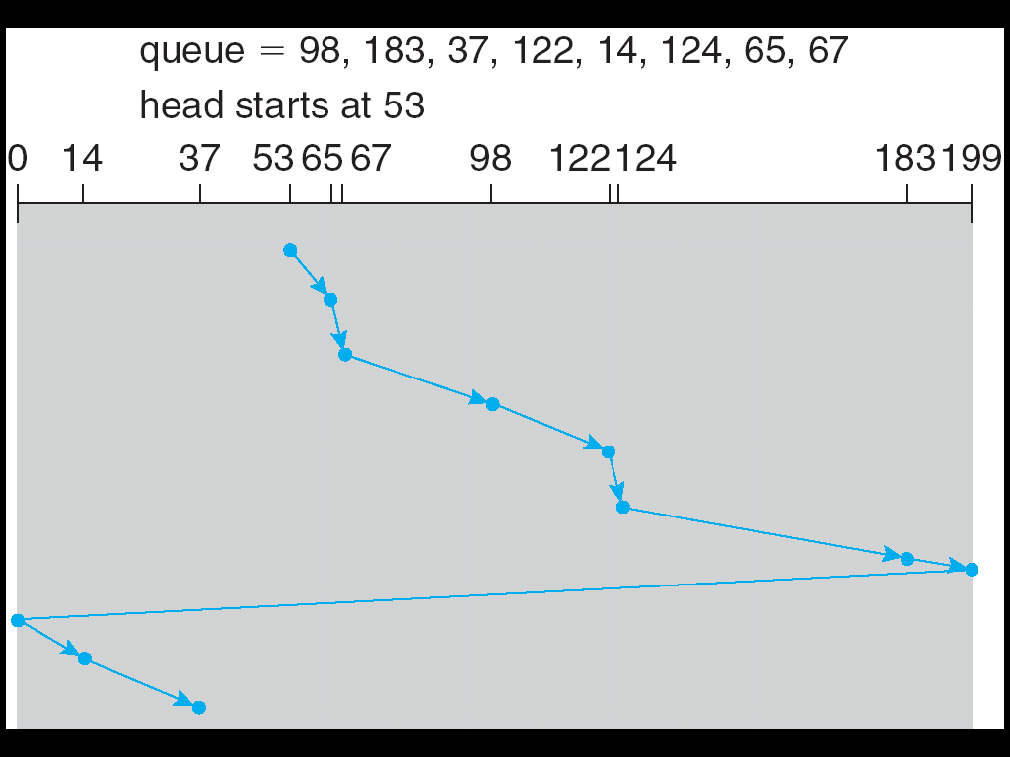
Example: C-SCAN

Slide 50
Final Notes on Disk Performance
When is disk performance highest?
  When there are big sequential reads, or
  When there is so much work to do that they can be piggy backed
  (reordering queues)
OK to be inefficient when things are mostly idle
Bursts are both a threat and an opportunity
Other techniques:
  Reduce overhead through user level drivers
  Reduce the impact of I/O delays by doing other useful work in the meantime

Slide 51
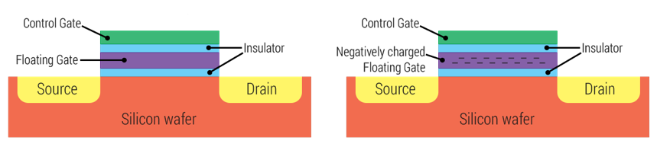
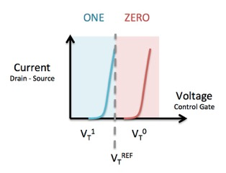
Flash Memory
1995: replace rotating magnetic media with battery backed DRAM
2009: use NAND multi-level cell (e.g., 2 or 3-bit cell) flash memory
  No charge on FG ⇒ 1 and negative charge on FG ⇒ 0
  Data can be addressed, read, and modified in pages, typically between 4KiB and 16KiB
  But … data can only be erased at level of entire blocks (MiB in size)
  When block is erased all cells are logically set to 1
No moving parts (no rotate/seek motors)
  Eliminates seek and rotational delay
  Very low power and lightweight
  Limited “write cycles”
Figures: www.androidcentral.com and flashdba.com

Slide 52
Flash Memory: Reads
NAND
NAND
NAND
NAND
NAND
NAND
NAND
NAND
NAND
NAND
Host
Flash Memory
Controller
NAND
NAND
Buffer Manager
(Software Queue)
NAND
NAND
NAND
NAND
NAND
NAND
NAND
NAND
NAND
NAND
DRAM
NAND
NAND
NAND
NAND
NAND
NAND
NAND
NAND
NAND
NAND
Reading data is similar to memory read
  No seek or rotational latency
Transfer rate is limited by controller and bus
  E.g., transfer 4KiB page over SATA: 300-600 MiB/s ⇒ 4KiB / 400MiB/s ~ 10us
Latency = queuing time + controller time + transfer time
Highest bandwidth: sequential OR random reads

Slide 53
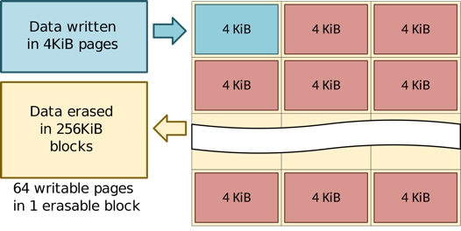
Flash Memory: Writes
Writing data is complex!
Write and erase cycles require “high” voltage
  Damages memory cells, limits SSD lifespan
  Controller uses ECC, performs wear leveling
Data can only be written into empty pages in each block
Pages cannot be erased individually, erasing entire block takes time
wikipedia.org

Slide 54
Flash Memory Controller
Flash devices include flash translation layer (FTL)
  Maps logical flash pages to physical pages on flash device
  Wear-levels by only writing each physical page a limited number of times
  Remaps pages that no longer work (sector sparing)
When logical page is overwritten, TTL write new version to already-erased page
  Remaps logical page to the new physical page
FTL maintains pool of empty blocks by coalescing used pages
  Garbage collects blocks by copying live pages to new location, then erase
  More efficient if blocks stored at the same time are deleted at the same time
  (e.g., keep blocks of file together)
How does flash device know which blocks are live?
  File system tells device when blocks are no longer in use (Trim command)

Slide 55
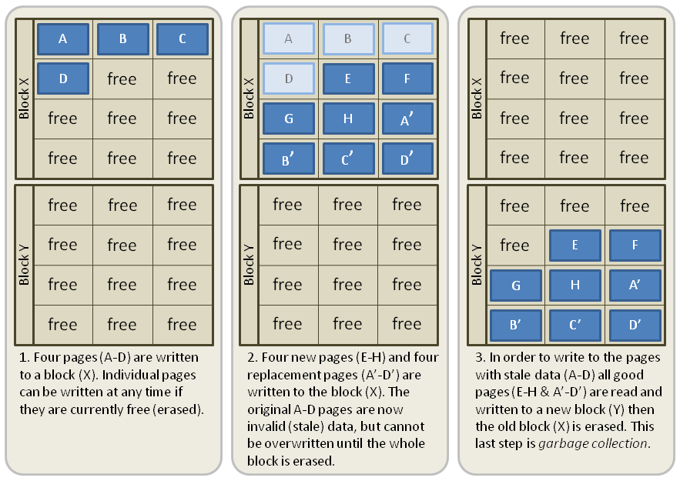
Example: Writes with GC
Rewriting some data requires reading, updating, and writing to new locations
If new location was previously used, it also needs to be erased
Much larger portions of flash may be erased and rewritten than required by size of new data
wikipedia.org

Slide 56
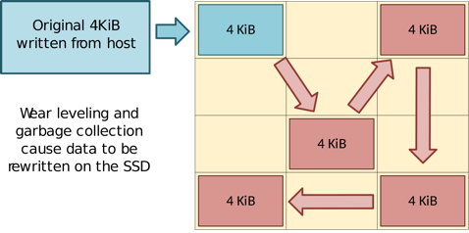
Flash Memory: Write Amplification
Flash memory must be erased before it can be rewritten
Erasure happens in much coarser granularity then writes
Flash controllers end up moving (or rewriting) user data and metadata more than once
This multiplying effect increases number of writes required
  Shortens life cycle of SSD
  Consumes bandwidth, which reduces random write performance
Result is very workload dependent performance
Latency = queuing time + controller time (find free block) + transfer time
Highest bandwidth: sequential OR random writes (limited by empty pages)
wikipedia.org

Slide 57
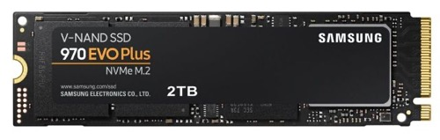
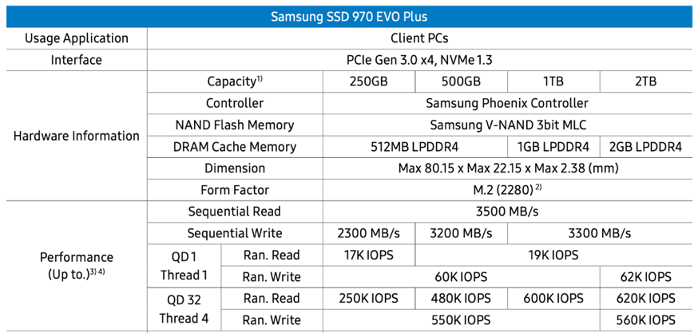
Example of Current SSDs
Flash controller could cache random writes and flush them to flash efficiently
  Write latency becomes latency of accessing the cache
For random reads, however, controller can't do much
  Pre-fetching data helps sequential reads but could hurt performance of random reads

Slide 58
Is Full Kindle Heavier Than Empty One?
Actually, “Yes”, but not by much
Flash works by trapping electrons:
  So, erased state lower energy than written state
Assuming that:
  Kindle has 4 GB flash
  ½ of all bits in full Kindle are in high-energy state
  High-energy state about 10-15 joules higher
  Then: Full Kindle is 1 attogram (10⁻¹⁸ gram) heavier (Using E = mc2)
Of course, this is less than most sensitive scale can measure (10⁻⁹ grams)
This difference is overwhelmed by battery discharge, weight from getting warm, …
According to John Kubiatowicz (New York Times, Oct 24, 2011)

Slide 59
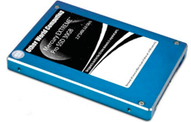
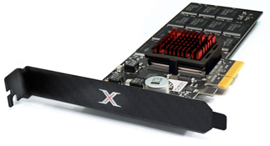
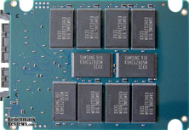
SSD Summary
Pros (vs. hard disk drives)
  Low latency, high throughput (eliminate seek/rotational delay)
  No moving parts (very light weight, low power, silent, very shock insensitive)
  Read at memory speeds (limited by controller and I/O bus)
Cons (these are changing rapidly!)
  Expensive
  Asymmetric block write performance
    Controller garbage collection (GC) algorithms have major effect on performance
  Limited drive lifetime
    1-10K writes/page for MLC NAND
    Average failure rate is 6 years, life expectancy is 9–11 years

Slide 60
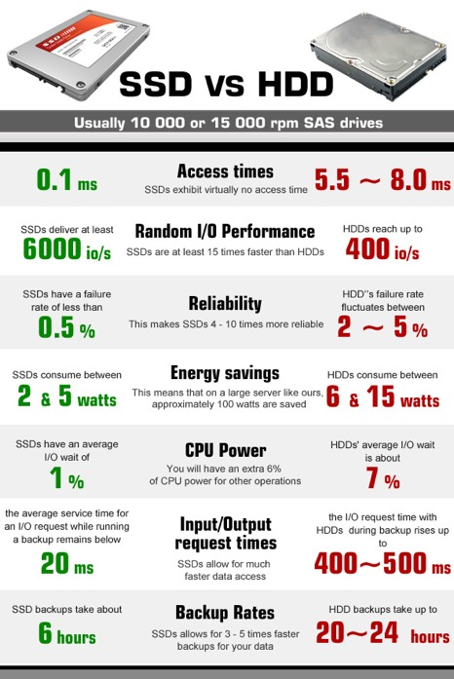
HDD vs. SSD

Slide 61
Summary
I/O devices
  Different speeds, different access patterns, different access timing
I/O controllers
  Hardware that controls actual device
  Processor accesses through I/O instructions, load/store to special physical memory
I/O performance
  Latency = overhead + transfer
  Queueing theory help in analyzing overhead
Disk scheduling
  FIFO, SSTF, SCAN, CSCAN, R-CSCAN
HDD performance
  Latency = queuing time + controller + seek + rotation + transfer
SDD performance
  Latency = queuing time + controller + transfer (erasure & wear)

Slide 62

Questions?
globaldigitalcitizen.org

Slide 63
Acknowledgment
Slides by courtesy of Anderson, Culler, Stoica, Silberschatz, Joseph, and Canny

