Slide 1

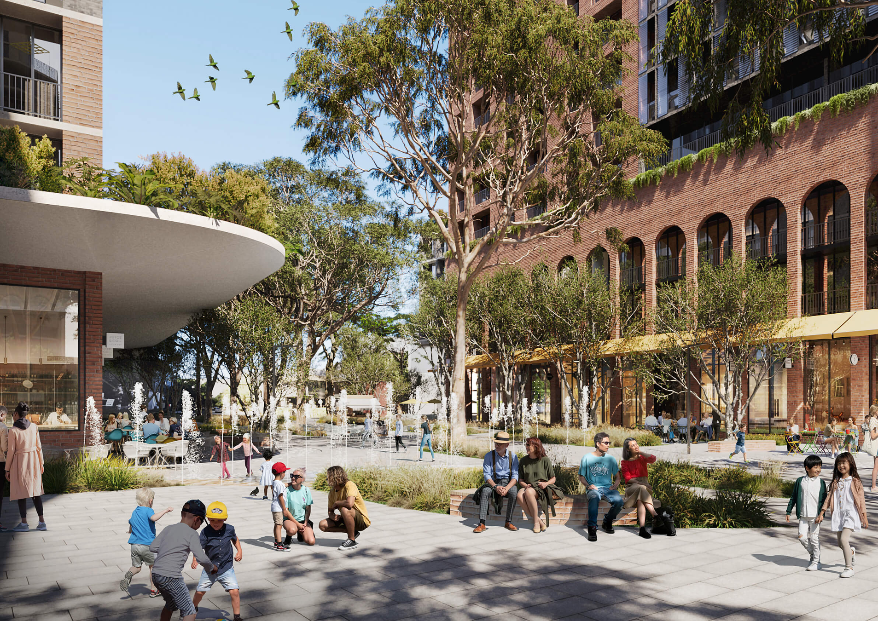
WATERLOO SOUTH RENEWAL PROJECT
DING ZHIYIN 3036648793

Slide 2


Contents:
01 | Site History and Evolution
02 | Stakeholder Dynamics
03 | Project Vision and Implementation
04 | Site-Specific Challenges
05 | Outcomes and Future Potential

Slide 3
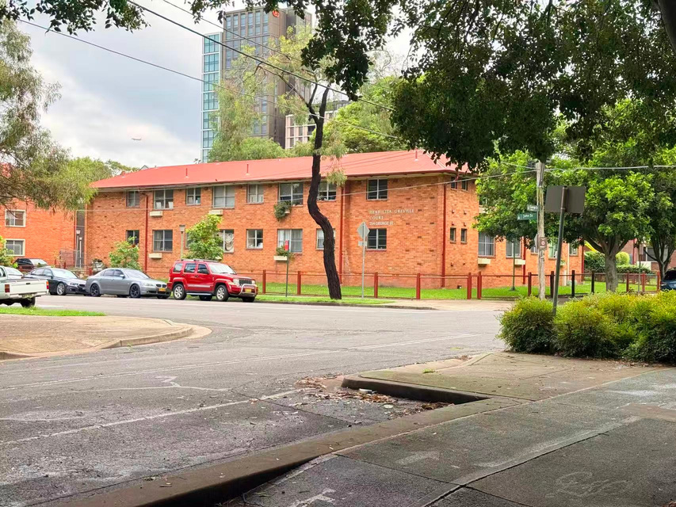

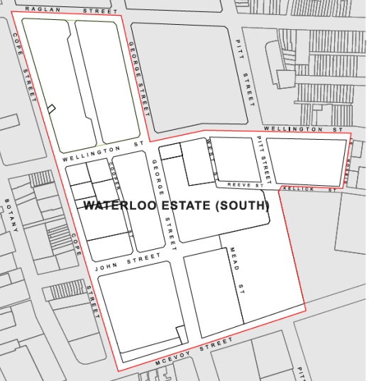
Waterloo South History
and Evolution

Slide 4
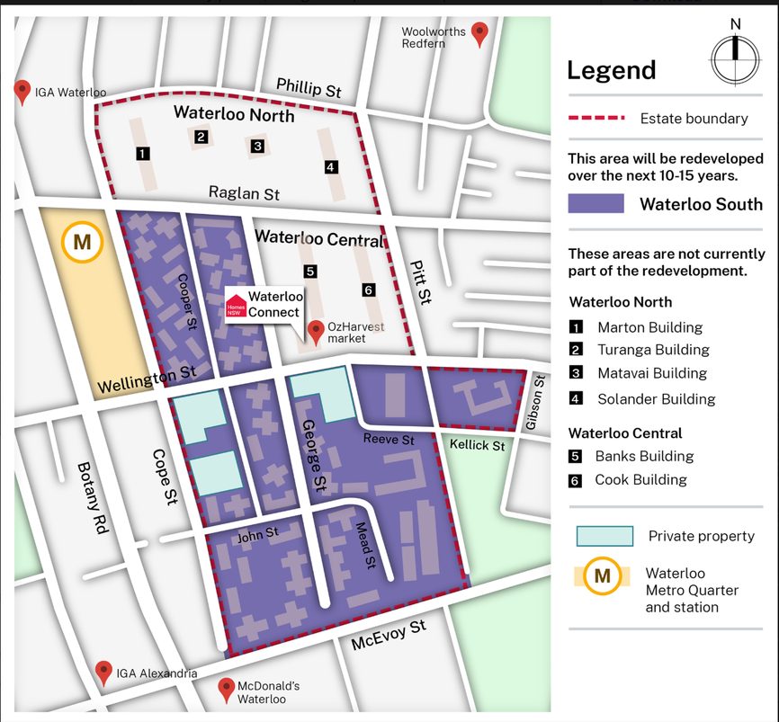
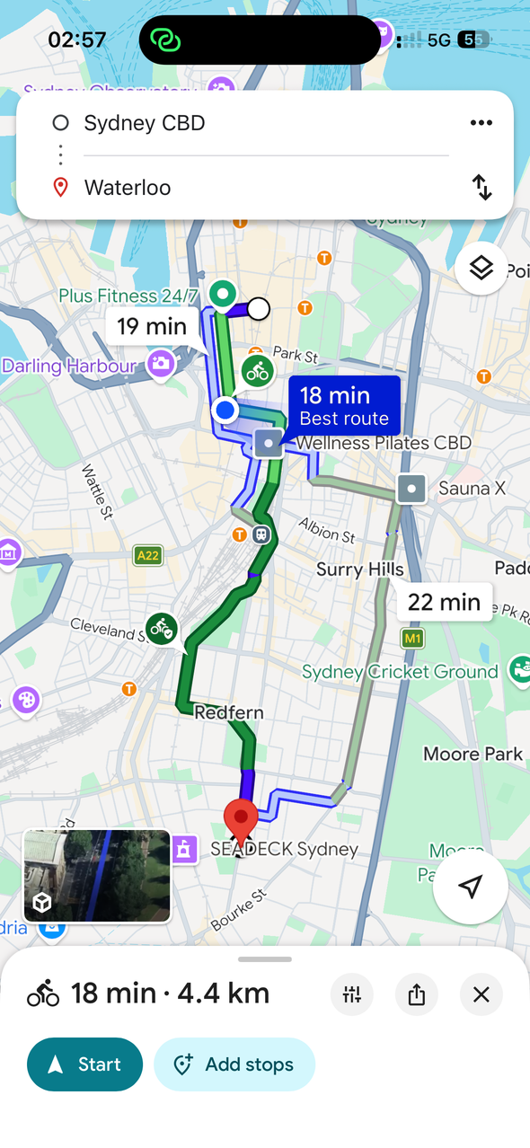
Introduction
Location
  Inner-city suburb of Waterloo, Sydney
  About 4 km south of Sydney CBD
Site characteristics
  One of the largest public housing estates in NSW
  Major urban renewal project transforming the estate
Project aims
  Improve street connectivity, public spaces, and access to services
Planning vision
  Create a mixed-income and more integrated community( 50% social/affordable and 50% privatehousing)
Source: Waterloo Renewal Project (2026)

Slide 5


Timeline
Early Industrial Development
Public Housing Renewal
Redfern–Waterloo Authority
Waterloo Urban Renewal
Mid-19th Century
1950s–1970s
2004–2011
2012–Present

Slide 6
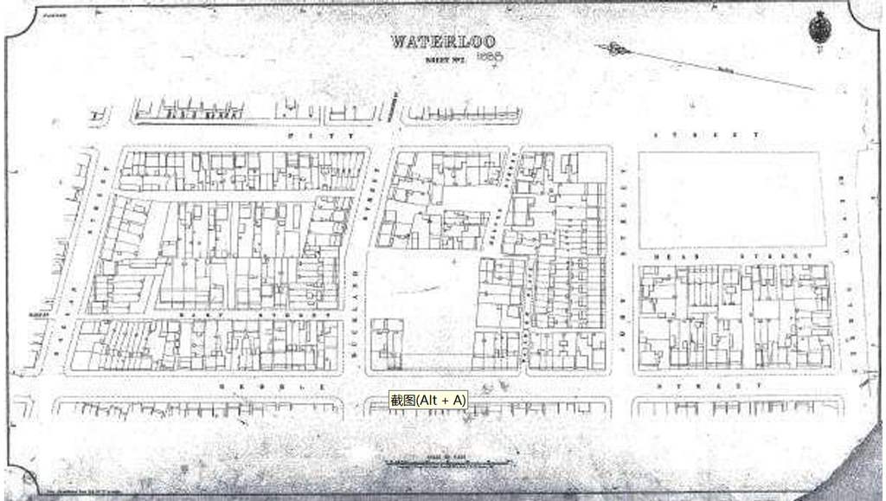
Early Development of Waterloo
  Originally part of the Waterloo Estate owned by William Hutchison
  Large land grant of around 1,400 acres in early colonial Sydney
  Rapid subdivision in the late 19th century
  Developed as a working-class suburb with terrace housing
  Close to factories and railway yards
Source: City of Sydney Archives, 2021

Slide 7
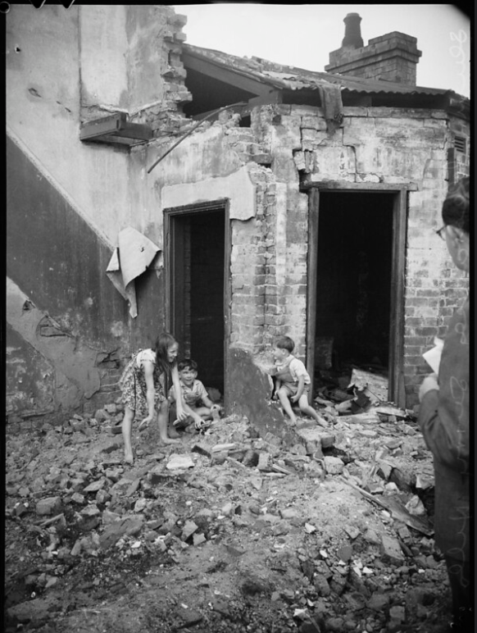
Decline and Slum Conditions
  Rapid population growth in the late 19th century
  Poor housing quality and overcrowding
  1900 bubonic plague outbreak in Sydney
  By the 1920s, Waterloo labelled a “slum” suburb

Slide 8
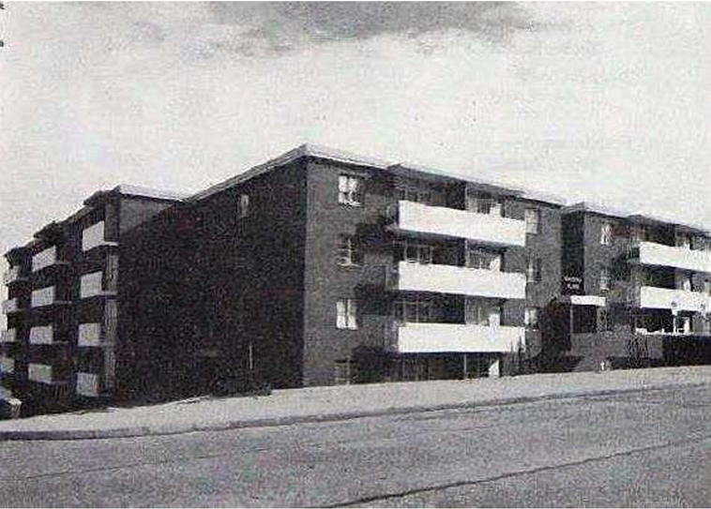
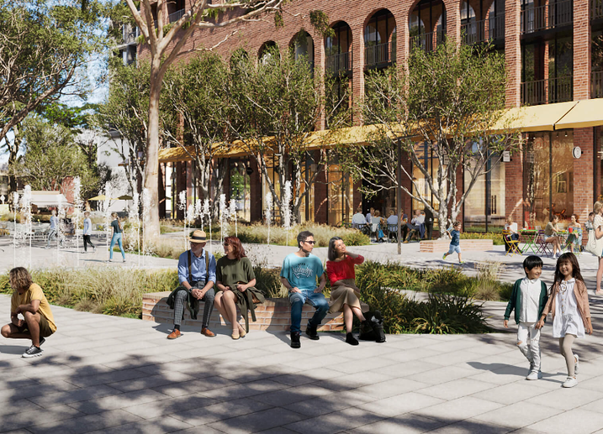
Public Housing and Urban Renewal
  1941: NSW Housing Commission established
  1948: First public housing development in Waterloo
  1940s–1980s: construction of high-rise public housing towers
  Since 2012: Waterloo Urban Renewal Program
  Plan to redevelop the estate into a mixed-income community
Source: Housing commission annual report 1966

Slide 9
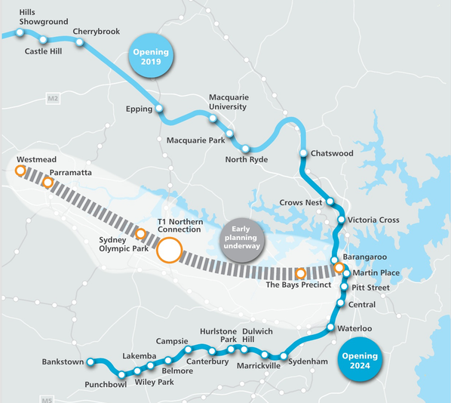
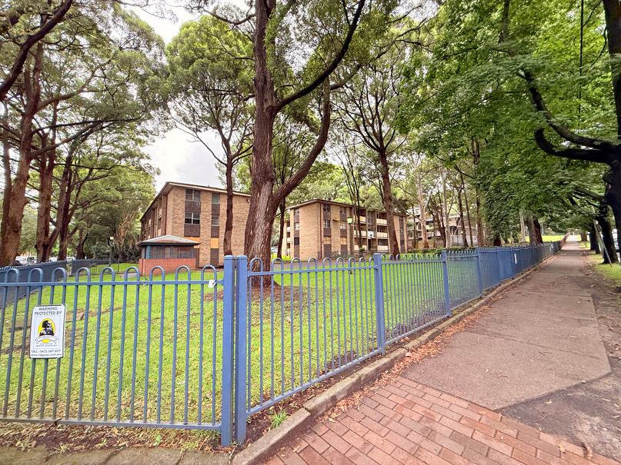
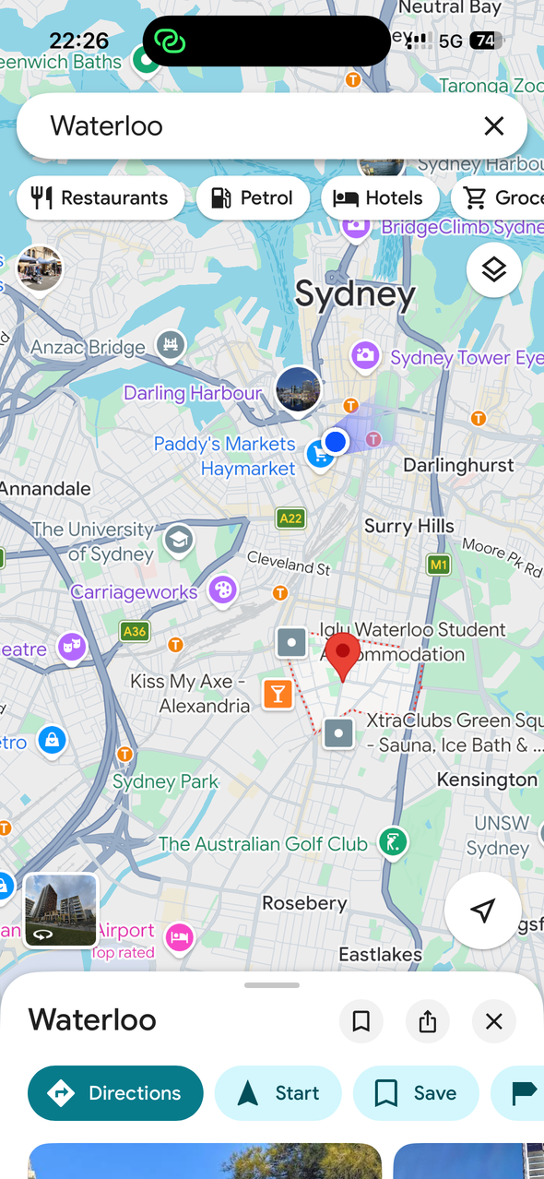
Factors Leading to Renewal
Urban Infrastructure Change | Development of the Sydney Metro Construction of Waterloo Metro Station Created opportunities for transit-oriented development
Ageing Public Housing | Housing towers built in the 1960s–1970s Poor building conditions and high maintenance costs Inefficient land use in a valuable inner-city area
Urban Regeneration Strategy | Government plans to redevelop ageing housing estates Introduce mixed housing types Improve community facilities and urban integration
Strategic Inner-city Location | Located close to Sydney CBD Near employment centres and universities High redevelopment potential

Slide 10
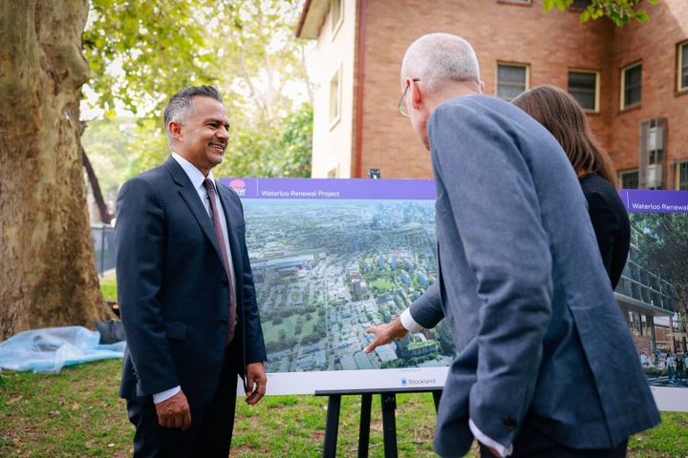

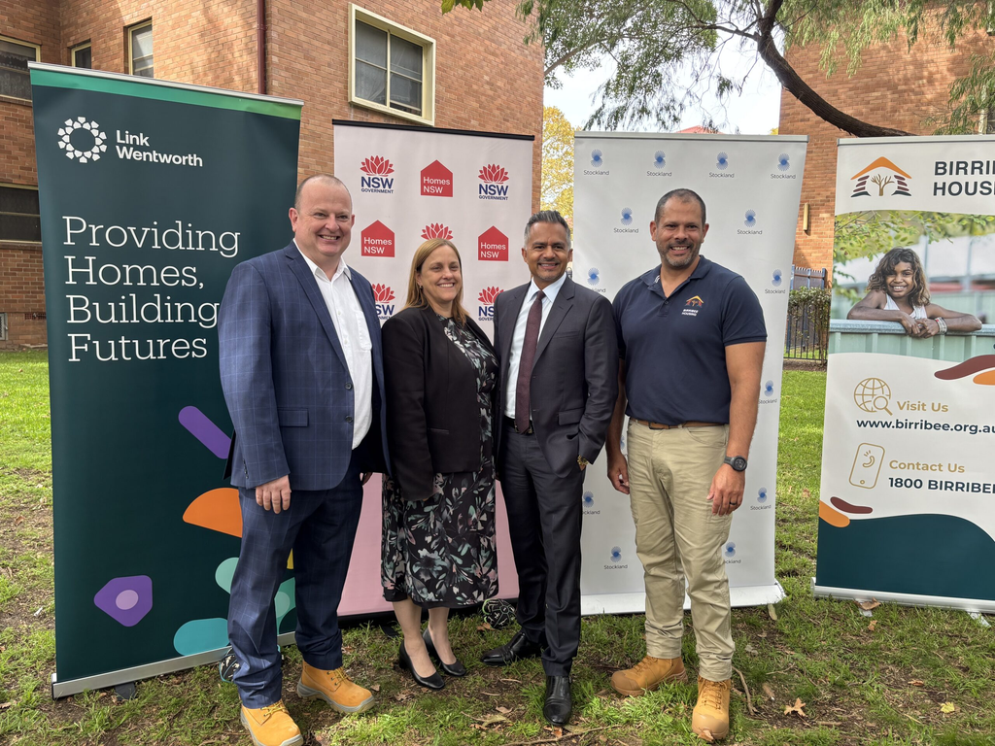
Stakeholder Dynamics

Slide 11
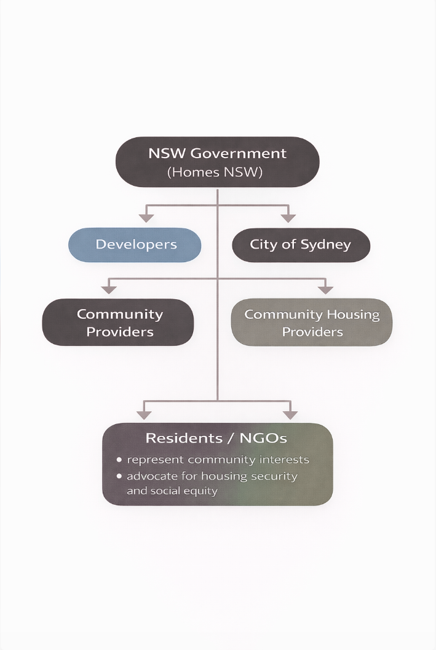
Stakeholder Governance Network
NSW Government (Homes NSW / LAHC)
• Project leadership
• Land ownership
• Housing policy and redevelopment strategy
City of Sydney
• Local planning framework
• Infrastructure and urban design coordination
Private Developers
• Investment and construction delivery
Community Housing Providers
• Management of social housing
Residents and Community Groups
• Represent local interests
• Advocate for housing rights and community stability

Slide 12
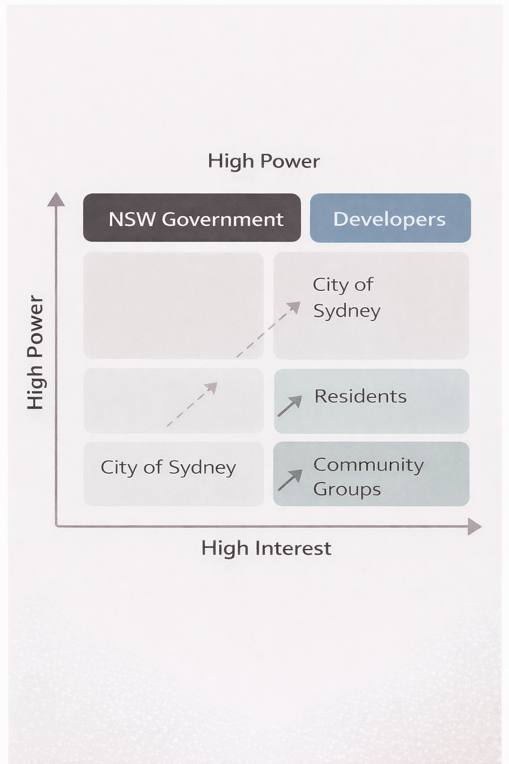
Stakeholder Powerand Interest Dynamics
Power concentration
• Decision-making authority is concentrated in government agencies and development partners
Interest imbalance
• Residents and community organisations have strong interests but limited institutional power
Governance challenge
• Balancing redevelopment objectives with social equity concerns

Slide 13
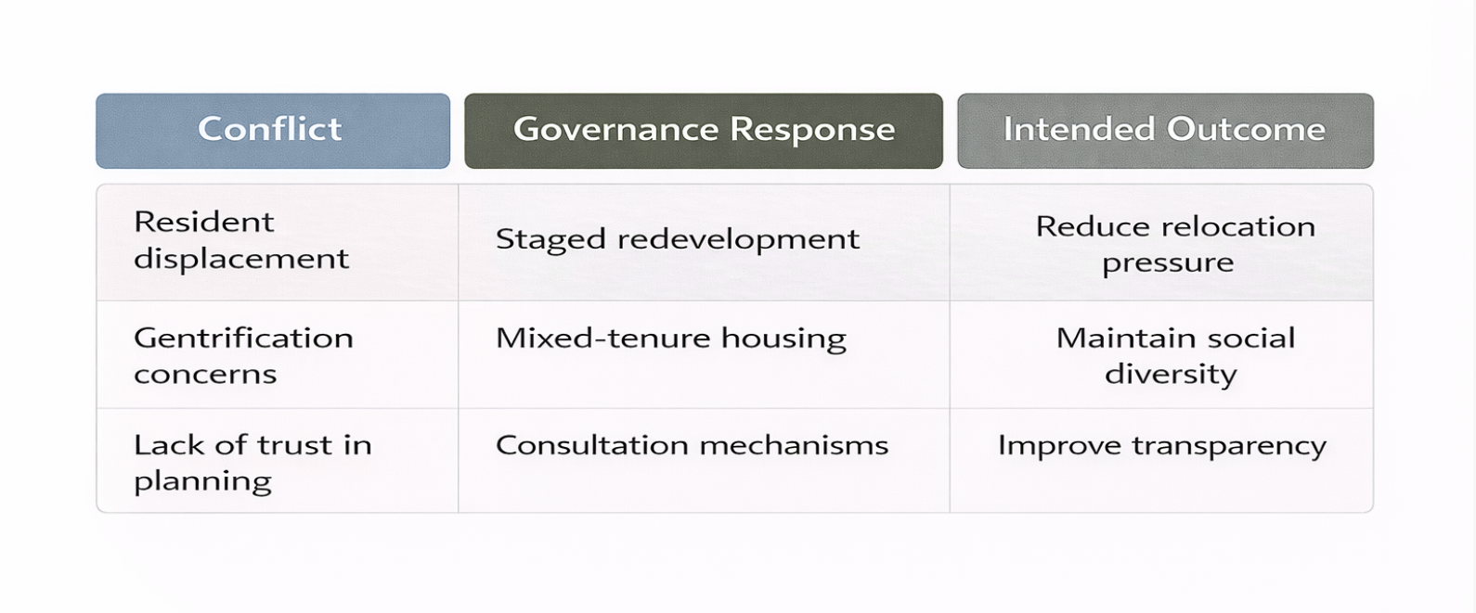
Conflict – Governance Response Framework
Resident displacement
Redevelopment requires demolition of existing public housing, leading to temporary relocation and disruption of social networks
Gentrification concerns
Higher-density private housing may increase property values and reshape the neighbourhood’s social structure
Participation and trust
Community groups argue consultation occurred late in the planning process.

Slide 14
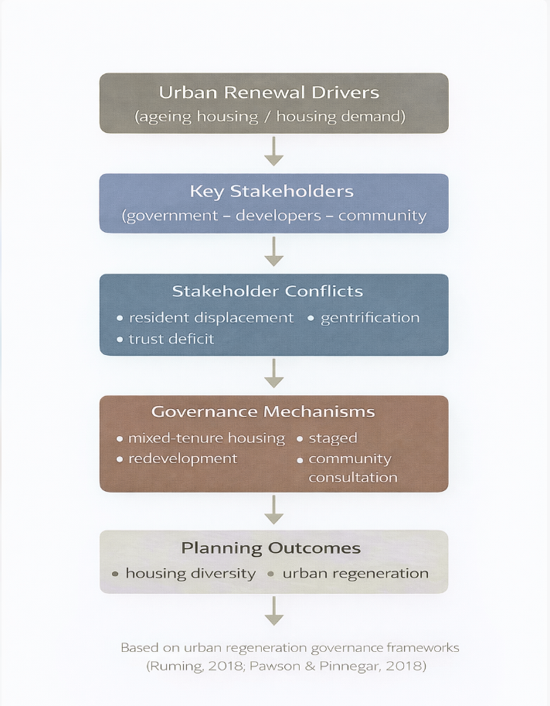
Governance Lessons
• Urban renewal requires
multi-stakeholder governance
• Social equity must be considered in public housing redevelopment
• Meaningful participation is essential to build trust

Slide 15
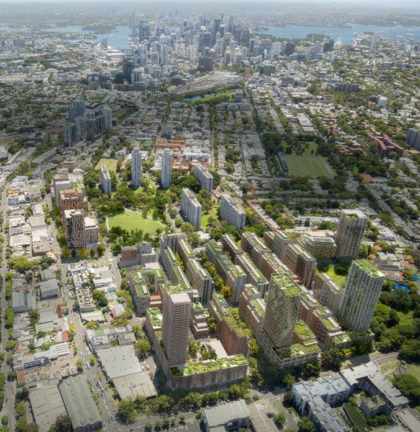
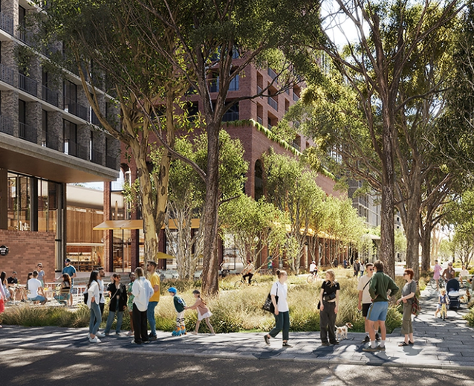
Project Vision and Implementation

Slide 16
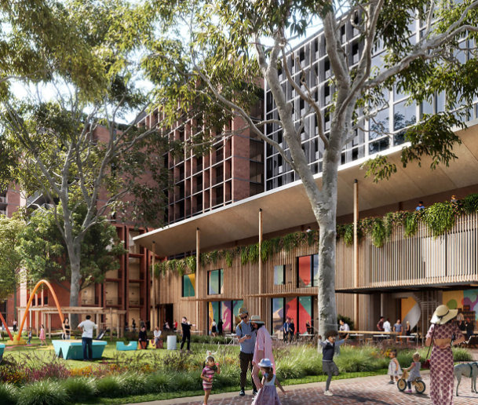
Project Vision
It is a state-led effort to transform an ageing estate into a mixed, socially, transit-connected, inclusive neighbourhood, not only housing replacement
  Replace ageing public housing with mixed-tenure housing
  A complete neighbourhood with parks, services, shops
  Improve wellbeing, cultural inclusion and sustainability
Ageing Public Housing Estate
Mixed and Connected Neighbourhood

Slide 17

Economic, Social, Environmental Priorities
Economic
Social
Environmental
  Mixed-tenure delivery improves feasibility
  Shops, services and local business activation
  Jobs and training pathways in the precinct
  more and better social housing in mixed communities
  tenure-blind design reduces stigma
  targeted Aboriginal housing outcomes and wrap-around support
  Minimum 6-star Green Star communities target
  Landscape design manages heat and stormwater
  Parks, trees and better sunlight support liveability

Slide 18
Housing Diversity, Affordability, Public Benefits
Housing Diversity - Mixed
Housing Diversity
Affordability
Public Benefits
  Mix of social, affordable and private housing
  Housing suitable for families, older residents and key workers
  Planning controls secure affordable housing provision
  Long-term management by community housing providers
  New community facilities
  Active ground-floor uses
  Improved public realm quality

Slide 19
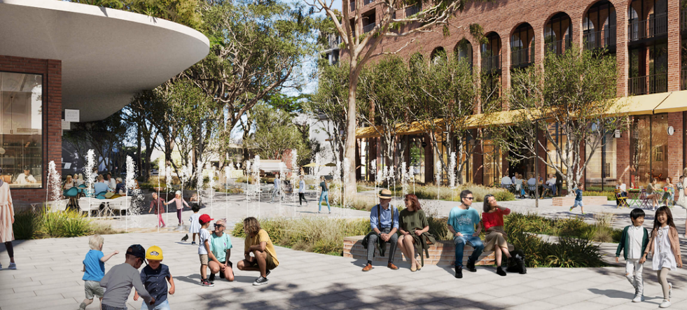
Integration with Infrastructure
Contribution to Local Services
Transport integration
Movement and urban connectivity
  Adjacent to Waterloo Metro Station
  Supports transit-oriented density
  Strong access to CBD and employment hubs
  Encourages reduced car dependence
  New street network improves permeability
  Enhanced pedestrian and cycling links
  Connected to Redfern–Waterloo urban fabric
  Promotes walkable neighbourhood structure
Access to services and amenities
  Improved reach to schools, health and retail
  Integration with existing neighbourhood centres
  New parks, community spaces, shops
  Active ground floors amenities

Slide 20

Implementation and Staging
Key implementation insight
Staging is fundamentally a social management strategy. NSW states that renewal will be staged over roughly 30 years to minimise disruption for existing tenants, while Waterloo South as the first stage is expected to unfold over 10–15 years.
2020
2022
2025
2026+
10–15 yrs
Planning proposal lodged
Planning controls finalised
Stage 1 relocations
Detailed design after concept phase
Waterloo South redevelopment

Slide 21
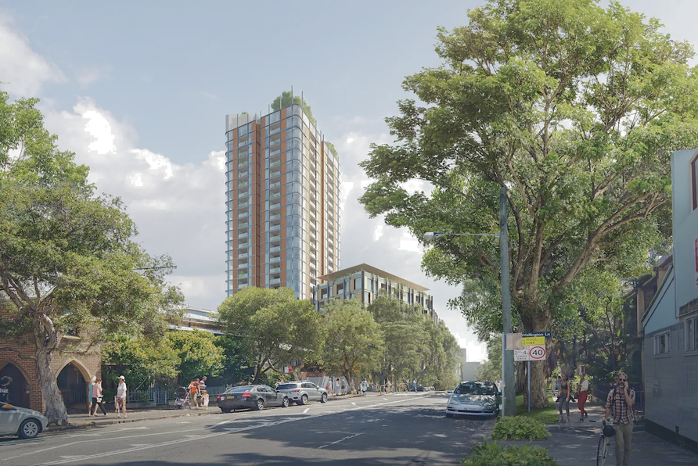
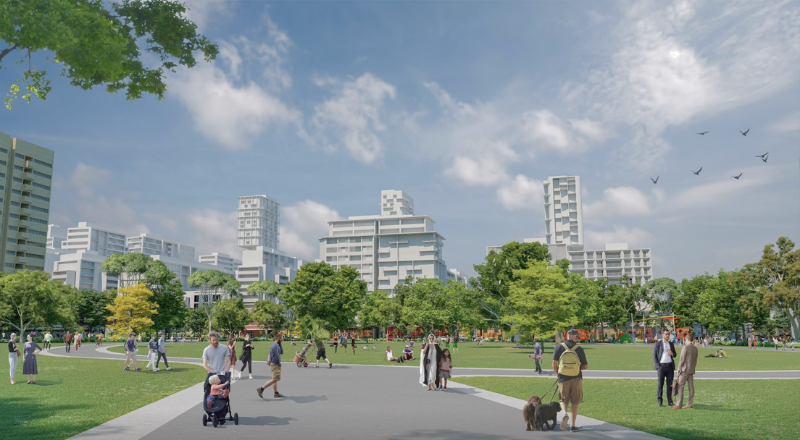
Site-Specific Challenges

Slide 22
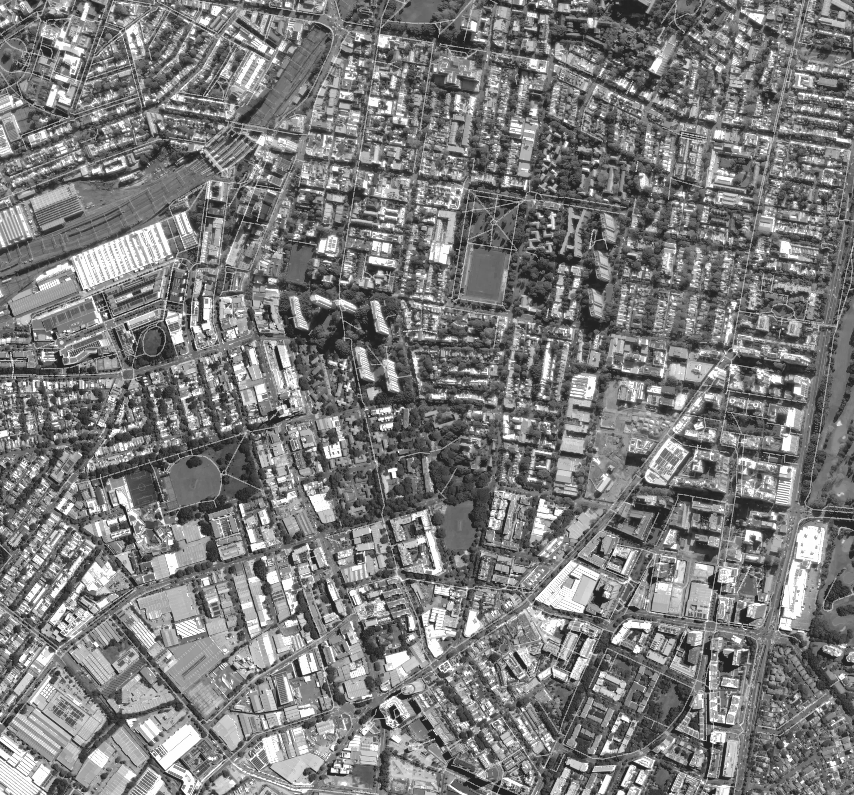
Site-Specific Challenges of Waterloo South
Metro station influence
High development pressure due to transit access.
High density pressure
Redevelopment plans around 3000 dwellings.
Heritage interface
Nearby Alexandria Park heritage area.
Social housing concentration
Large number of vulnerable residents.
High housing demand near CBD.
Social & Community Considerations
Large number of vulnerable residents.
It faces public housing stigmatization and tenant displacement risks.

Slide 23
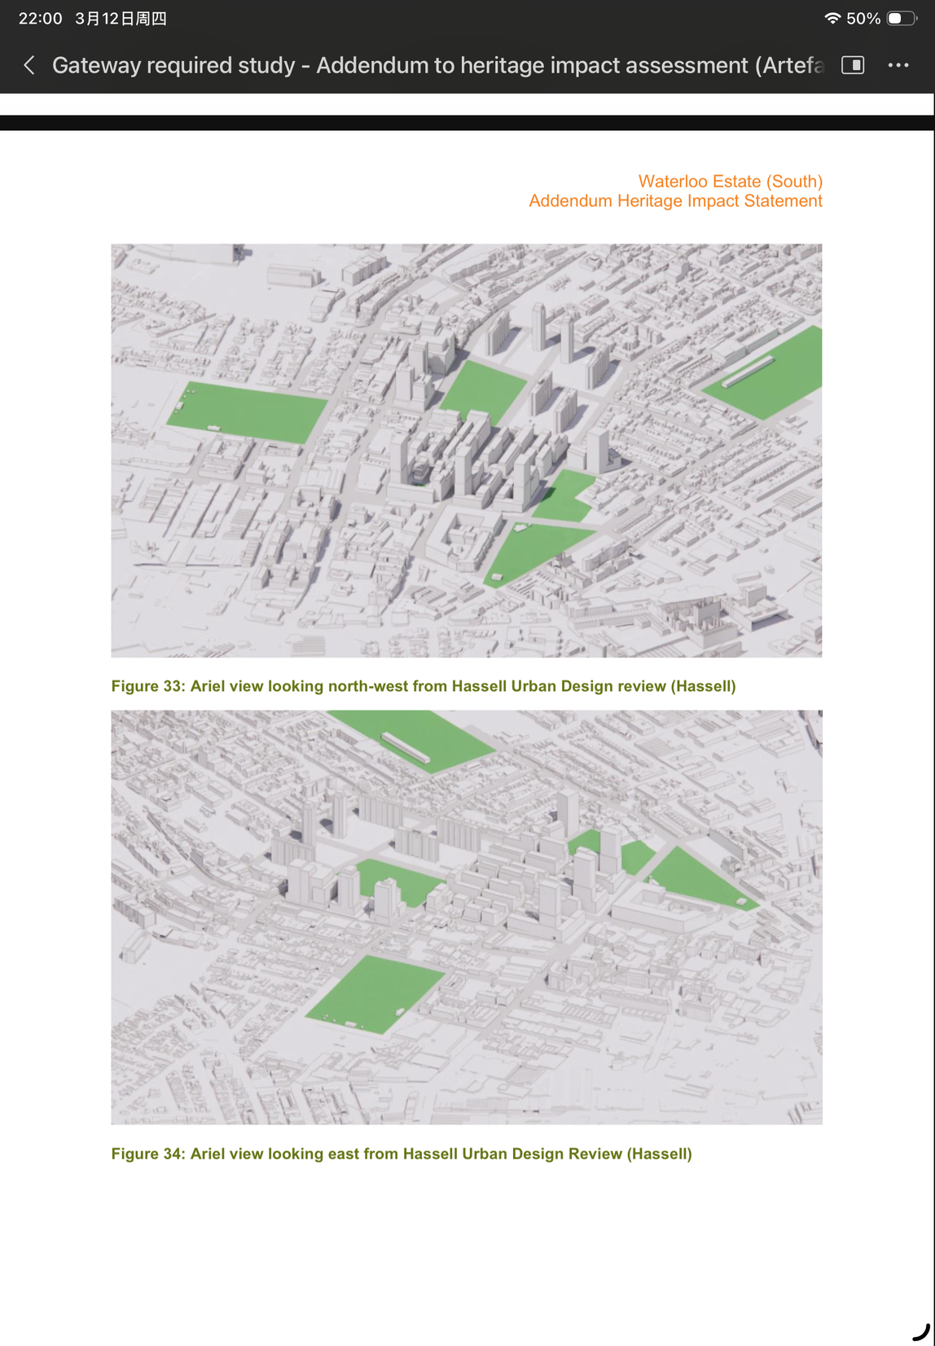
Local Conditions
  Waterloo Estate is located in a dense inner-city area of Sydney
  Limited land area but strong demand for new housing
  Planned redevelopment of around 3,000 dwellings
Challenges
  High density pressure
  Potential pressure on infrastructure and public space
High Density Pressure
Planning Controls and Design Responses
  Stepped Configuration: Taking advantage of topographic variations, a podium-and-tower form is adopted to provide direct building access at all street levels.
  Wind Environment Optimisation: Design validated via wind tunnel testing. Building corners are curved; podiums and canopies are introduced to mitigate high-rise wind effects on public spaces.
  Tower Distribution: Four high-rise towers are clustered in the southern section (McEvoy Street) to reduce bulk imposition on low-rise areas, with a minimum separation of 60 metres to maintain view corridors.

Slide 24
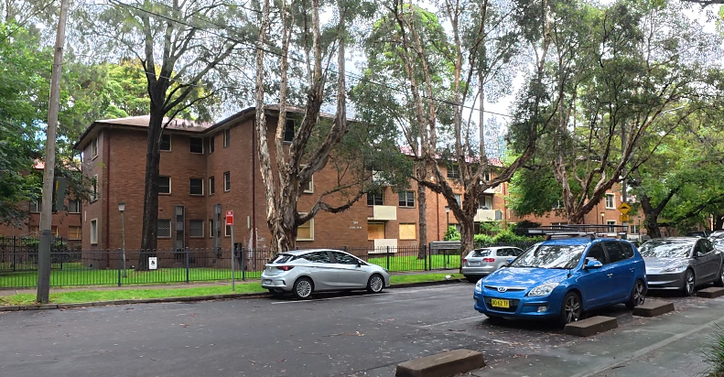
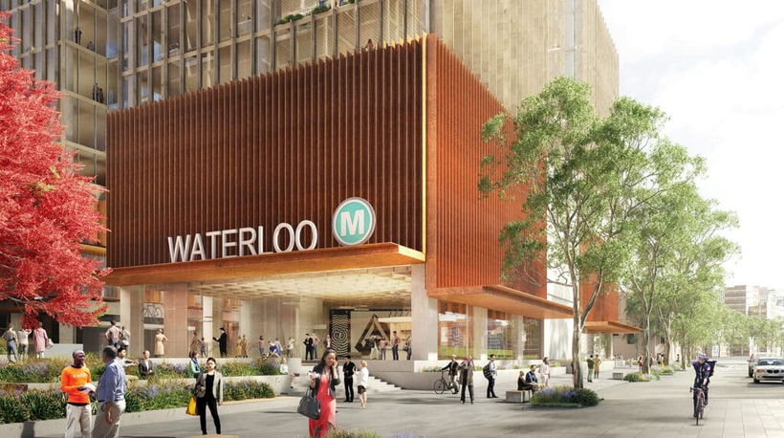
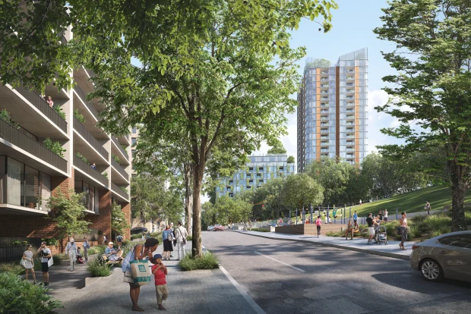
Existing Problems
  Old public housing layout with poor connectivity
  Limited public space and street activity
  Urban design that isolates the estate from surrounding areas
Environmental
and
Urban Design Factors
Design Solutions
  New street connections linking the estate with surrounding neighbourhoods
  Creation of parks and open spaces
  Improved pedestrian and cycling networks
Planning Goal
  Improve liveability and integrate the estate into the surrounding urban fabric.

Slide 25
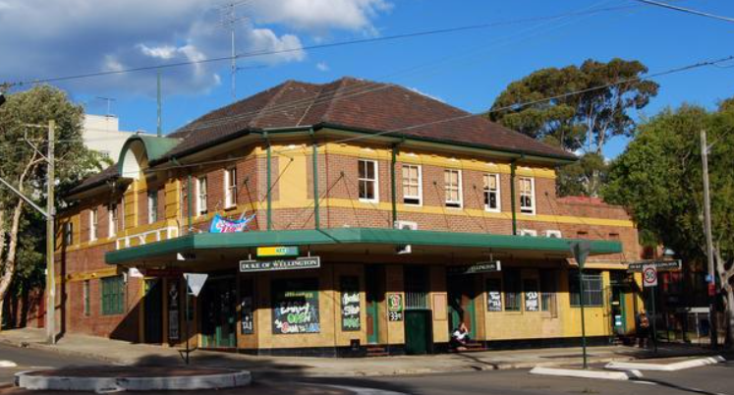
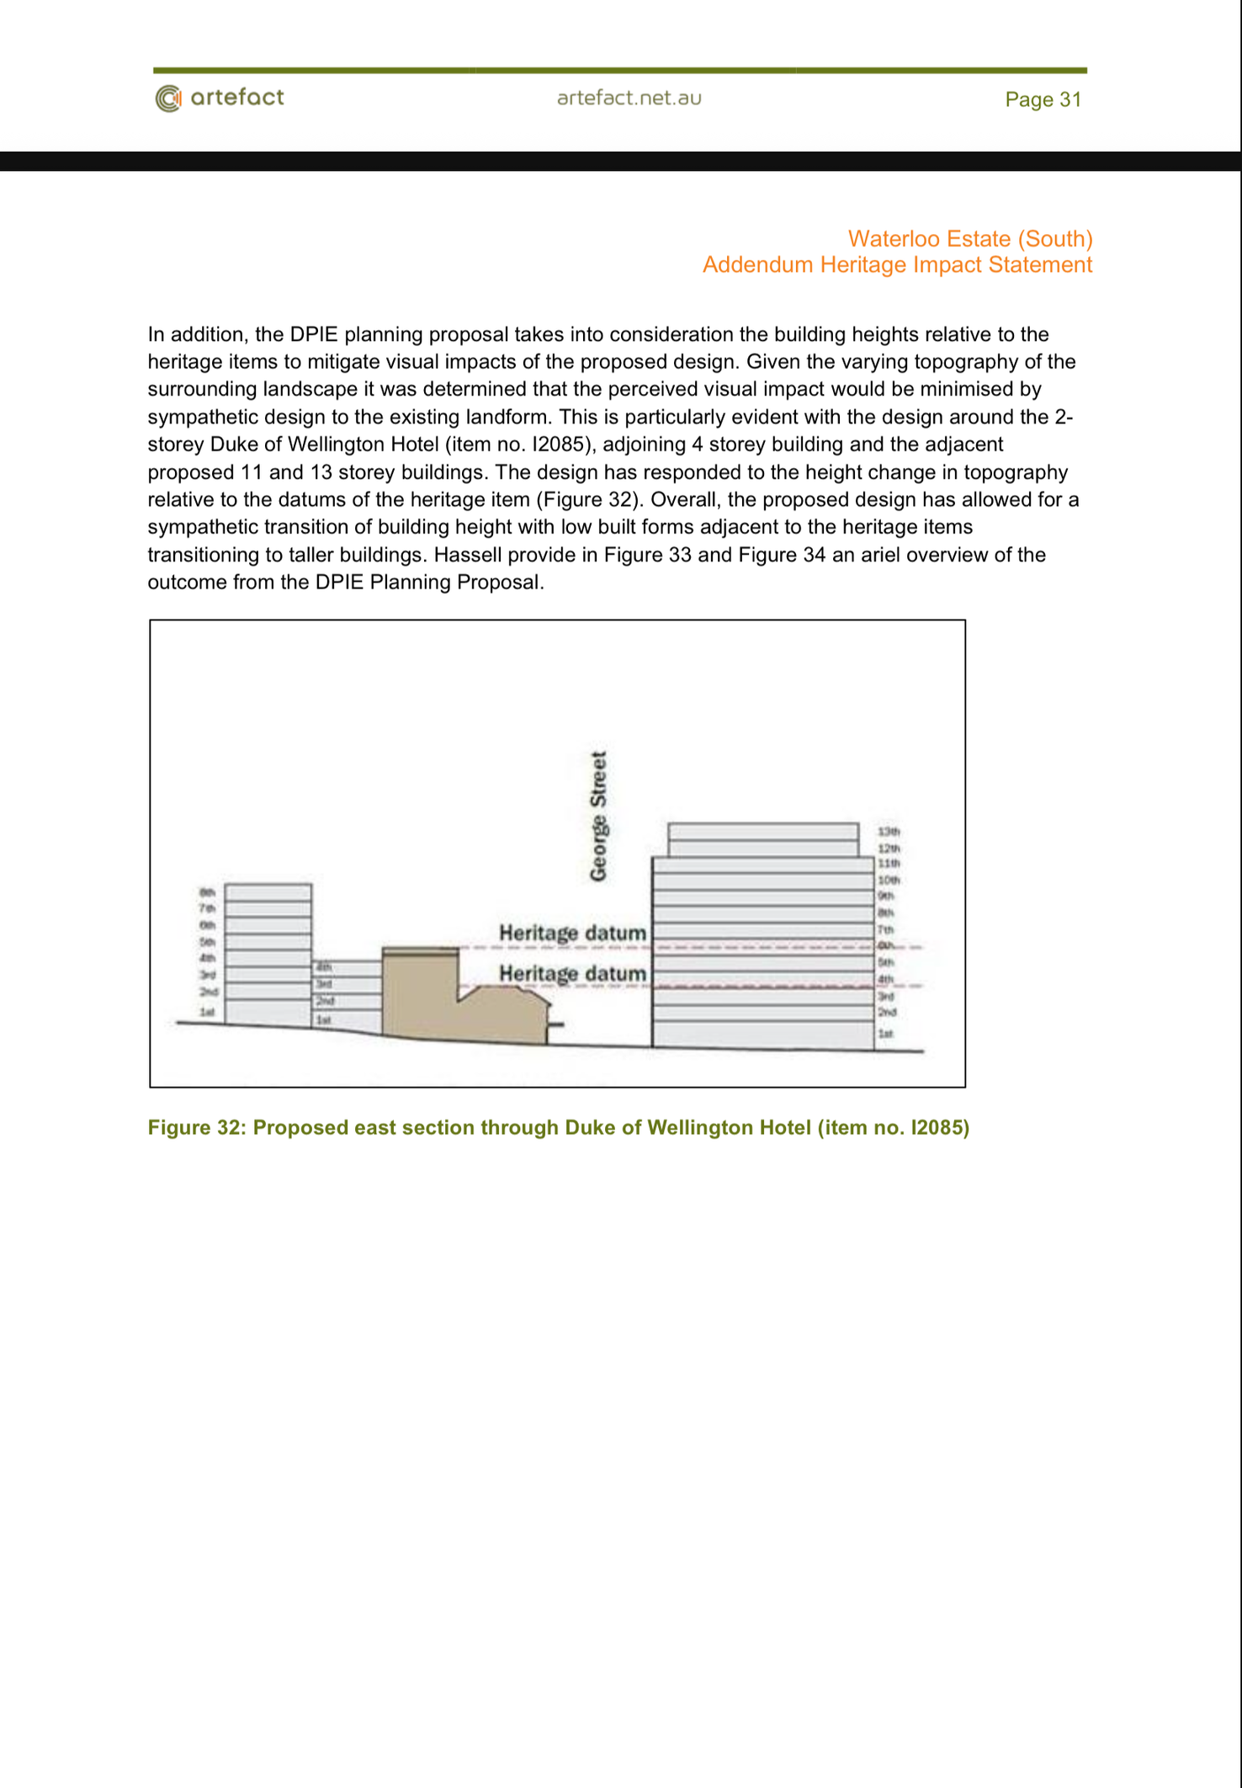
Heritage
Interface
Local Condition
  There are numerous heritage buildings on and around the site, including the Duke of Wellington Hotel, the former Waterloo Pre-school, and Gordon Terraces
Challenges
  Tall buildings may create visual impact
  Risk of overshadowing heritage areas
Planning Controls and Design Responses
  Height Transition: Height buffers applied around heritage buildings; limited to 2–6 storeys near Cope Street terraces to avoid overshadowing historic structures.
  Setbacks and View Protection: View corridors to Waterloo Park and the church preserved; topography used to reduce skyline impacts.
  Potts Hill Pressure Tunnel: Detailed geotechnical surveys required to protect the 15–67m-deep state heritage tunnel during excavation.

Slide 26
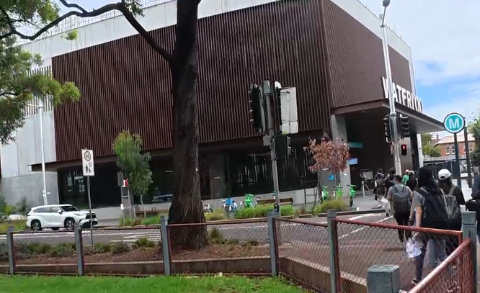
Transit-Oriented Development ＆Market Pressure
Specific Challenges
  Metro Station Catalytic Effect: The new Waterloo Metro Station has significantly increased land values, generating intense development pressure.
  Market Viability: The need to sell portions of land to private developers to secure funding may lead to gentrification, driving up living costs in the surrounding area.
Planning Controls and Design Responses
  Intensive Mixed-Use Development: High-density commercial/retail around the metro station; George Street as the main high street to maintain activity off-peak.
  Fine-Grained Block Division: Large sites subdivided into small plots; multiple architects to avoid developer monopoly and deliver diverse street frontages.
  Parking Restrictions: Substantial parking reduction near the station to promote public transport; vehicle access moved to secondary streets for better pedestrian experience.

Slide 27
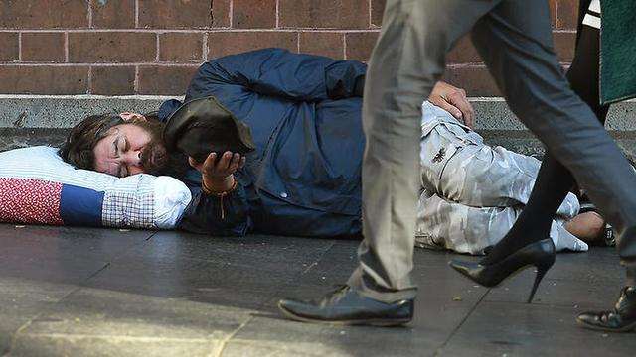
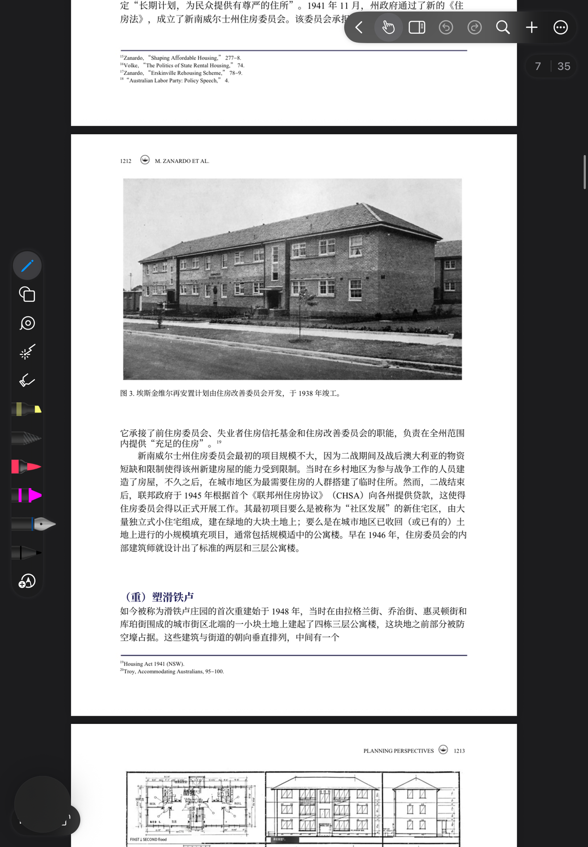
Social Housing Concentration ＆ Displacement
Specific Challenges
  Sensitive Demographics: Long-term elderly, low-income and Indigenous residents with tight community bonds.
  Stigmatization: Old public housing labeled outdated/ problematic to push demolition & redevelopment.
  Tenant Rights: Protect existing tenants from permanent displacement during renewal.
Planning Controls and Design Responses
  Communities Plus Policy: Net increase in social housing, 20% affordable housing guaranteed.
  Culturally Appropriate Housing: Custom homes for Indigenous residents, with Indigenous architects involved.
  Community Facilities First: 2+ hectares of parks, centres & health services built alongside housing.

Slide 28
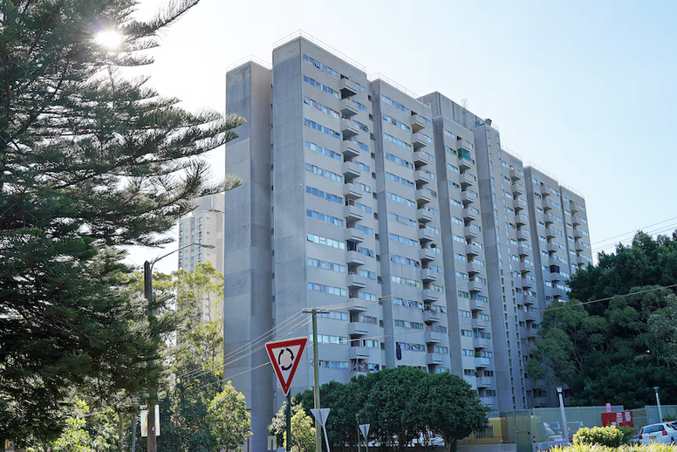
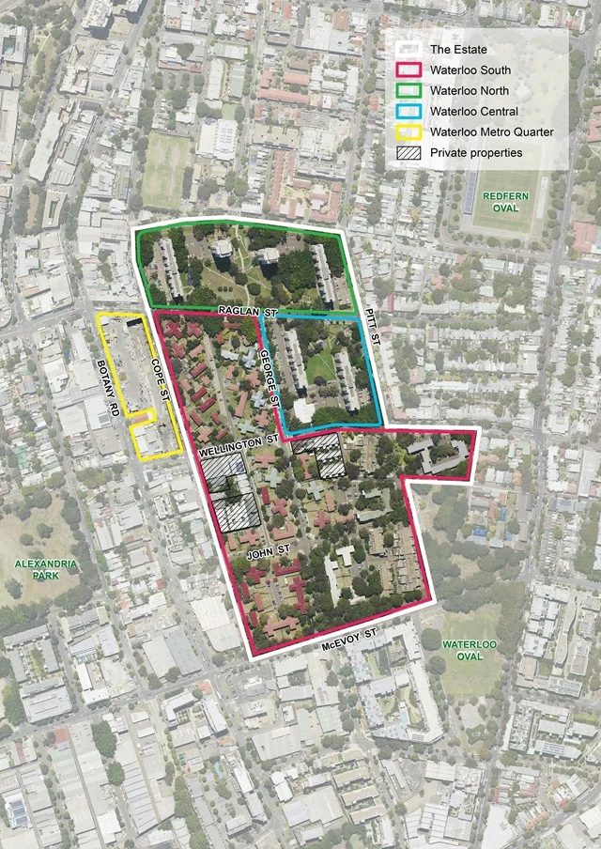
Outcomes and
Future Potential

Slide 29

Evaluation Framework
  DOES URBAN RENEWAL MAINTAIN SOCIAL INCLUSIVENESS?
  DOES THE PROJECT SUPPORT SUSTAINABLE DEVELOPMENT?
  DOES THE PROJECT ENHANCE URBAN FUNCTIONALITY?
Key Dimensions | Core Issue
Equity | · housing rights of low-income groups · proportion of social housing · relocation of original residents
Sustainability | · Land use efficiency · Housing supply · Transit-oriented development
Urban Integration | · Integrate with the urban transportation system · New public spaces · Quality of urban environment

Slide 30
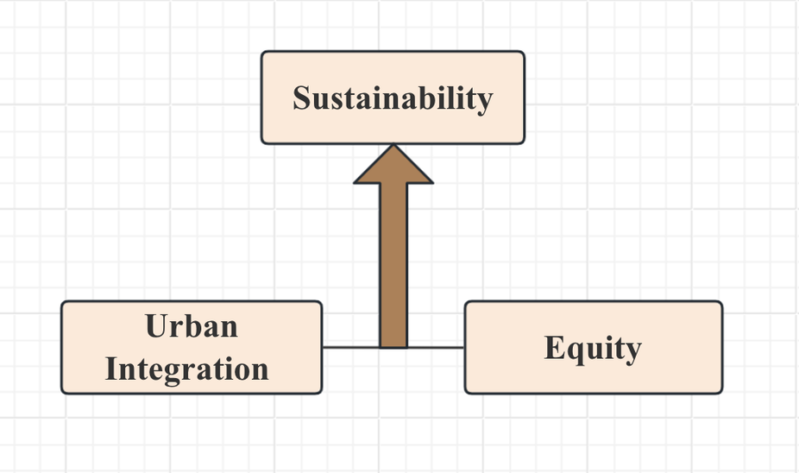
03/13
Project Outcomes
The Waterloo South update project has achieved notable results, but it also faces certain challenges.
Urban Integration
Sustainability
Equity
· The project has a good connection with Waterloo Metro Station.
· Provide new public spaces and pedestrian-friendly environments .
· Improve the quality of regional urban design.
· Higher-density development enhances land utilization efficiency.
·
· Closer to public transportation.
· Reduce reliance on private cars.
• Some existing buildings still meet basic living standards.
• Good natural lighting and ventilation.
Controversies：
· Residential relocation.
· Breakdown of community relations.
· Social housing has decreased.

Slide 31
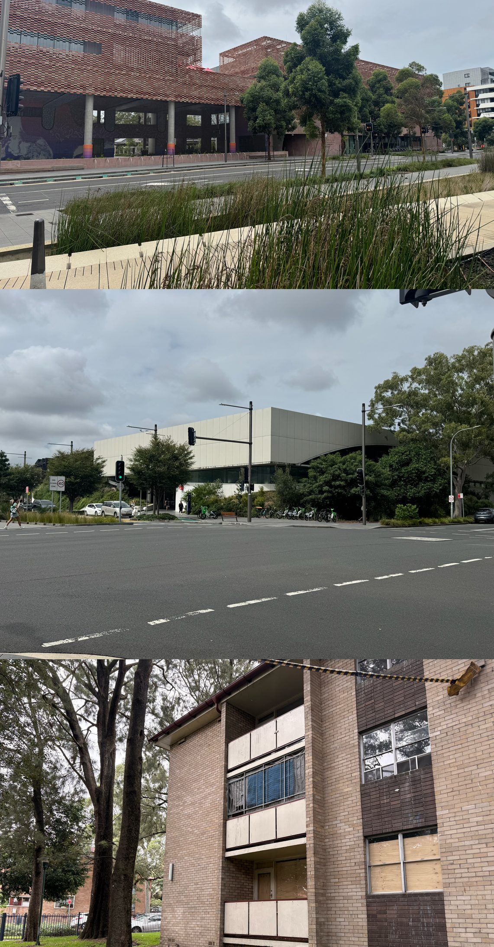
Future Potential
Improvement #1
Retain and upgrade the existing housing.
Improvement #2
Strengthen residents' participation.
· Increase community participation
· Provide a more transparent decision-making process.
Improvement #3
Achieve a more equitable housing structure .
· Increase the proportion of social housing
· Provide more affordable housing

Slide 32
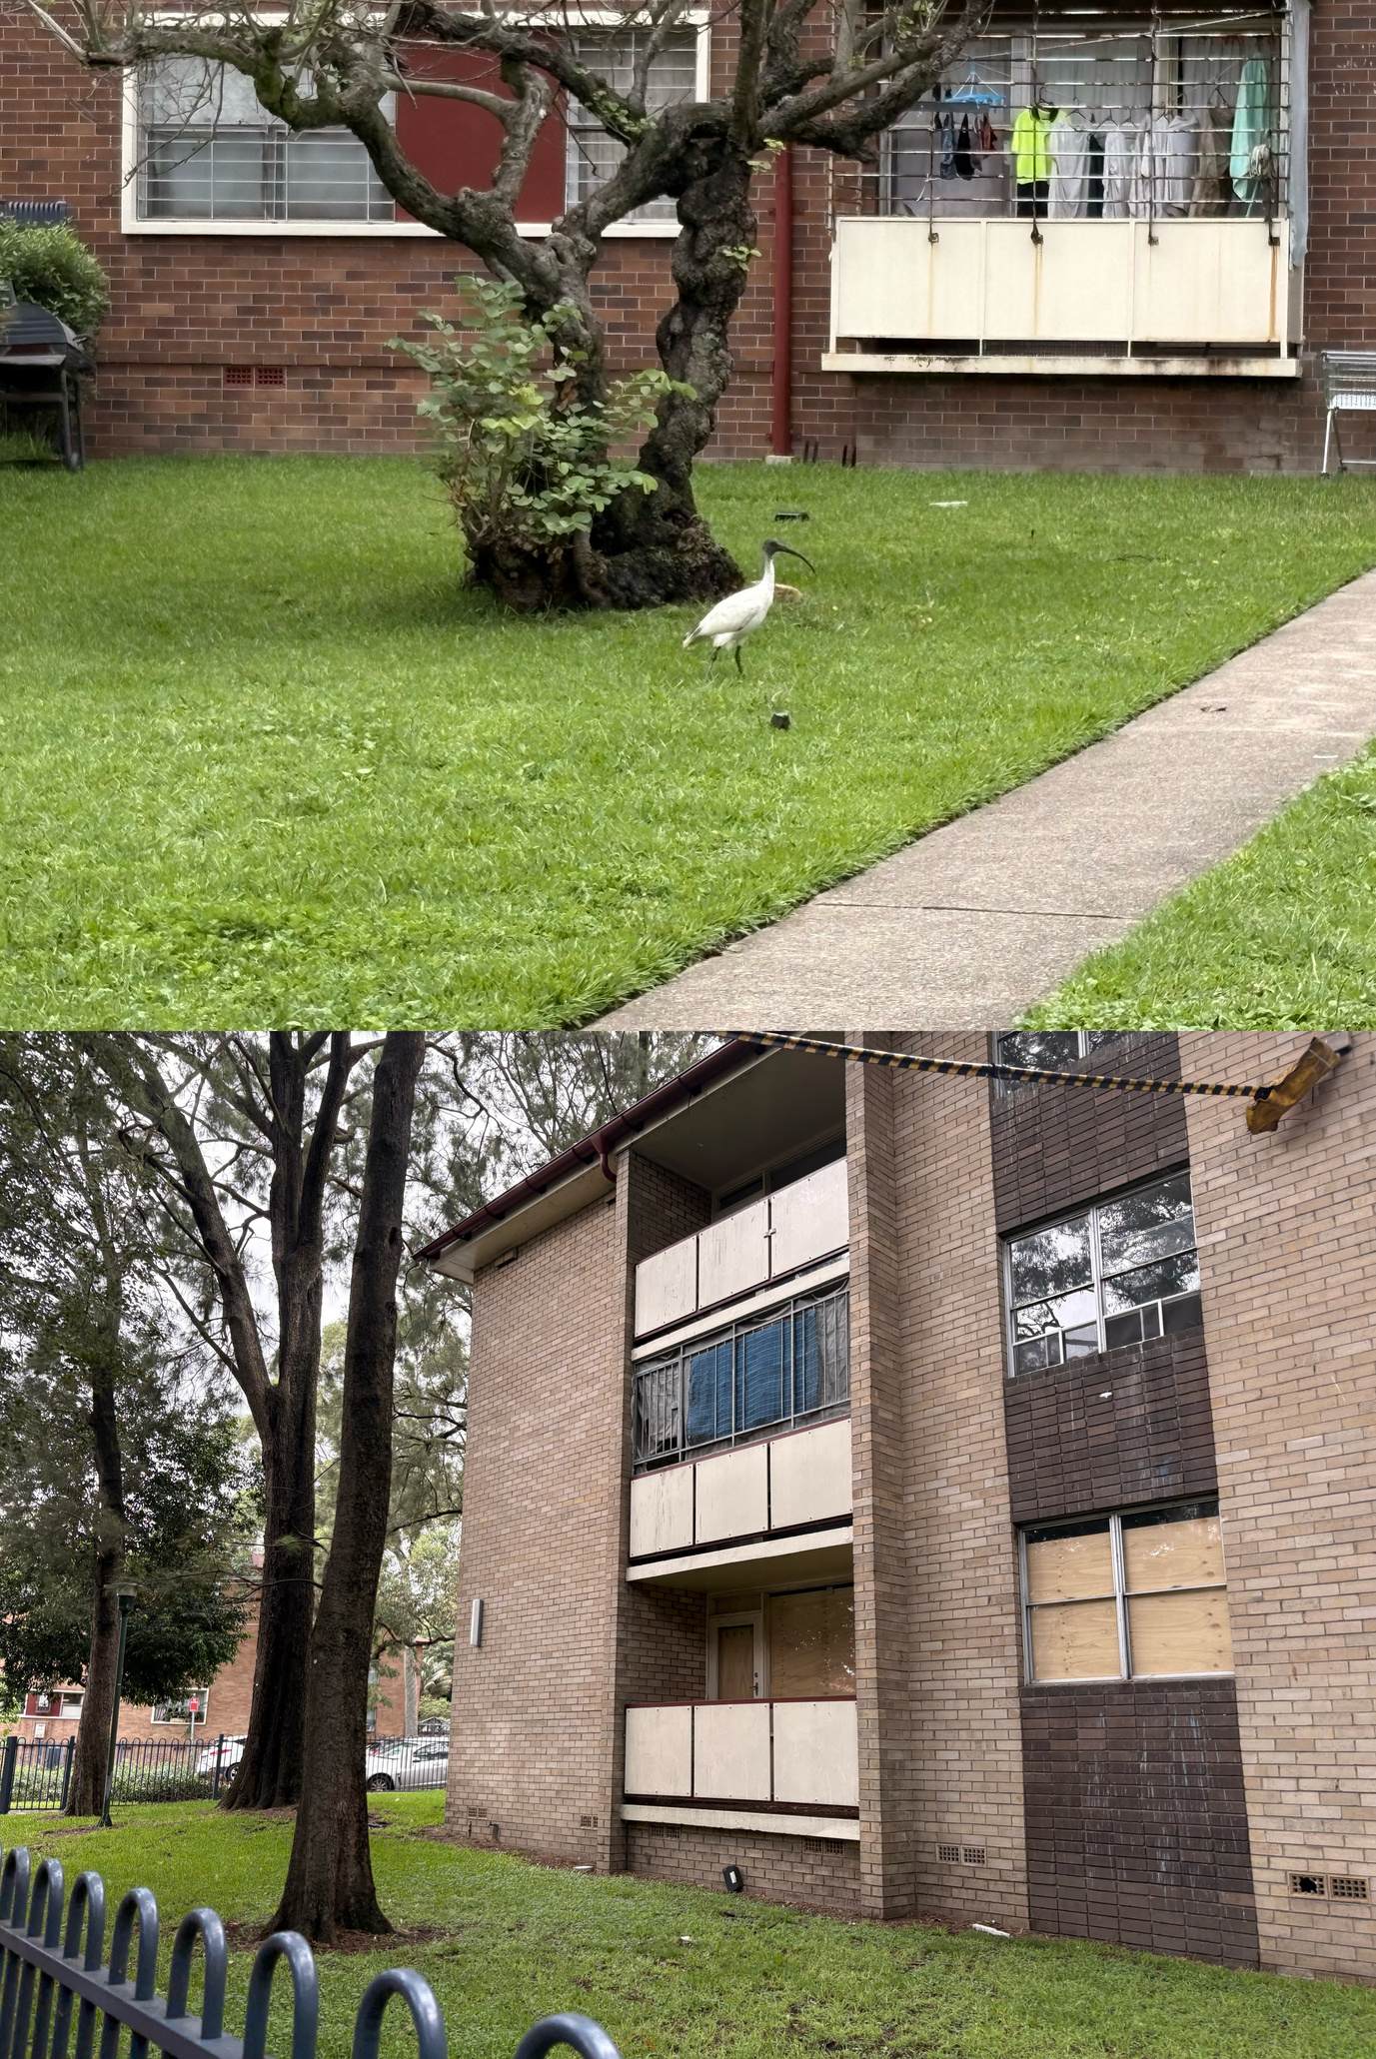
Conclusion
• Large-scale urban renewal transforming ageing public housing estates
• Influenced by historical development, governance challenges, planning policies, and site conditions
• Aims to improve housing quality, housing supply, and mixed-income communities
• Supported by transit-oriented development and enhanced public spaces
• Key challenge: balancing urban growth, social equity, and community stability
• Long-term success depends on inclusive governance, community participation, and liveable urban environments
Source: Zanardo, M., Sisson, A., Logan, C., & McLaughlan, R. (2024). Wilful ignorance at Waterloo: public housing quality and political stigma in Sydney’s largest estate renewal. Planning Perspectives, 39(6), 1207–1239.

Slide 33
References:
  Artefact Heritage Services. (2021). Gateway required study: Addendum to heritage impact assessment – Waterloo Estate (South).
  Artefact Heritage Services. (2021). Waterloo Estate (South): Addendum heritage impact statement.
  City of Sydney & NSW Government. (n.d.). Waterloo renewal: Concept plan.
  https://www.waterloorenewal.com.au
  NSW Department of Planning and Environment. (2022). Waterloo Estate (South): Design guide.
  Pawson, H., Pinnegar, S., & Wiesel, I. (2018). Regenerating Australia’s public housing estates. In K. Ruming (Ed.), Urban regeneration in Australia: Policies, processes and projects of contemporary urban change (pp. 243–260). Routledge.
  Ruming, K. (Ed.). (2018). Urban regeneration in Australia: Policies, processes and projects of contemporary urban change. Routledge.
  Sydney Metro. (n.d.). Waterloo integrated station development community brochure.
  Transport for NSW. (2020). Waterloo metro station precinct planning documentation.
  Zanardo, M., Sisson, A., Logan, C., & McLaughlan, R. (2024). Wilful ignorance at Waterloo: Public housing quality and political stigma in Sydney’s largest estate renewal. Planning Perspectives, 39(6), 1207–1239. https://doi.org/10.1080/02665433.2024.2337268
  Hassell. (2020). Waterloo South planning proposal urban design review.

Slide 34
Thank you！

