Slide 1
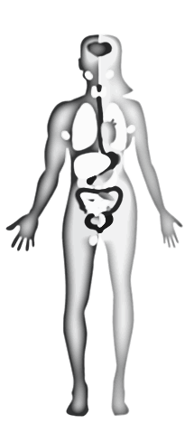
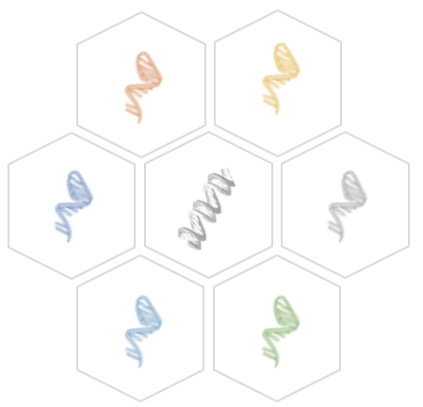
Transcript-centric analysis and REOs-based analysis
Dr. Xiangyu Li
KTH-Royal Institute of Technology
http://sysmedicine.com

Slide 2
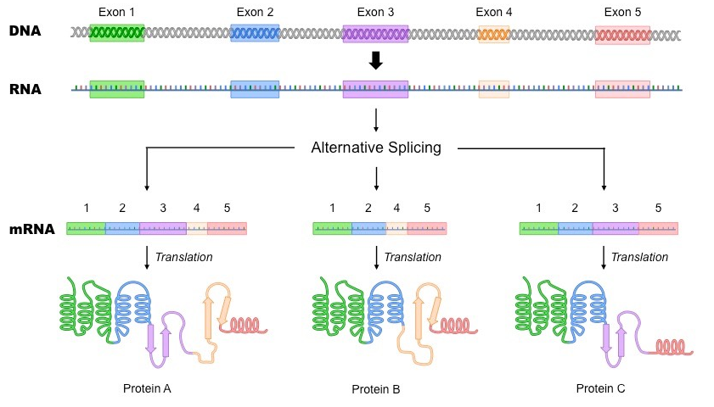
Where the transcripts come from?
Intron
Pre-mRNA

Slide 3
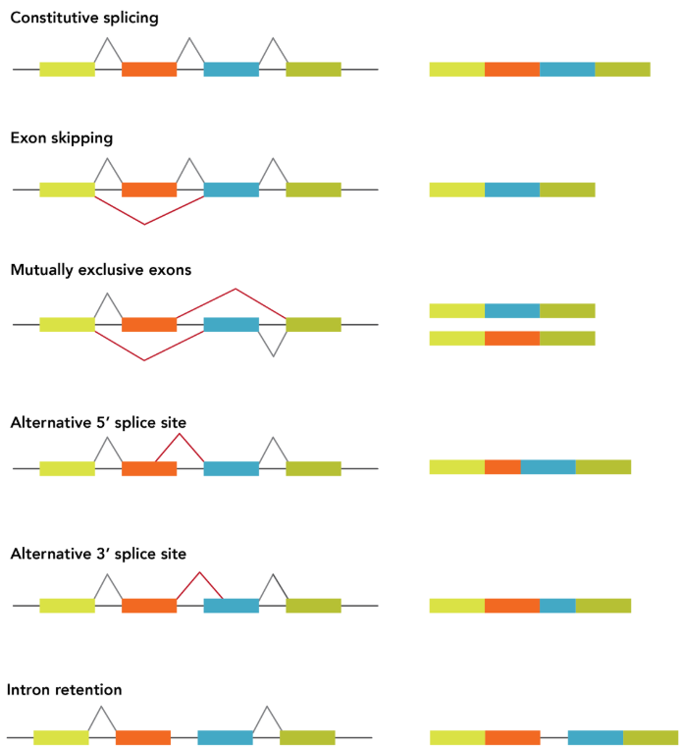
Patterns of alternative splicing

Slide 4
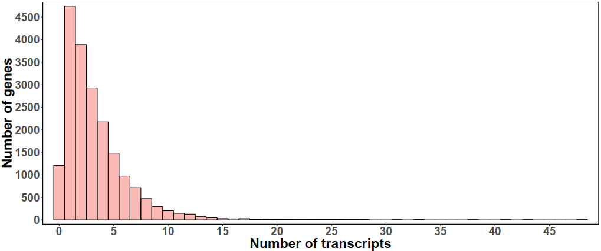
HPA 37 different human tissues
(Ensembl V92)
Protein coding genes: 19628
Protein coding transcripts: 82221
More than 13,000 genes have at least two transcripts with TPM>1
Transcripts expression level (TPM) >1 in at least one human tissue

Slide 5
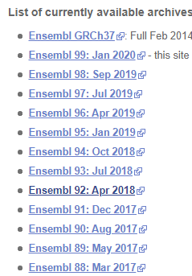
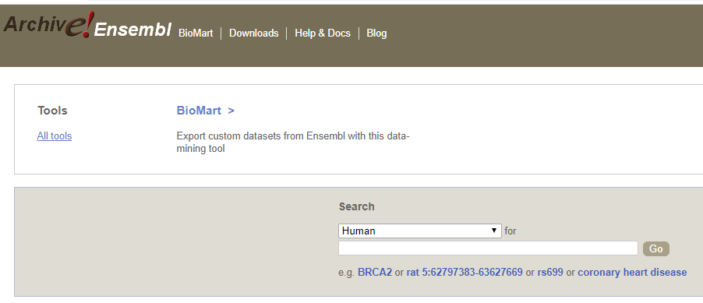
Ensembl website
Ensembl is a genome browser for vertebrate genomes that supports research in comparative genomics, sequence variation and transcriptional regulation.
https://www.ensembl.org/info/website/archives/index.html

Slide 6
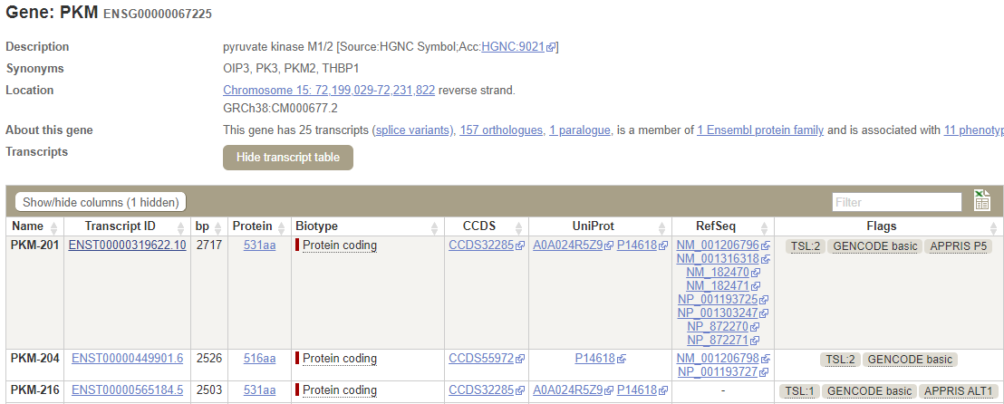
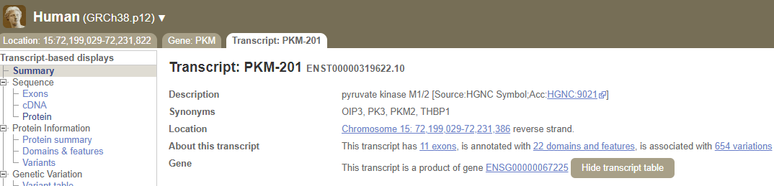
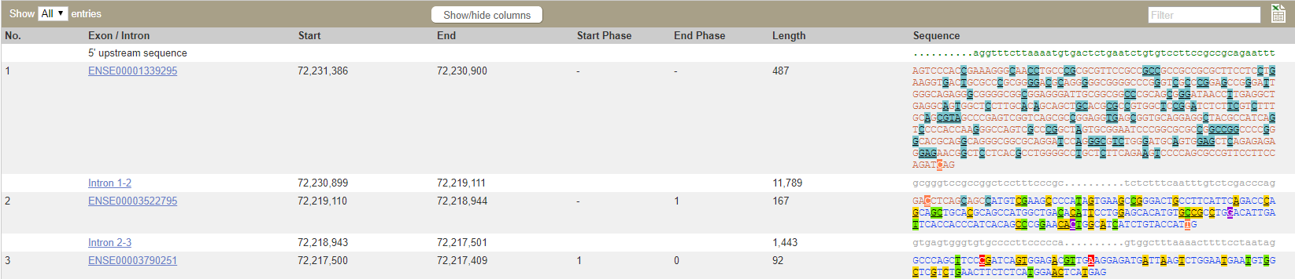

Slide 7
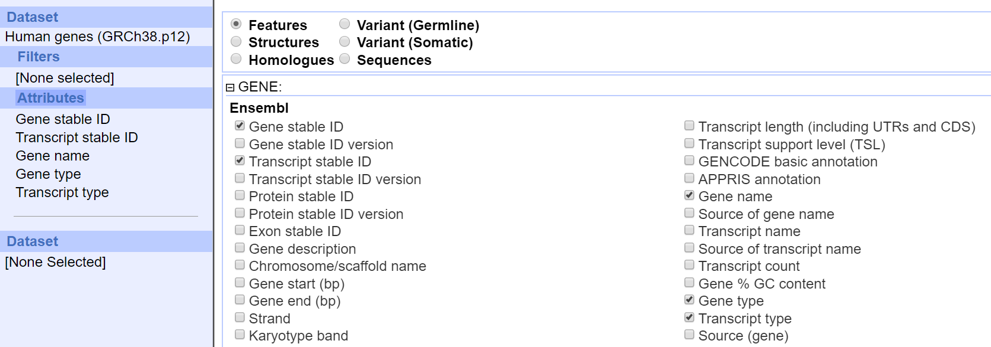
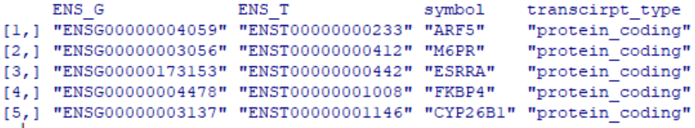
Download all transcripts information in bulk
BioMart tool

Slide 8
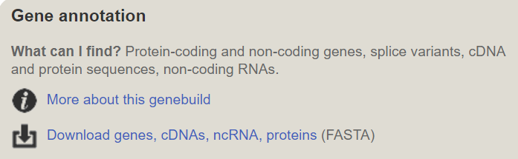
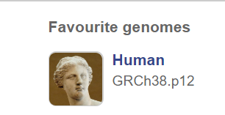
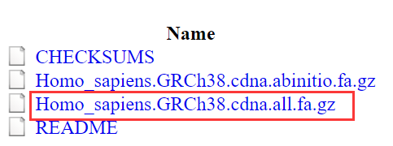
Download reference genome file

Slide 9
RNA-seq: Quantification of transcript abundance
Kallisto
Salmon
cufflinks
RSEM

Slide 10
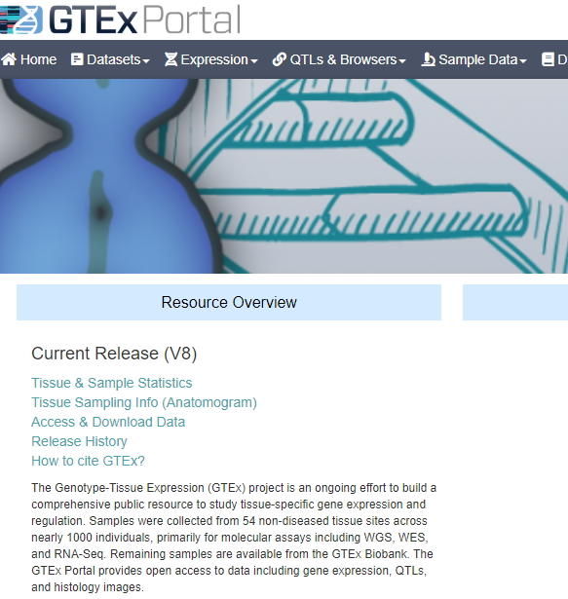

Human tissue databases
The Genotype-Tissue Expression project (GTEx)
31 human normal tissues
https://www.gtexportal.org/home/
Kallisto quantification:
https://xenabrowser.net/datapages/?hub=https://toil.xenahubs.net:443

Slide 11
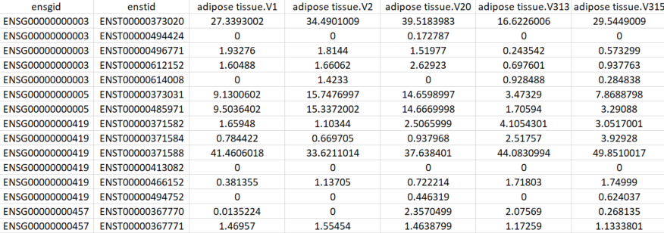
Gene ID
Transcript ID

Slide 12
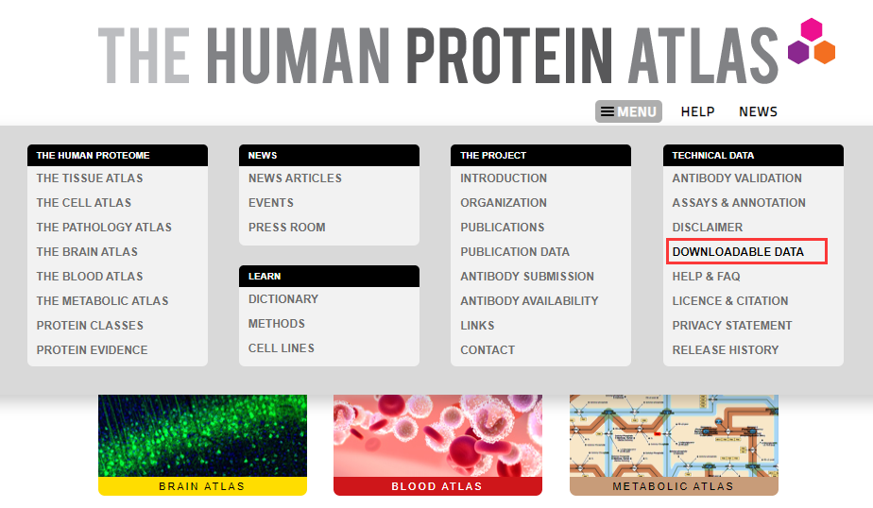
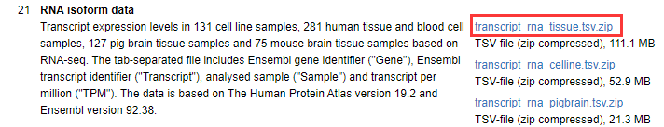
Human protein atlas (HPA)
37 human normal tissues
https://www.proteinatlas.org/

Slide 13
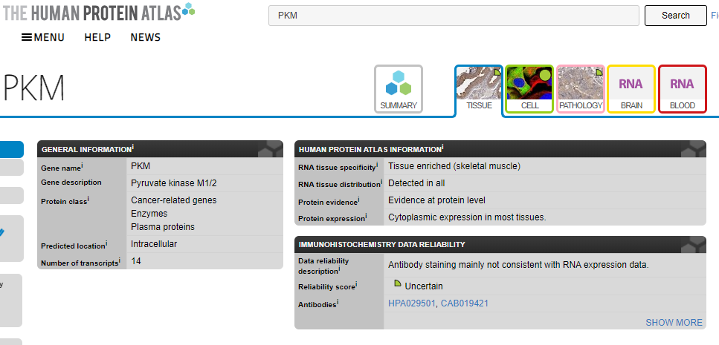
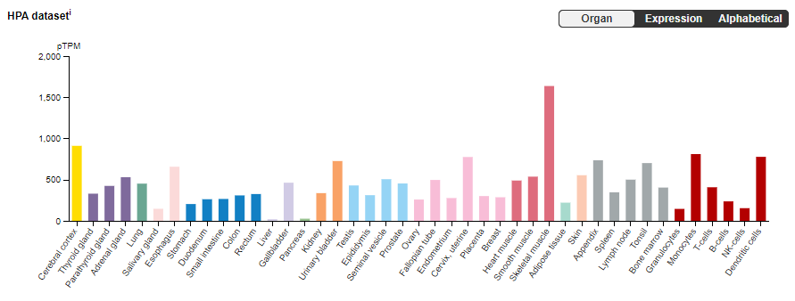
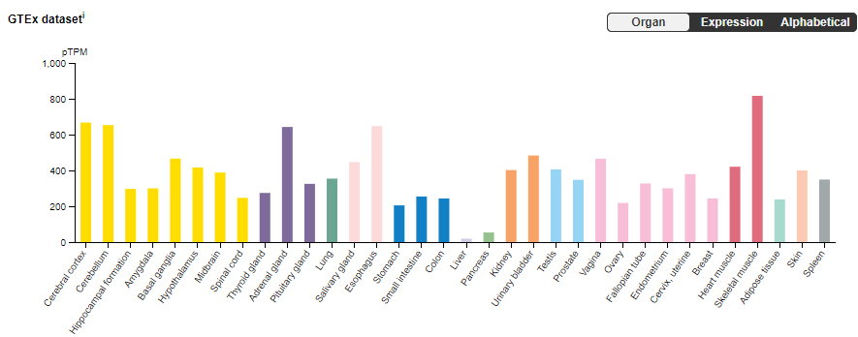

Slide 14
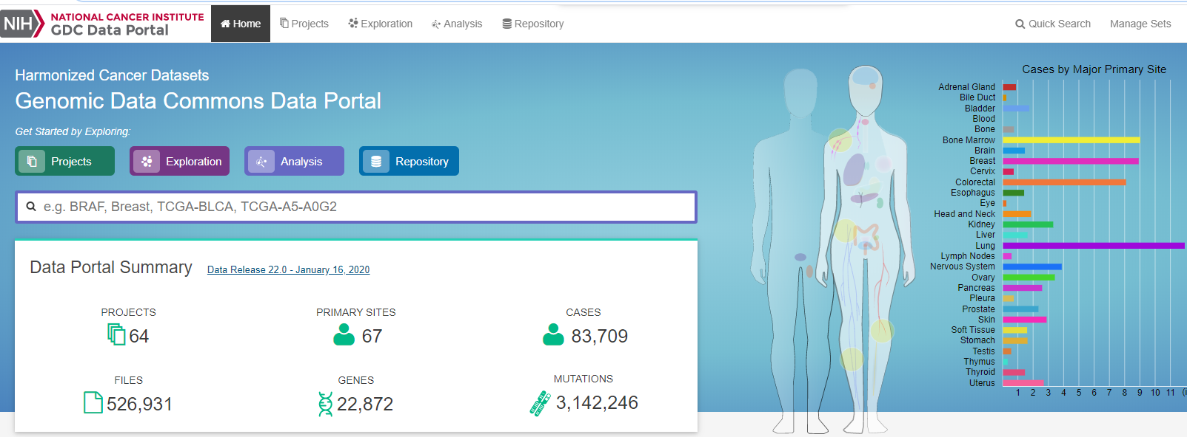
The Cancer Genome Atlas Program (TCGA)
33 human cancer tissues
Multi-omics: https://portal.gdc.cancer.gov/
Somatic mutation, DNA methylation, copy number, mRNA, miRNA, protein
Quickly download: R package TCGAbiolinks
Transcript-level data:
https://xenabrowser.net/datapages/?hub=https://toil.xenahubs.net:443 or https://osf.io/gqrz9/

Slide 15
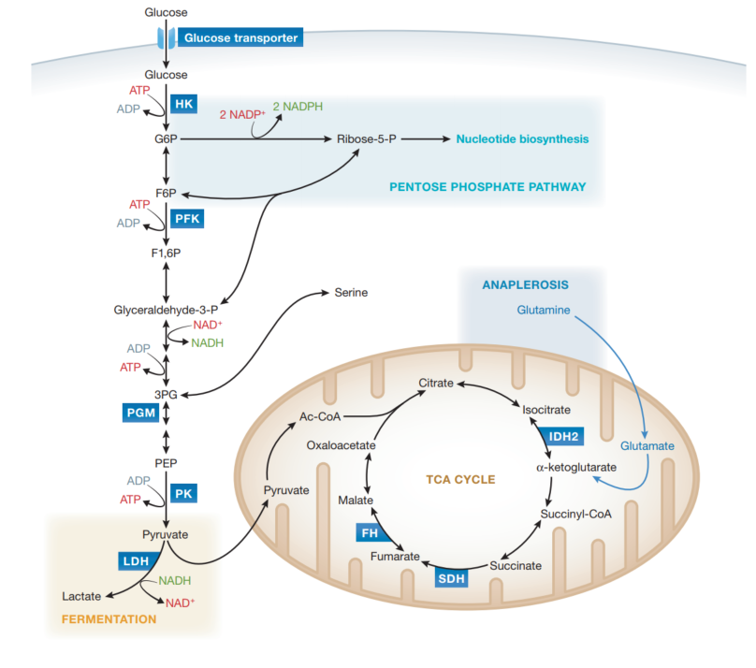
Discovery of functional alternatively spliced PKM transcripts in human cancers
PKM

Slide 16
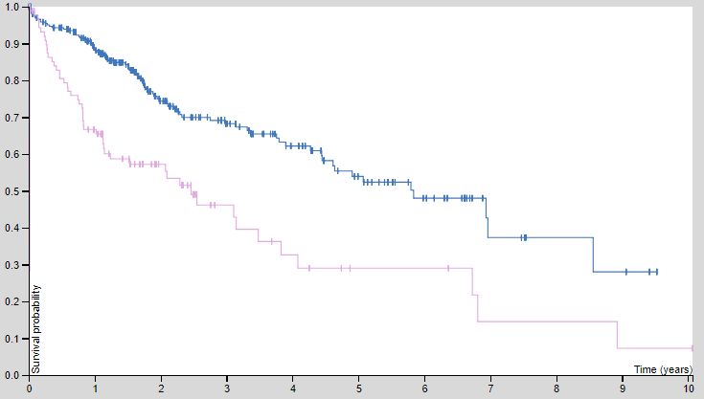
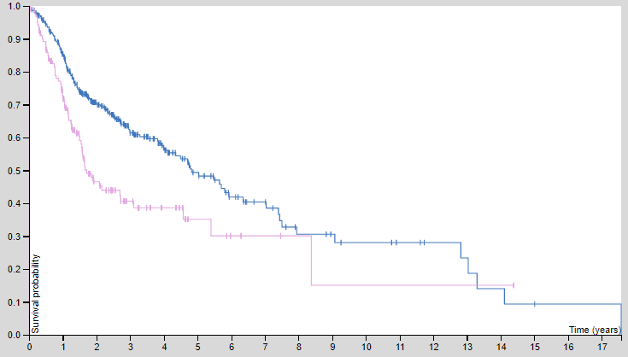


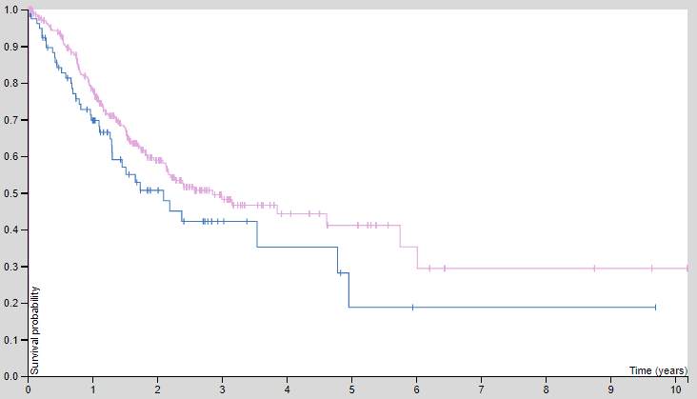
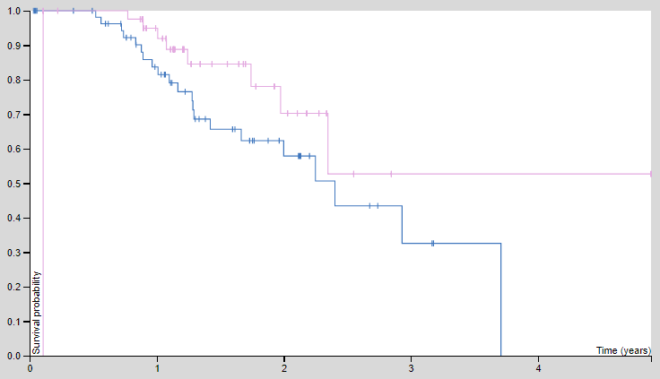


Survival analysis (PKM gene level)
Liver cancer
Head and neck cancer
P=0.0000027
P=0.00013
Stomach cancer
Melanoma
P=0.078
P=0.095

Slide 17
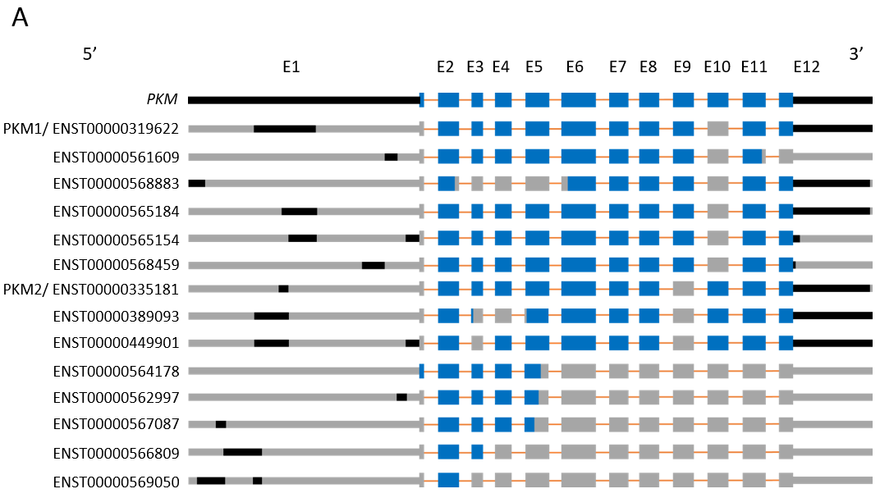
Exon-intron structures of PKM transcripts

Slide 18
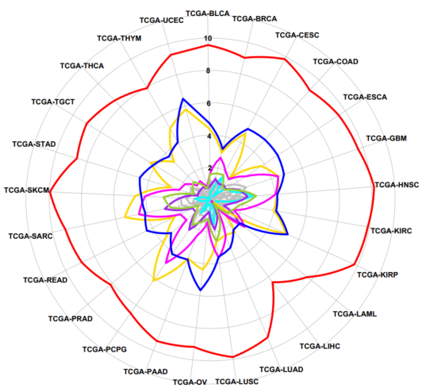
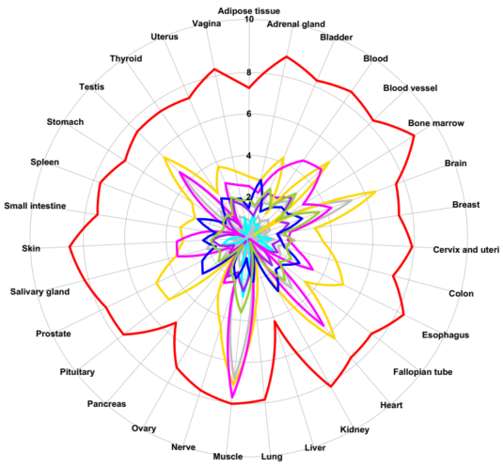
Expression levels of PKM transcripts
25 tumor tissues
31 normal tissues

Slide 19
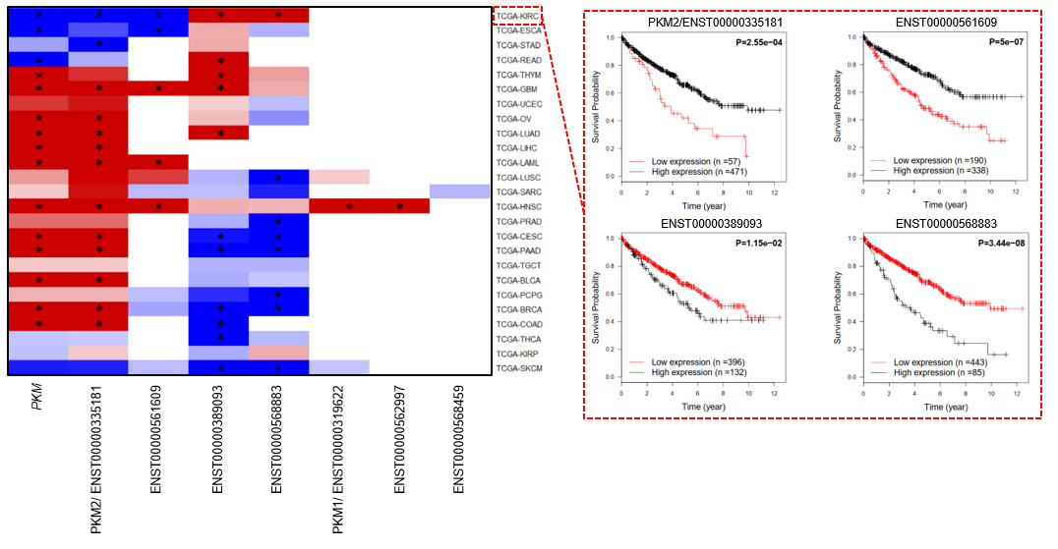
Prognostic analysis of PKM transcrips
-1
-0.5
0
0.5
1

Slide 20
Functional analysis for each transcript
PKM2/ ENST00000335181
ENST00000561609
Down-regulation
Up-regulation
Down-regulation
Up-regulation
ENST00000389093
ENST00000568883
Down-regulation
Up-regulation
Down-regulation
Up-regulation

Slide 21
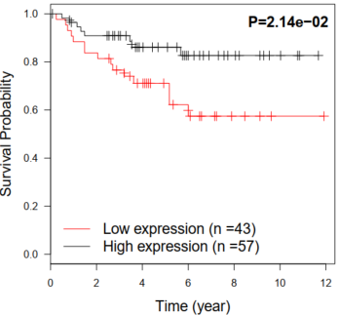
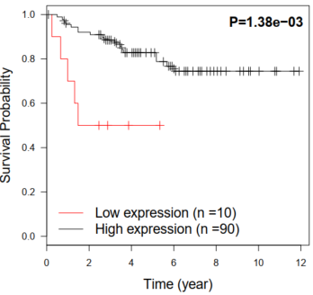
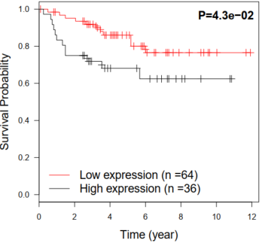
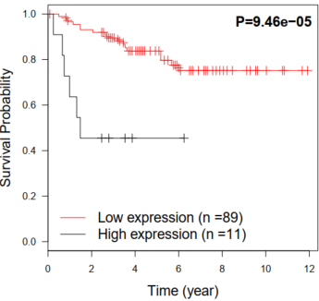
Validation of prognostic transcripts
PKM2/ ENST00000335181
ENST00000561609
ENST00000389093
ENST00000568883

Slide 22

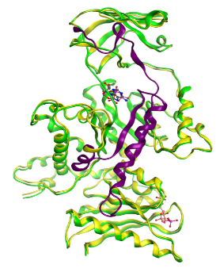
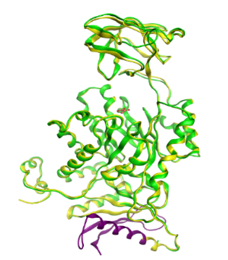
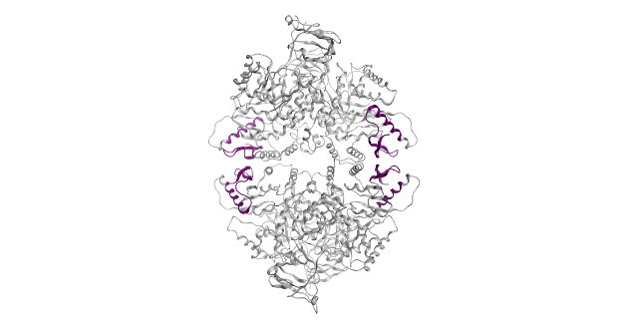
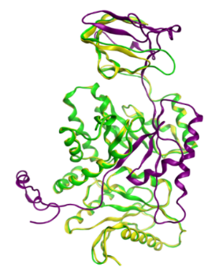
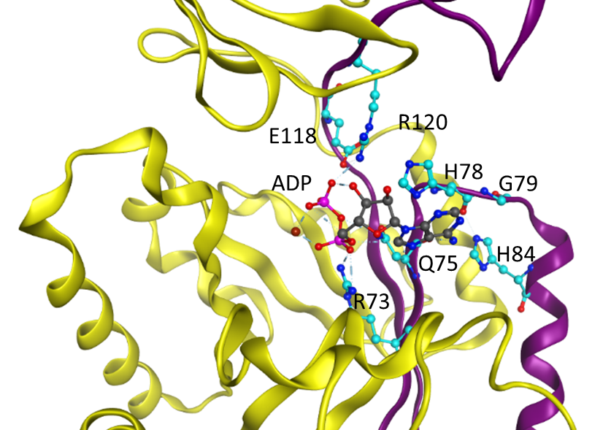
Predicted structure of protein products
K270: active site
K433: FBP binding site
1
44
116
218
389
531
ENST00000335181(PKM2)
N
A1
B
A2
C
57.9 kDa
ENST00000319622(PKM1)
58.1 kDa
ENST00000561609
53.0 kDa
ENST00000389093
49.9 kDa
ENST00000568883
40.2 kDa
243
531
ENST00000389093
ENST00000561609
ENST00000568883
B domain
ADP
C-C
A domain
FBP
N-terminal
A-A
C domain

Slide 23
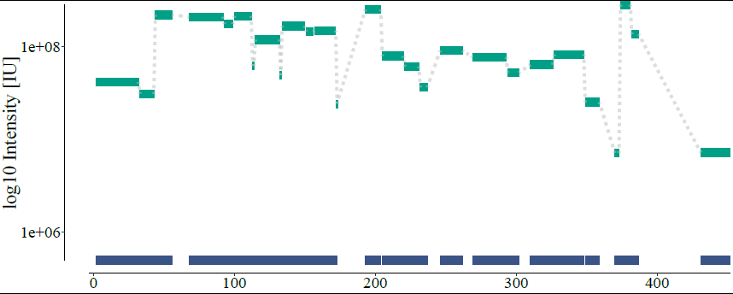
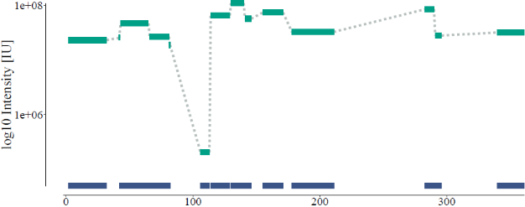
Protein products in human cells
Whole lysate
Cytosolic protein
Nuclear protein
PC3
RWPE-1
MRC5
PC3
RWPE-1
MRC5
PC3
RWPE-1
MRC5
PKM(58 kDa)
ENST00000389093(49 kDa)
ENST00000568883(40 kDa)
PC3
RWPE-1
MRC-5
siPKM #A
siPKM #A
siPKM #A
siPKM #B
siPKM #B
siPKM #B
siCont.
siPKM #C
siCont.
siPKM #C
siCont.
siPKM #C
PKM(58 kDa)
ENST00000389093(49 kDa)
ENST00000568883(40 kDa)
α-tubulin
ENST00000389093
ENST00000568883

Slide 24
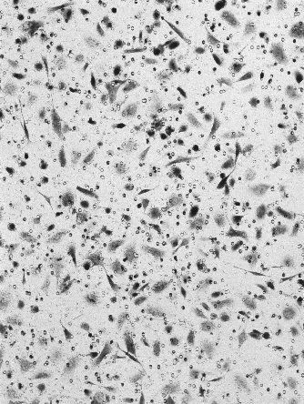
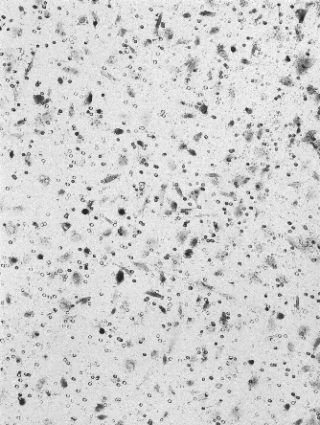
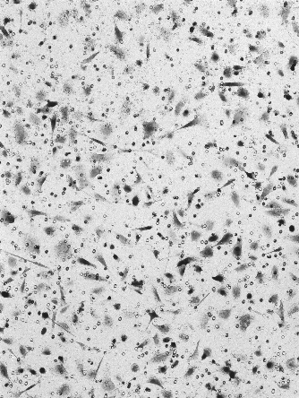
Biological effect of PKM transcript
PC3 transfection
ENST00000568883
ENST00000389093
pCMV6KN
50KDa
30KDa
*
Empty vector
ENST00000389093
ENST00000568883
*

Slide 25
*
*
*
*
*
*
*

Slide 26
Conclusion
Identify the associated biological functions of the transcripts of PKM
Validate their prognostic effect in an independent KIRC cohort
Show the protein products of two novel transcripts of PKM for the first time
Demonstrate these proteins play key roles in glycose and lipid metabolism, invasion, hypoxia and apoptosis

Slide 27

REOs-based analysis of gene expression profiles
Applicaiton of gene expression profiles
Risk-score-based biomarker (prognosis, drug benefit...)
Differentially expressed genes
Clustering analysis
Correlation analysis
Repeatable
...

Slide 28
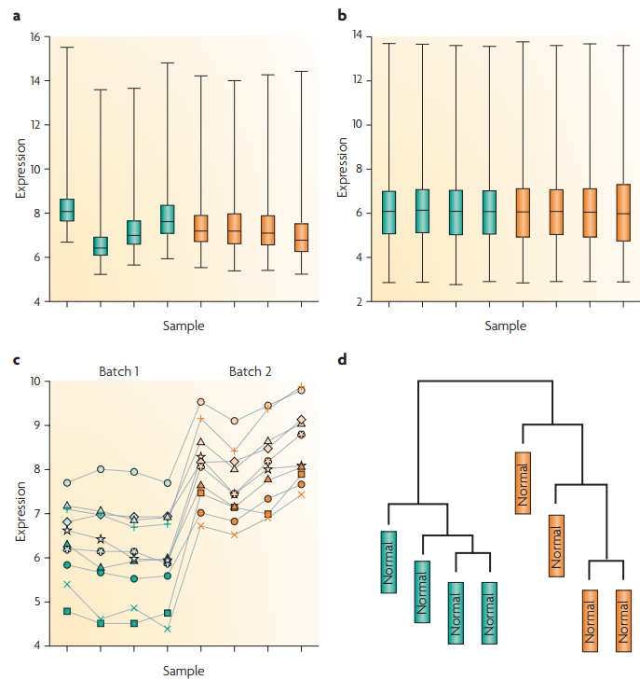
Batch effect
Reagent lots
Handlers
High-throughput data
Lab conditions
Notes:
Bladder sample

Slide 29
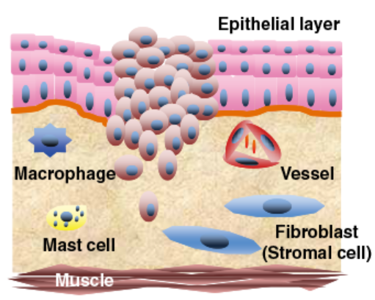
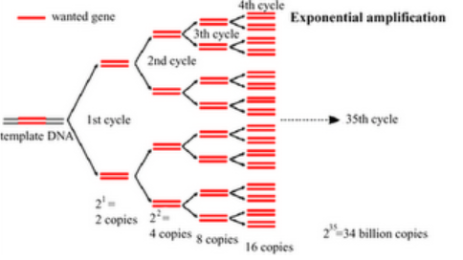
Poor quality of clinical samples
Tumor cell
Different proportions of tumor epithelial cells within different
sites for the same tumor tissue
RNA degradation during sample preparation and storage
Amplification bias for low-input samples
Formalin-fixed paraffin-embedded (FFPE) samples
VS
Fresh-frozen (FF) samples

Slide 30
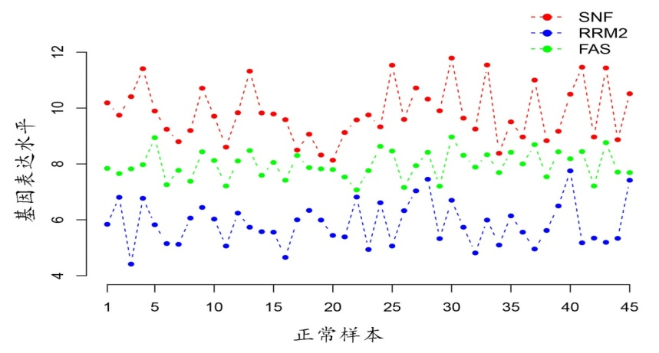

Relative expression orderings (REOs) of genes
REO patterns :
SNF > RRM2
SNF > FAS
FAS > RRM2
REO of gene A and B
G_{A}>G_{B}
Or
G_{A}<G_{B}
Log-intensity
Normal samples
Dataset 1
Dataset 2
Dataset 3
Dataset 4
Log-intensity

Slide 31
Advantages of REOs
Be insensitive to batch effect
Be invariant to monotonic data normalization
Be highly robust against the proportion variations of tumor cells, partial RNA degradation and amplification bias

Slide 32
Finding
The REOs of gene pairs are overall stable in one state of a particular type of human tissue (e.g. normal samples) but widely disturbed in another state (e.g. disease samples).
Normal samples
Dataset 1
Dataset 2
Dataset 3
Dataset 4
Log-intensity
Normal samples
Cancer samples
Dataset 1
Dataset 2
Dataset 3
Dataset 4
Log-intensity
Cancer samples

Slide 33




Application Ⅰ : Prognostic biomarker for KIRC
Go term analysis of 539 genes:
RNA splicing
RNA catabolic process
nuclear transport

Slide 34




Biomarker training and validation
Final biomarker
High-risk patients:
ATP synthesis
Mitochondrial respiratory
Oxidative phosphorylation
Ribonucleotide and purine nucleotide metabolic process
Low-risk patients;
Histone modification
Chromatin modification

Slide 35
Q1: What are these marker gene pairs?

Slide 36
RP9 plays an important role in pre-mRNA splicing and could interact with well-known oncogene PIM-1 (Maita et al., 2000).
MYO9A serves as a potent promoter in progression and metastasis of cancers of epithelial origin (Friedl and Gilmour, 2009; Ouderkirk and Krendel, 2014).
GADD45GIP1, also known as CRIF1, encodes a nuclear-localized protein that may be induced by TP53 and regulates cell cycle.
CRIF1 is a novel transcriptional coactivator of STAT3 which is a well-known oncogene in multiple human cancers (Kwon et al., 2008).
SNRNP200 encodes a component of U5 snRNP-specific proteins of spliceosome.
It has been shown that overexpression of SNRNP200 was associated with tumor aggressiveness in prostate cancer (Jimenez-Vacas et al., 2020).
PIK3CB is involved in the PI3K signaling pathway which is frequently dysregulated in cancer.
Inhibition of PIK3CB remarkably suppressed cell growth, migration and enhanced apoptosis in glioblastoma (Cen et al., 2018; Pridham et al., 2018).

Slide 37
Q2: Is REOs-based biomarker really promising or feasible in clinical practice?

Slide 38
RNA-seq Real-time PCR
FDA-approved signatures:
AlloMap®: consisting of 20 genes, for estimating the risk of acute cellular rejection in heart transplant recipients (Starling et al., 2006).
Oncotype DX®: consisting 21 genes, for estimating the risk of distant recurrence in tamoxifen-treated patients with node-negative, estrogen-receptor-positive breast cancer (Paik et al., 2004).

Slide 39
Q3: why don’t use the prognostic transcripts as biomarker?

Slide 40

Comparison between different classification systems of KIRC

Slide 41

Drug repositioning
High-risk group:
paracetamol
nizatidine
dimethadione
conessine
Low-risk group:
chenodeoxycholic acid
fenoterol
hexylcaine

Slide 42
Application Ⅱ: Drug benefit biomarker for gastric cancer
5-Fluorouracil-based chemotherapy resistent predictive signature for gastric cancer and distinct multi-omics characteristics of prognostic groups
1. Uncertainty of drug resistance detection
Different tumor response metrics (WHO/RECIST/RECIST1.1)
Underestimate the effect of drugs
Deviation of SUV value of PET
2. Limitations of signature based on risk score

Slide 43

Development of biomarker

Slide 44

5-Fu resistant predictive biomarker
KCNE2
<
PRPF3
Resistance
KCNE2
API5
Resistance
For an individual patient
Count=2
Count<2
High-risk
Low-risk
A patient would be predicted to be resistant to 5-FU if and only if KCNE2 had lower expression level than both PRPF3 and API5.

Slide 45
Multi-omics characteristics
5-FU resistance group:
Spliceosome
Cell cycle
DNA replication
DNA repair
Mismatch repair
Nucleotide excision repair
Base excision repair
5-FU sensitive group:
Intestinal immune network for IgA production
Natural killer cell mediated cytotoxicity
T cell receptor signaling pathway
B cell receptor signaling pathway
Drug metabolism - cytochrome P450

Slide 46

Multi-omics characteristics
Copy number alterations
The 5-FU resistance patients have significantly higher frequencies of copy number gain at seven regions.
The 85 genes located in the seven regions displayed significant overexpression in the 5-FU resistance samples and were significantly enriched in the mismatch repair pathway.
In PPI network analysis, these genes with copy number gains mainly impacted the cell cycle, DNA repair and apoptosis pathways.

Slide 47

Multi-omics characteristics
Somatic mutation
Among the 156 genes whose mutation frequencies were significantly different between the 5-FU sensitivity and resistance groups, 155 gene had higher frequencies in the 5-FU sensitivity groups.
These 155 mutation genes were significantly enriched in Wnt signaling, Ras signaling and autophagy pathways.
In the PPI network analysis, these mutated genes mainly impacted the pyrimidine metabolism, DNA repair, cell cycle and apoptosis pathways.

Slide 48

Multi-omics characteristics
DNA methylation alternations
The downregulation of 400 genes were induced by hypermethylation in 5-FU resistant patients.
The 400 genes were significantly enriched in the cell adhesion pathway.
In the PPI network analysis, these genes mainly impacted the pyrimidine metabolism and folate metabolism pathways.

Slide 49




Aplication Ⅲ : Identify differentially expressed genes
Identification of differentially expressed genes (DEGs) in small-scale cell line experiments
Limitations of commonly used methods
Student’s t-test/ SAM: Insufficient statistical power
Fold Change (FC): Lack of statistical control and produce selection bias
Control-1
Control-2
Control-3
Case-1
Case-2
Case-3

Slide 50
Finding
The REOs of gene pairs are overall stable in a cell line but widely disturbed after a certain treatment.
Control cell line
Treated cell line
Gene D
>
Gene B
>
Gene C
>
Gene A
Gene A
>
Gene B
>
Gene C
>
Gene D
C₁ C₂ C₃ T₁ T₂ T₃

Slide 51

CellComp: step 1
Take gene g as an example.
G denotes the expression value of gene g.
Identify stable gene pairs including g in the state 1 and state 2.
REO comparison is limited to the overlapped gene pairs of the lists of stable gene pairs.

Slide 52

CellComp: step 2
G_{p} denotes the expression values of the partner genes of g.
m₁ and m₂ denote the numbers of gene pairs in which g shows a higher expression level than its partner genes in state 1 and state 2.
n₁ and n₂ denote the numbers of gene pairs in which g shows a lower expression level than its partner genes in state 1 and state 2.
The null hypothesis is that f₁ = f₂.

Slide 53
Dataset
Data accession | Cell line | Cancer type | Treatment | Size
GSE29084 | HepG2 | Liver cancer | HNF4A knockdown | 2 VS 2
GSE38581 | MKN45 | Gastric cancer | Hsa-miR-29c transfection | 2 VS 2
GSE38581 | MKN74 | Gastric cancer | Hsa-miR-29c transfection | 2 VS 2
GSE31450 | SNU638 | Gastric cancer | LAP2β transfection | 3 VS 3
E-MEXP-1691 | HCT116 | Colon cancer | 5-FU-treatment for 24h | 3 VS 3
GSE35004 | Hep3B | Liver cancer | YAP knockdown | 3 VS 3
GSE78167 | MCF7 | Breast cancer | Estrogen-treatment for 2h | 3 VS 3

Slide 54
Performance in simulated data
Sensitivity, specificity and F-score of DEGs identified by CellComp, RankComp, SAM, limma and RP for simulated data
FDR | Evaluation | HepG2 (2vs2) |  |  |  |  | SNU638 (3vs3)
 |  | CellComp | RankComp | SAM | limma | RP | CellComp | RankComp | SAM | limma | RP
1% | Sensitivity | 0.709 | 0.628 | 0 | 0.025 | 0 | 0.956 | 0.736 | 0.475 | 0.648 | 0
 | Specificity | 1 | 1 | 1 | 1 | 1 | 0.999 | 0.999 | 1 | 1 | 1
 | F-score | 0.829 | 0.772 | 0 | 0.049 | 0 | 0.977 | 0.848 | 0.644 | 0.786 | 0
5% | Sensitivity | 0.726 | 0.644 | 0.041 | 0.197 | 0.015 | 0.965 | 0.744 | 0.635 | 0.878 | 0.288
 | Specificity | 1 | 1 | 1 | 1 | 1 | 0.999 | 0.999 | 1 | 1 | 1
 | F-score | 0.842 | 0.784 | 0.079 | 0.328 | 0.029 | 0.982 | 0.853 | 0.777 | 0.935 | 0.447
10% | Sensitivity | 0.798 | 0.755 | 0.345 | 0.393 | 0.058 | 0.970 | 0.755 | 0.802 | 0.936 | 0.506
 | Specificity | 1 | 1 | 0.994 | 1 | 1 | 0.999 | 0.999 | 1 | 1 | 1
 | F-score | 0.888 | 0.860 | 0.508 | 0.564 | 0.109 | 0.984 | 0.860 | 0.890 | 0.967 | 0.672

Slide 55
Performance in real data
In the datasets with two replicates, SAM, limma and RP only detected 0-57 DEGs.
In the datasets with three replicates, above 65% of DEGs detected by SAM, limma and RP were detected by CellComp.
All the DEGs identified by RankComp were detected by CellComp in all the seven datasets.

Slide 56
NCBI GEO database
NCBI SRR database: RNA-seq data
ArrayExpress

Slide 57


