Slide 1
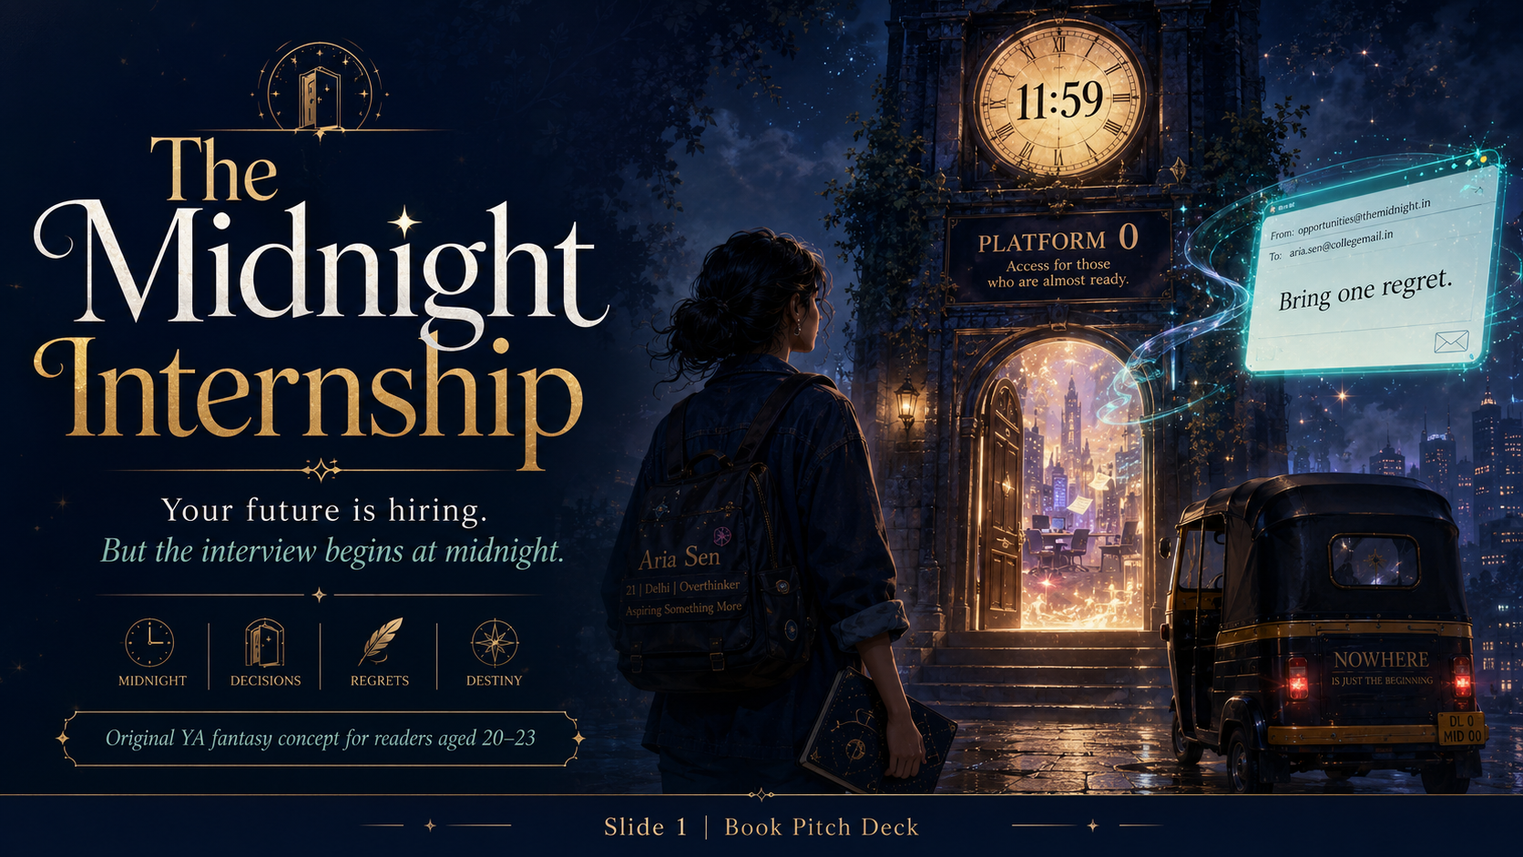

Slide 2
The Midnight Internship
An original illustrated fantasy book for readers aged 20–23
A story about career anxiety, regret, love, friendship, ambition, and the strange door that opens when your future feels closed.
Compiled as a readable PowerPoint book with AI-generated visuals.
Story Book Edition
02

Slide 3
Table of Contents
1. The Email at 2:07 A.M.
2. Bring One Regret
3. The Boy Who Knew Tomorrow
4. Orientation for the Unchosen
5. First Assignment
6. The Memory Room
7. Mira Is Lying
8. The Future That Was Stolen
9. Kabir’s Secret
10. The Second Contract
11. The Nameless Girl
12. Midnight War
13. The Internship Ends
14. The Life That Chooses You
15. 11:59 Again
Best read in slideshow mode or exported as PDF.
The Midnight Internship
03

Slide 4
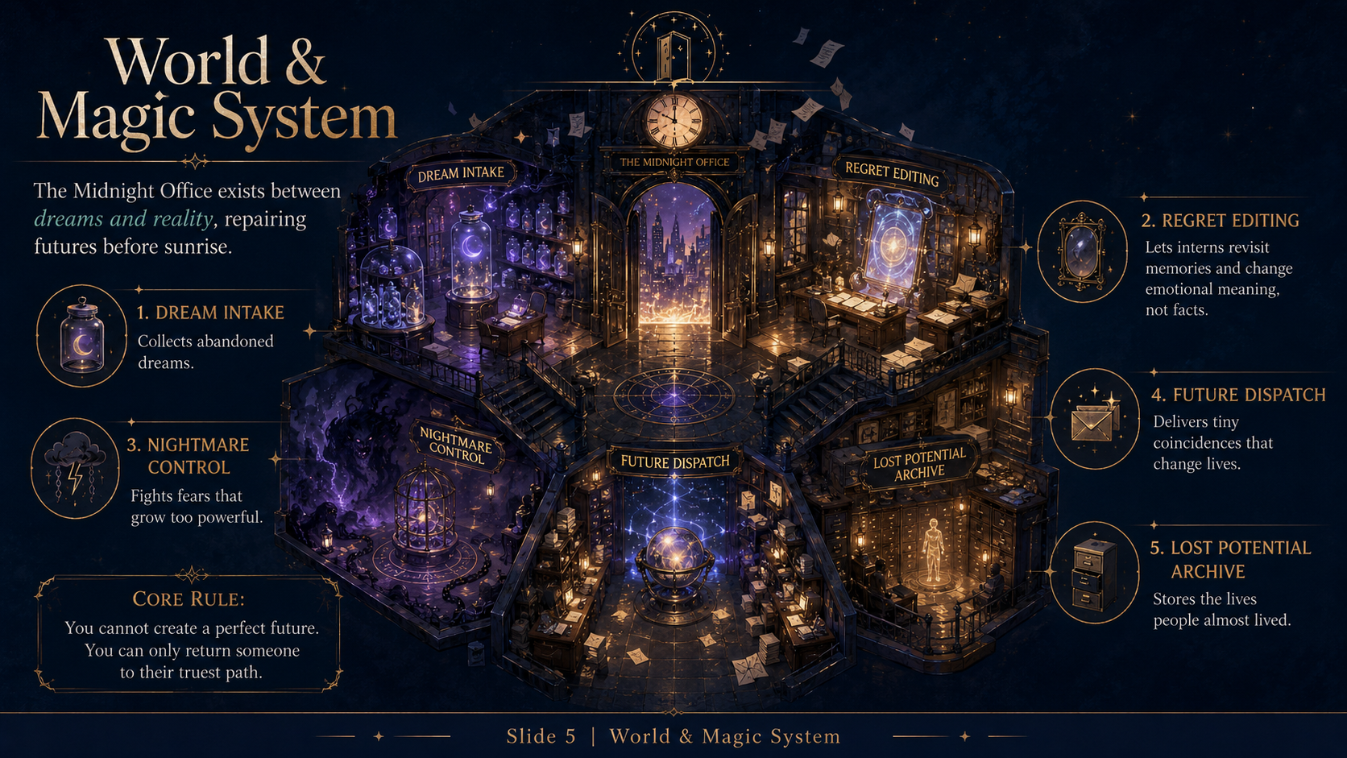

Slide 5
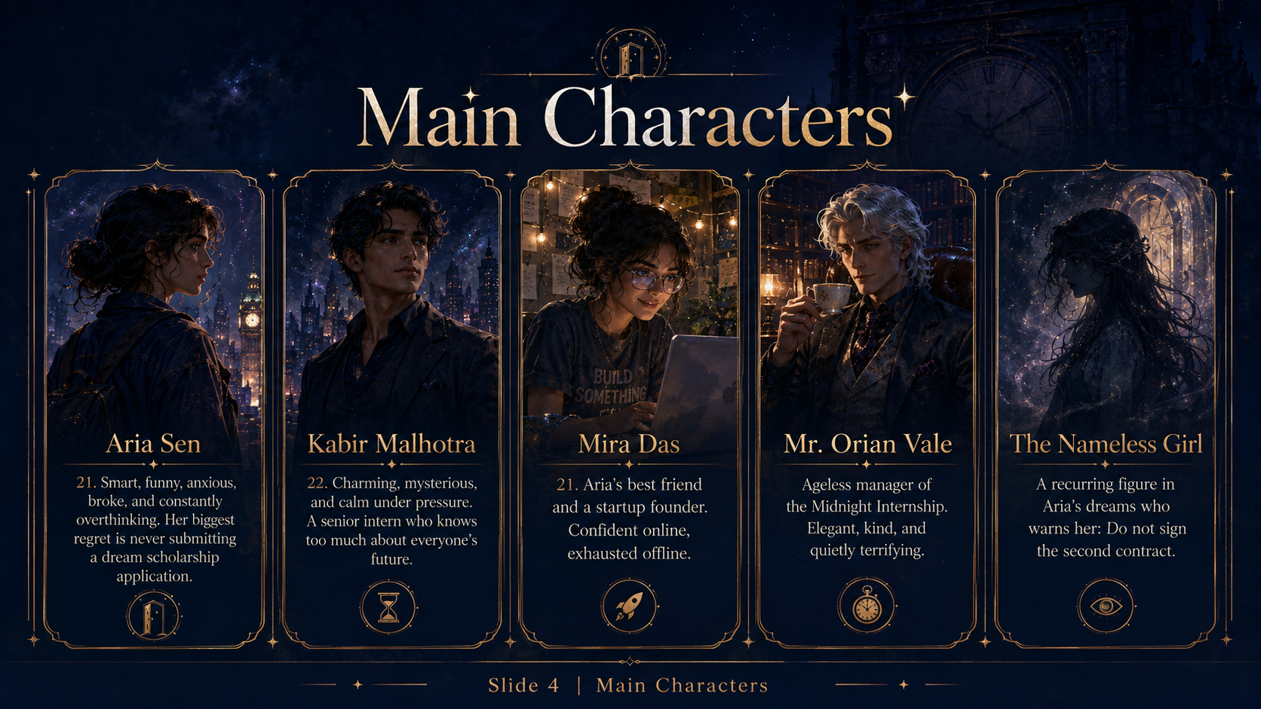

Slide 6
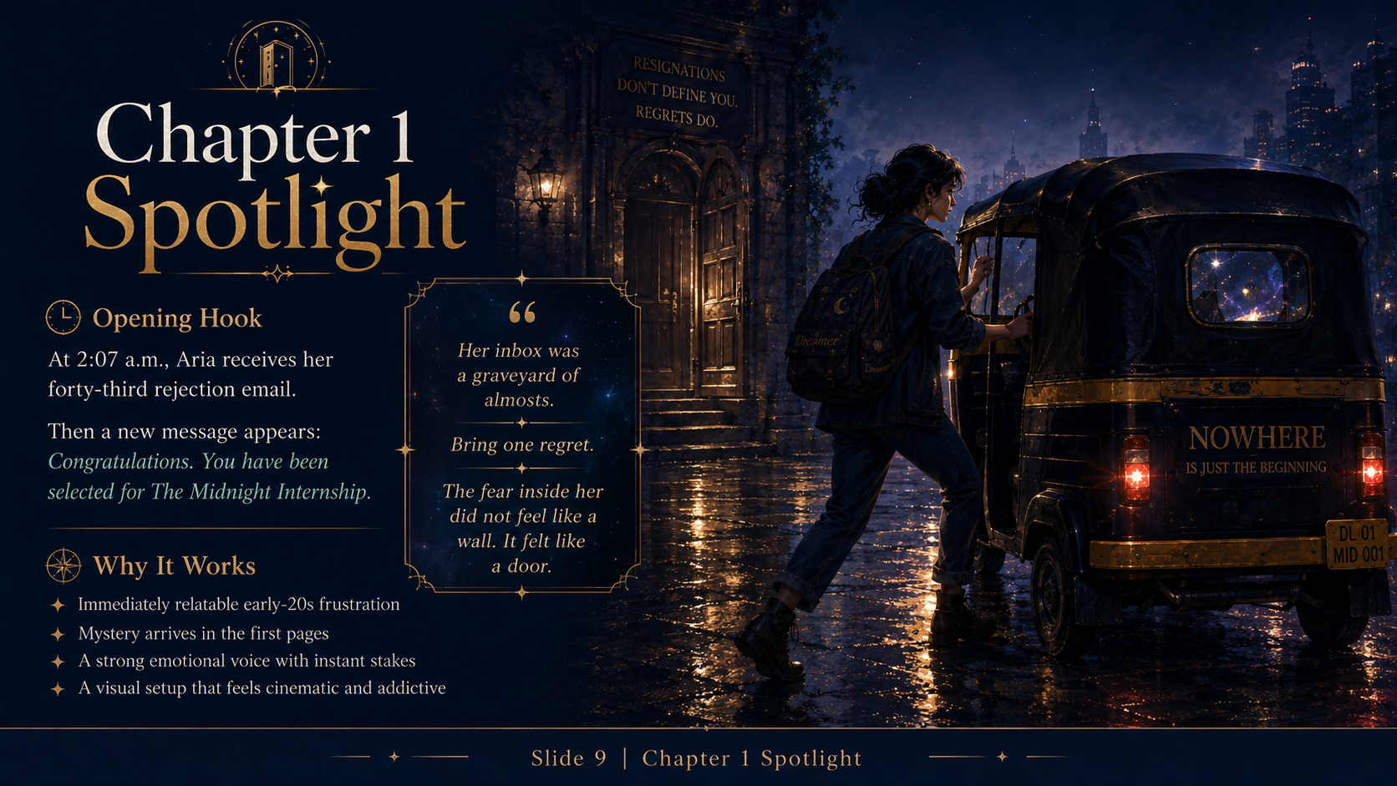

Slide 7
Chapter 1
The Email at 2:07 A.M.
At 2:07 a.m., Aria Sen received her forty-third rejection email. It arrived without thunder, without a sad violin, and without the kind of cinematic rain that would have at least made her failure look expensive. Just one cold notification lighting up her cracked phone screen: Thank you for applying. Unfortunately, we have decided to move forward with other candidates. Aria stared at the sentence until the words stopped looking like English and started looking like a personal attack. Other candidates, she whispered. Of course. The chosen species. Her room looked exactly like the kind of room where dreams came to quietly die. Half-folded laundry slept on a chair. Three coffee mugs formed a small, shameful civilization on her desk. Her laptop fan screamed like it was also tired of her life choices.
Part 1 of 4
Illustrated Story Edition
07

Slide 8
Chapter 1
The Email at 2:07 A.M.
On the wall above her desk, a motivational poster said: YOUR FUTURE STARTS TODAY. Aria had bought it in first year, back when she believed futures were things you could start by buying posters about them. Now she was twenty-one, in final year, and her future seemed to have started without her. Mira had raised funding for her app. Kabir from economics had moved to Singapore. Her ex, Rohan, had posted a LinkedIn update titled Grateful to announce, which Aria believed should be illegal. Her inbox was a graveyard of almosts. Almost selected. Almost impressive. Almost enough. She closed LinkedIn after the fifth success post and whispered, Dreams come true if your uncle knows someone.
Part 2 of 4
Illustrated Story Edition
08

Slide 9
Chapter 1
The Email at 2:07 A.M.
Then her laptop opened by itself. The screen glowed pale blue. A new email appeared at the top of her inbox. No sender name. No profile picture. Subject line: Congratulations, Aria Sen. She clicked before fear could turn into common sense. Dear Aria Sen, it said. You have been selected for The Midnight Internship. Report tonight at 11:59 p.m. Bring one regret. Do not be late. Your future has already been delayed enough. At the bottom was an address that had not been there a second ago: Platform 0, Old Clock Tower Metro Station. Aria laughed once, badly. Everyone knew the station had only two platforms, one broken escalator, and a momo stall where the chutney could legally be classified as a weapon.
Part 3 of 4
Illustrated Story Edition
09

Slide 10
Chapter 1
The Email at 2:07 A.M.
The email changed. You are wondering if this is real. That is why you were selected. Aria stopped breathing. Her wall clock said 11:41 p.m. Her phone said 11:41 p.m. Somehow the night had folded backward while she was busy failing. Outside her window, every streetlight blinked once, twice, then died except one. Beneath it waited a black auto-rickshaw, its meter glowing red with a single word: MIDNIGHT. The driver looked up and tapped his wrist. Hurry. Aria should have called Mira, or Maa, or the police, or a priest. Instead she looked at the old scholarship folder on her desktop, the application she had never submitted. For the first time in months, fear did not feel like a wall. It felt like a door.
Part 4 of 4
Illustrated Story Edition
10

Slide 11
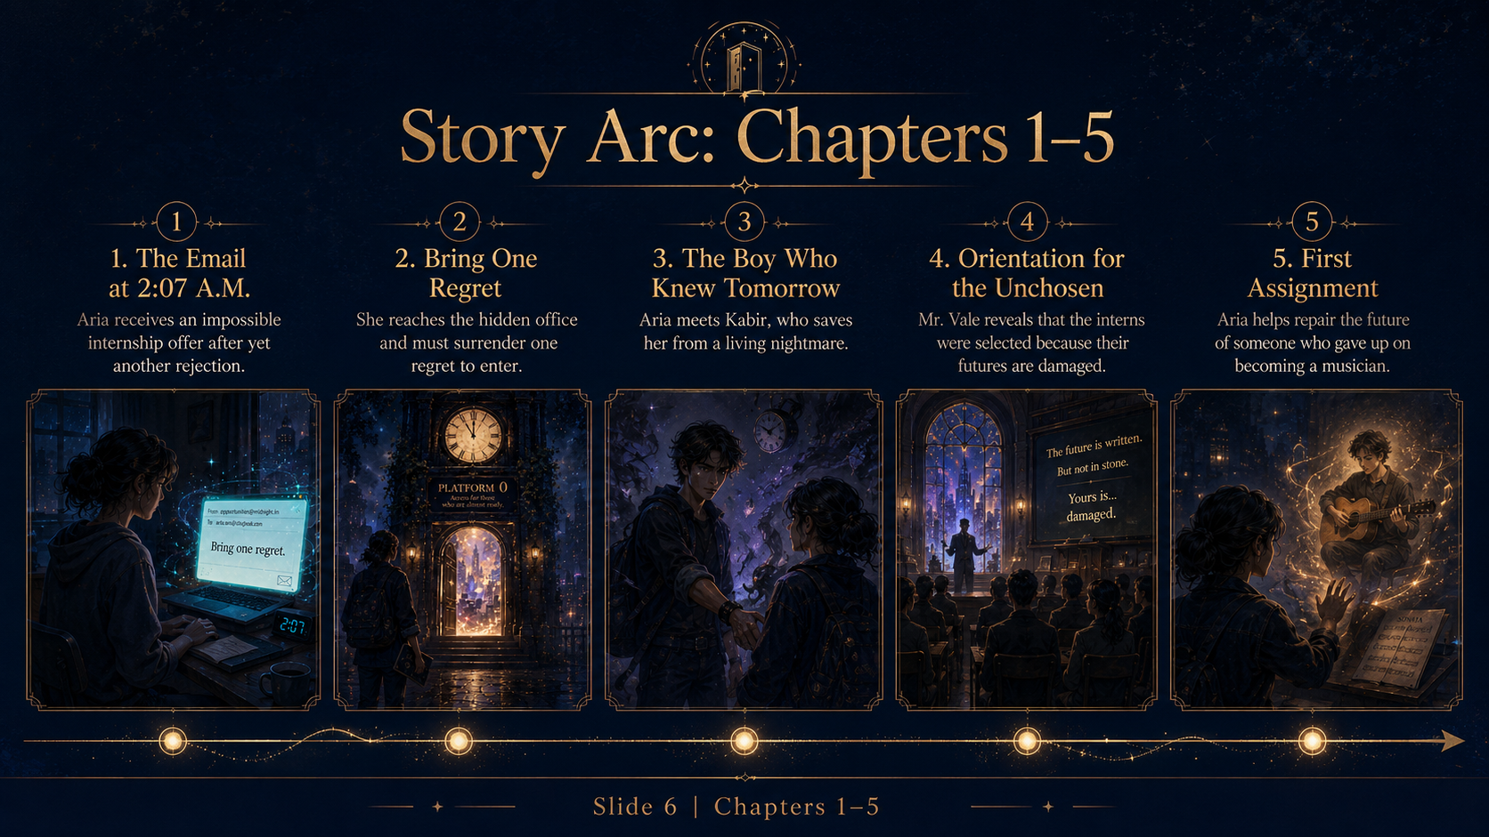

Slide 12
Chapter 2
Bring One Regret
The auto-rickshaw smelled like rain, petrol, and impossible decisions. Aria climbed in with her backpack clutched to her chest, half expecting the driver to ask for an OTP. He did not ask where she was going. He only said, Regret? Aria swallowed. I have many. Only one allowed for entry, he replied, turning the meter from MIDNIGHT to NOWHERE. The road bent downward like soft paper. The city above stayed where it was, but the auto slipped under it, through a tunnel made of old train announcements, missed calls, and the exact kind of silence that arrives after you disappoint someone you love.
Part 1 of 4
Illustrated Story Edition
12

Slide 13
Chapter 2
Bring One Regret
Old Clock Tower Metro Station was closed when they reached it, which apparently did not matter. The shutter rolled up by itself. Inside, the station lights flickered in gold. Platforms 1 and 2 were exactly where they had always been. Between them, where only a wall should have existed, an archway stood under a clock that read 11:59 and refused to move. A sign above it said PLATFORM 0. Access for those who are almost ready. Aria stepped closer. The air smelled like library dust and birthday candles. A woman in a navy uniform sat behind a counter that had not been there a second ago. Name? she asked. Aria Sen. Regret? The scholarship, Aria whispered. I was too scared to apply.
Part 2 of 4
Illustrated Story Edition
13

Slide 14
Chapter 2
Bring One Regret
The receptionist opened a drawer and pulled out a small glass envelope. Inside it floated a miniature version of Aria’s memory: her finger hovering over the Submit button, her breath shallow, her dream waiting on the other side of a click. The receptionist placed a gold stamp on it. Entry fee accepted. Aria felt a tug inside her chest, not pain exactly, more like a thread being pulled from a sweater. The memory stayed, but its weight changed. It became official. Less like shame. More like evidence. A door opened behind the counter, revealing an elevator lined with velvet walls and tiny constellations. A plaque above the buttons read: The Office of Almost Futures.
Part 3 of 4
Illustrated Story Edition
14

Slide 15
Chapter 2
Bring One Regret
When the elevator doors closed, Aria saw herself reflected in the brass: messy hair, tired eyes, a hoodie that said Make It Happen even though nothing was happening. The elevator did not go up. It went sideways through a storm of glowing papers. Each paper carried a sentence: I should have called. I should have left. I should have stayed. I should have tried. The elevator jerked violently. One regret stuck to the glass, blackening into smoke. It had teeth. Aria backed away. The lights died. A voice from the darkness said, New interns usually scream here. Aria spun around. A boy stood in the corner, calm as if nightmare elevators were normal. He smiled. I am Kabir. Try not to make eye contact with your regret. It gets attached.
Part 4 of 4
Illustrated Story Edition
15

Slide 16
CHAPTER 3
The Boy Who Knew Tomorrow
Some people know your future. Some are trying not to ruin it.
✦
The Midnight Internship
16

Slide 17
Chapter 3
The Boy Who Knew Tomorrow
Kabir Malhotra looked like the kind of boy who made dangerous things seem optional. Dark shirt, messy hair, tired eyes, and a calmness so precise it felt rehearsed. The smoky regret pressed against the elevator glass, forming Aria’s own face with a mouth too wide. It whispered, You never try because then you can never fail. Aria’s skin went cold. Kabir stepped between them and snapped his fingers. The regret shrank into a black moth and vanished through the elevator ceiling. You just killed my trauma? Aria asked. No, he said. I folded it. Very different. Less paperwork.
Part 1 of 4
Illustrated Story Edition
17

Slide 18
Chapter 3
The Boy Who Knew Tomorrow
The elevator opened into a lobby bigger than any building could legally contain. Desks floated in midair. Clocks hung from the ceiling like fruit. People in midnight-blue badges hurried past carrying glowing files, dream jars, umbrellas made of starlight, and one very angry violin case that was shouting in French. Welcome to the Midnight Office, Kabir said. We repair futures before sunrise. Aria waited for him to laugh. He did not. Is this a scam? she asked. Probably, he said. Most institutions are. But this one pays better. She glared. You are not helping. I rarely do on the first day.
Part 2 of 4
Illustrated Story Edition
18

Slide 19
Chapter 3
The Boy Who Knew Tomorrow
Kabir led her past a wall covered with names. Some glowed bright gold. Some flickered. A few were scratched out completely. Aria looked for hers and found it almost instantly, because fear always knows where to look. ARIA SEN blinked weakly, as if her name was struggling to stay awake. Beside it was one word: DELAYED. She tried to touch it, but Kabir caught her wrist. Do not touch your status without training. Last week a boy poked his destiny and accidentally became a dentist in three timelines. Aria pulled her hand away. You joke too much. Kabir’s smile thinned. Only when things are serious.
Part 3 of 4
Illustrated Story Edition
19

Slide 20
Chapter 3
The Boy Who Knew Tomorrow
They reached a corridor where the floor was made of dark glass. Beneath it moved possible lives: Aria giving a speech in London, Aria working in a tiny office with no windows, Aria crying in a bathroom, Aria laughing on a train with someone whose face she could not see. One future flashed brighter than the rest, then went black. Kabir saw it too. For a second his calm broke. What was that? Aria asked. Nothing. He looked away too fast. Your orientation is starting. Ahead, golden doors opened to a hall filled with people who looked exactly like Aria felt: exhausted, hopeful, and one bad sentence away from falling apart.
Part 4 of 4
Illustrated Story Edition
20

Slide 22
Chapter 4
Orientation for the Unchosen
Mr. Orian Vale entered the orientation hall without walking. One moment the stage was empty. The next, he stood beneath a clock with no hands, wearing a charcoal suit, silver hair, and the patient smile of someone who knew all your secrets and found them predictable. Good evening, almosts, he said. The word landed hard. Around Aria, twenty new interns shifted in their seats. Some wore college hoodies. Some wore office badges. One girl still had a grocery delivery helmet in her lap. You were not chosen because you are special, Mr. Vale continued. You were chosen because something in your future has cracked.
Part 1 of 4
Illustrated Story Edition
22

Slide 23
Chapter 4
Orientation for the Unchosen
A screen behind him lit up with each intern’s name and a diagnosis. Burned Path. False Calling. Stolen Chance. Delayed Courage. Aria’s name appeared last: ARIA SEN — WITHHELD POTENTIAL. A murmur spread through the hall. Aria sank lower in her chair. Mr. Vale looked directly at her. Potential is not a compliment here, Miss Sen. It is a debt. You have borrowed too much from the person you could become. Now interest is due. Mira would have called that toxic motivation. Aria nearly laughed, then remembered she was inside a magical HR department.
Part 2 of 4
Illustrated Story Edition
23

Slide 24
Chapter 4
Orientation for the Unchosen
The rules were simple and impossible. Interns could not change facts, only meaning. They could not make someone rich, only brave enough to walk toward the door they had been avoiding. They could not create a perfect future, because perfect futures were traps with better lighting. Every night, they would receive an assignment. Every sunrise, the assignment would either be repaired, delayed, or lost. If lost, the office would archive that life forever as something that almost happened. A boy raised his hand. What happens to us if we fail? Mr. Vale smiled. You already know what failure feels like. We simply make it more organized.
Part 3 of 4
Illustrated Story Edition
24

Slide 25
Chapter 4
Orientation for the Unchosen
After orientation, each intern received a badge. Aria’s badge was warm and heavier than it looked. It said Junior Future Repair Intern, Temporary. Kabir appeared beside her, holding two paper cups of coffee that smelled like burnt hope. Temporary is good, he said. Permanent means the office has stopped believing you can leave. Aria looked around at the endless corridors, floating clocks, and doors opening into people’s most private moments. Why are you still here? she asked. Kabir’s face closed like a book. Because some mistakes take longer than one night to fix. Before she could ask more, her badge burned against her palm. Her first assignment had arrived.
Part 4 of 4
Illustrated Story Edition
25

Slide 27
Chapter 5
First Assignment
The file was thin, which Kabir said was always suspicious. Big problems loved small folders. Inside was a name: Samar Roy, twenty-three, former musician, current insurance trainee, future classified as Diminishing Light. Objective: return subject to truest path before sunrise. Aria expected a dramatic portal. Instead, the office gave her a bus ticket, a cheap umbrella, and a note that said Do not improvise unless absolutely necessary. The bus carried her and Kabir through a rainstorm that smelled like old guitar strings. They arrived inside a memory: a cramped rented room, a broken fan, and a young man staring at a guitar case as if it were a body.
Part 1 of 4
Illustrated Story Edition
27

Slide 28
Chapter 5
First Assignment
Samar’s memory played around them while Samar himself sat frozen on the bed. A phone buzzed beside him. On the screen, his father’s message read: Enough music. Come home serious. Aria felt the sentence like a slap. On the table was an unopened email from a small venue offering Samar his first paid performance. In the corner, a future version of him wore an ID card and practiced smiling at clients. This is easy, Aria whispered. We just make him open the email. Kabir shook his head. We cannot move his hand. We can only change what the moment means. Then how do we do that? Aria asked. Kabir pointed to the guitar. We listen.
Part 2 of 4
Illustrated Story Edition
28

Slide 29
Chapter 5
First Assignment
Aria touched the guitar case. The room dissolved into sound: Samar at sixteen playing on a terrace while neighbors clapped, Samar at nineteen skipping dinner to buy strings, Samar’s mother humming as he practiced, Samar’s father counting bills at the kitchen table and flinching every time music filled the house. Aria understood suddenly that the dream was not only joy. It was guilt. Music felt like selfishness because love had made itself practical. She knelt in front of the frozen Samar and spoke, though he could not hear words. Your dream did not betray your family. Your fear is trying to protect them badly. The guitar strings glowed.
Part 3 of 4
Illustrated Story Edition
29

Slide 30
Chapter 5
First Assignment
The room unfroze. Samar looked at the email, then at the guitar. He did not become successful in one magical moment. He did not sign a record deal or stand under spotlights. He simply opened the email and typed: I would like to play. The future around him shifted from gray to uncertain gold. Aria’s badge pulsed: REPAIRED. She should have felt triumphant. Instead she felt painfully awake. How many lives had she left unopened like that email? Back in the office, Mr. Vale watched her from the balcony. First repairs are mirrors, he said softly. Aria looked at her own hands. They were trembling. Kabir pretended not to notice, which was the first kind thing he did.
Part 4 of 4
Illustrated Story Edition
30

Slide 31
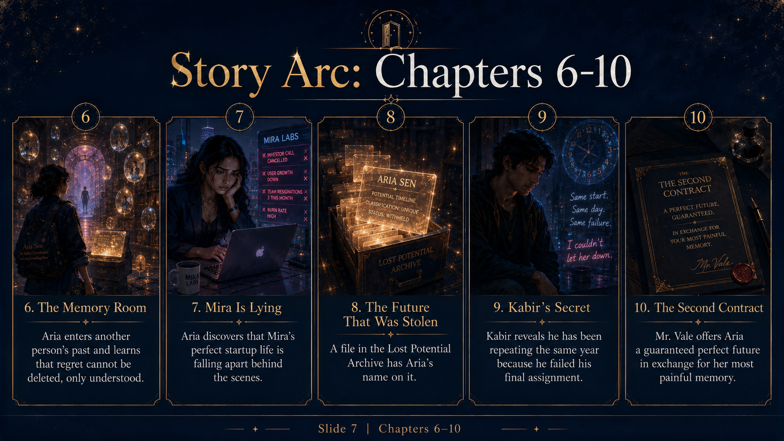

Slide 32
Chapter 6
The Memory Room
By her third night, Aria learned that the Midnight Office had weather. Mondays rained missing chances. Wednesdays produced fog made of unread messages. Fridays were apparently dangerous because hopes became louder near weekends. Her next training session took place in the Memory Room, a circular chamber where thousands of glass orbs floated like sleepy planets. Each orb held a moment someone could not stop replaying. Some glowed warm. Some smoked. One orb sobbed quietly into itself. Aria kept her hands in her pockets. Kabir had warned her: memories are dramatic. Give them attention and they will expect commitment.
Part 1 of 4
Illustrated Story Edition
32

Slide 33
Chapter 6
The Memory Room
Mr. Vale assigned her to a woman named Leela, who had spent seven years blaming herself for leaving home before her younger brother fell ill. The memory showed Leela at a train station, boarding with a suitcase and anger in her throat. Her brother waved from the platform. The next day, he collapsed. Leela’s regret had built an entire cage around that goodbye. Aria entered the orb and stood beside younger Leela in the hot station air. She wanted to shout, Stay. She wanted to undo the pain. Instead she remembered the rule: facts do not move. Meaning does.
Part 2 of 4
Illustrated Story Edition
33

Slide 34
Chapter 6
The Memory Room
Aria looked around the memory more carefully. The brother was smiling. Not pretending. Smiling. He slipped a note into Leela’s bag when she turned away. In seven years of replaying the moment, Leela had never noticed. Aria nudged the strap of the bag, not changing the event, only revealing what was already there. The note fell out. Younger Leela picked it up. Didi, it read, go become the person who comes back with stories. I will save you the mango pickle. The platform trembled. The cage around the memory cracked. Outside the orb, older Leela began to cry without breaking.
Part 3 of 4
Illustrated Story Edition
34

Slide 35
Chapter 6
The Memory Room
When Aria emerged, she had tears on her own face. Mr. Vale looked pleased. Kabir looked worried. You felt it too much, he said. That is literally my only skill, Aria replied. It can get you killed here. Memories do not care that you are visiting. They will make space for you and then lock the door. Aria wanted to make a joke, but the warning sat between them like a third person. That night, she opened her old scholarship folder again in her real room. She did not submit anything. The deadline had passed years ago. But she read the essay she had written and realized the girl in those sentences had not disappeared. She was waiting.
Part 4 of 4
Illustrated Story Edition
35

Slide 36
CHAPTER 7
Mira Is Lying
Some people look successful because breaking quietly photographs better.
✦
The Midnight Internship
36

Slide 37
Chapter 7
Mira Is Lying
Mira Das posted a photo at 9:03 p.m. The caption said: Building is hard. Grateful for the journey. The photo showed her smiling beside a laptop and a whiteboard full of colorful arrows. Two thousand people liked it before midnight. Aria saw the post during a break and almost sent a fire emoji out of habit. Then her badge heated against her skin. Assignment detected nearby. Subject: Mira Das. Future classification: Burnout Collapse. Repair window: four nights. Aria felt the floor tilt. The office was not supposed to touch her real life. Kabir read the file over her shoulder and swore softly. That was the second sign things were bad.
Part 1 of 4
Illustrated Story Edition
37

Slide 38
Chapter 7
Mira Is Lying
They entered Mira’s office through a reflection in a coffee machine. The memory was not old. It was happening now. Mira sat alone in the dark, face lit by thirteen red notification bubbles. Investor call cancelled. User growth down. Co-founder conflict unresolved. Bank balance critical. She had changed from the blazer in her photo into an old hoodie and was eating cereal from a mug because the office had no clean bowls. Her smile from the post was still open on the laptop screen, bright enough to be cruel. Aria’s throat tightened. Mira always sounded fine. Mira always said, I will figure it out. Aria had believed her because believing was easier than asking.
Part 2 of 4
Illustrated Story Edition
38

Slide 39
Chapter 7
Mira Is Lying
A nightmare had attached itself to Mira’s whiteboard. It looked like a pitch deck with teeth. Every slide showed a different version of failure: employees leaving, parents saying they had warned her, strangers online calling her a fraud. Mira stared at it as if she deserved every scene. Aria stepped toward her, but Kabir caught her sleeve. Friends are hard assignments, he said. You cannot repair someone by needing them to be okay. The words annoyed Aria because they were true. So she sat on the floor beside Mira instead of fixing anything. In the memory, Mira could not see her, but somehow the room softened.
Part 3 of 4
Illustrated Story Edition
39

Slide 40
Chapter 7
Mira Is Lying
Aria found the meaning she needed to change inside an old voice note from Mira’s first week as a founder. In it, Mira laughed and said, I do not need this to make me look impressive. I need it to help one person feel less alone. The nightmare deck flickered. Aria amplified the note until it filled the room. Mira looked up from her cereal. Her face crumpled. She opened a new message to her team and typed: I have been pretending everything is fine. It is not. Can we talk honestly tomorrow? The whiteboard stopped growling. Back in the office, Aria texted the real Mira: Are you actually okay? Three dots appeared, vanished, appeared again. Finally: No. Can I call you? Aria answered before the phone could ring twice.
Part 4 of 4
Illustrated Story Edition
40

Slide 41
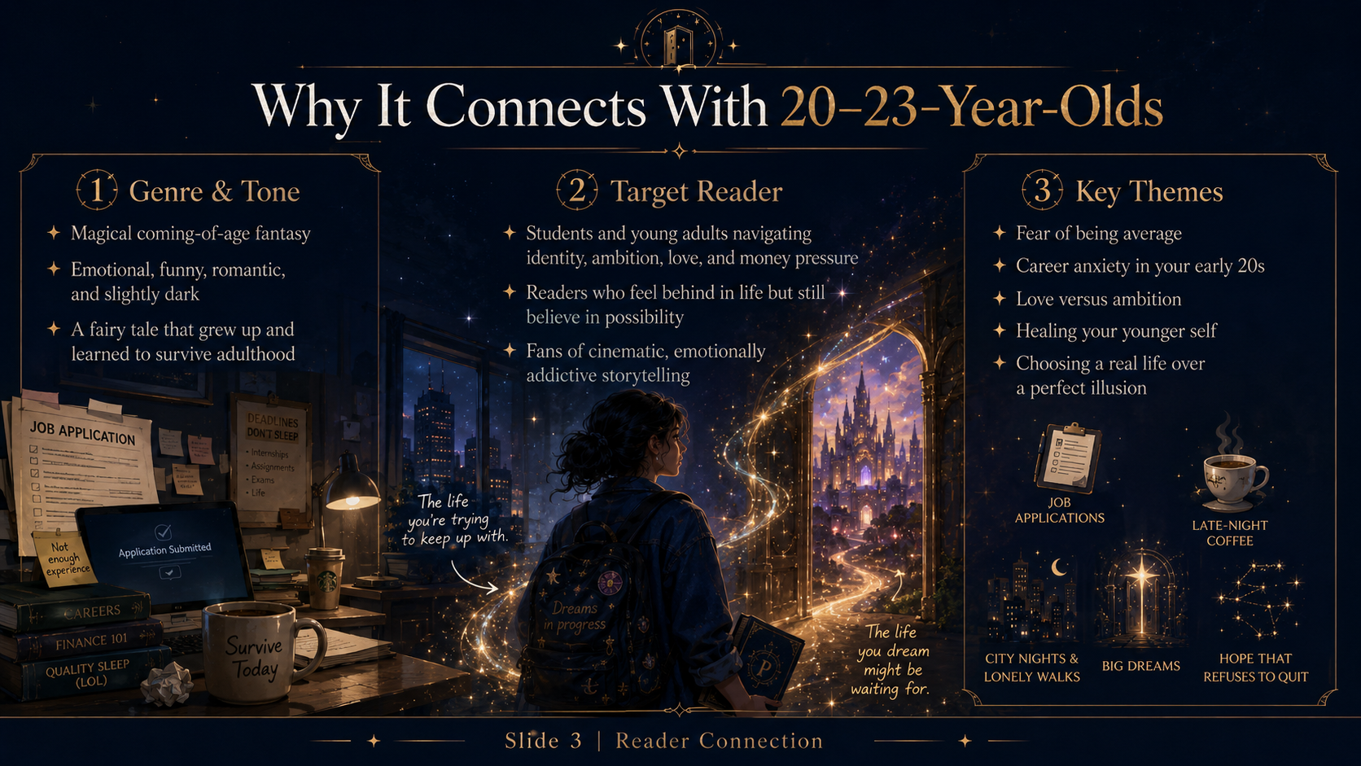

Slide 42
Chapter 8
The Future That Was Stolen
The Lost Potential Archive was colder than the rest of the office. It smelled like unopened letters and rooms that were cleaned after someone moved out. Filing cabinets stretched into darkness, each drawer labeled with a life that almost happened. There were drawers for abandoned novels, unasked apologies, unsent job applications, friendships ended by ego, and love stories killed by timing. Kabir hated the place. Aria could tell because he had stopped joking. I need to check something, she said. He shook his head immediately. Everyone thinks that. That is why the Archive has locks. But Aria had already seen her name flicker beneath the glass floor days ago. She needed to know what had gone black.
Part 1 of 4
Illustrated Story Edition
42

Slide 43
Chapter 8
The Future That Was Stolen
The Archive keeper was a woman made mostly of paper cuts and patience. She agreed to search Aria’s name only after Aria surrendered one hour of sleep as a late fee. A drawer opened somewhere above them. A file drifted down, glowing gold around the edges. ARIA SEN. POTENTIAL TIMELINE. CLASSIFICATION: UNIQUE. STATUS: WITHHELD. Not lost. Not delayed. Withheld. Aria looked at Kabir. His face had lost all color. You knew? she asked. No. His voice was too quiet. I suspected. The file opened by itself and showed flashes: Aria in London, Aria writing research, Aria speaking with a confidence she did not recognize, Aria coming home changed but still herself. Then the images tore apart like wet paper.
Part 2 of 4
Illustrated Story Edition
43

Slide 44
Chapter 8
The Future That Was Stolen
A second name appeared in the file: ORIAN VALE. Authorization: sealed. The Archive keeper snapped the folder shut. This is manager-level theft, she said, which apparently in the Midnight Office was worse than murder and involved more forms. Aria turned to Kabir, anger rising so fast it felt clean. Why would Mr. Vale steal my future? Kabir looked at the folder as if it were a grave. Not steal, maybe. Store. Protect. Trade. The office likes prettier words for ugly things. Then he added the sentence that made Aria’s stomach drop. Sometimes a future is withheld because someone else is using its light.
Part 3 of 4
Illustrated Story Edition
44

Slide 45
Chapter 8
The Future That Was Stolen
That night, Aria did not go home. She sat on the Archive floor while drawers whispered around her. She thought of all the times she had called herself lazy, scared, not enough. What if some part of her had been missing because someone had taken it? Then another thought arrived, sharper and less comforting: what if the stolen future was only proof of what she could have become, not a guarantee? Kabir sat beside her without speaking. After a long time, he said, I have a file here too. She looked at him. He did not look back. Mine is not withheld. Mine is repeating. Somewhere in the dark, a clock began striking the same minute again and again.
Part 4 of 4
Illustrated Story Edition
45

Slide 46
CHAPTER 9
Kabir’s Secret
Same start. Same day. Same failure.
✦
The Midnight Internship
46

Slide 47
Chapter 9
Kabir’s Secret
Kabir had joined the Midnight Internship one year ago. Also two years ago. Also three. Time did not know what to do with him, so it kept putting him back. He told Aria on the roof of the office, where interns went when the corridors became too full of other people’s lives. Above them, the city slept inside a glass dome of stars. Every year, he said, I get the same final assignment. Every year, I fail. Then the office resets me to the beginning of the internship with my memories mostly intact. Mostly? Aria asked. Kabir smiled without humor. Enough to suffer. Not enough to improve.
Part 1 of 4
Illustrated Story Edition
47

Slide 48
Chapter 9
Kabir’s Secret
His final assignment had been a girl named Naina, his younger sister. In the original timeline, Kabir had ignored her call during an exam. By sunrise, she had run away from home after a fight and vanished for thirty-six hours. She returned safe, but something in her changed, and Kabir spent years believing one answered call could have saved her. The office selected him to repair the meaning of that night. But every time he entered the memory, he tried to change the fact. He answered. He left the exam. He broke the rules. The timeline snapped back, and the year began again. I could not let her be hurt, he said. Aria understood too much.
Part 2 of 4
Illustrated Story Edition
48

Slide 49
Chapter 9
Kabir’s Secret
You do not have to save the fact to save the person, Aria said. Kabir laughed, but it broke in the middle. That sounds like something Vale would say before charging rent for hope. Aria moved closer. No. It sounds like something someone told me when a guitar was not just a guitar. He looked at her then, really looked, and the space between them filled with every almost-romance that should have been annoying but somehow felt like shelter. For the first time, Kabir’s calm seemed less like confidence and more like a room he had locked himself inside.
Part 3 of 4
Illustrated Story Edition
49

Slide 50
Chapter 9
Kabir’s Secret
When Aria touched his hand, the roof vanished. They stood inside Kabir’s memory: an exam hall, a buzzing phone, rain at the windows. NAINA CALLING. The younger Kabir stared at the screen, panic burning his face. Aria watched present Kabir reach for the phone again, doomed by love. She caught his wrist. Ask what the moment means, not what you wish happened. He froze. The phone kept buzzing. In the memory’s silence, they heard Naina’s voice from later that night, left in a message he had never played fully: I did not need you to fix it, Bhai. I just wanted to know you would come after. Kabir closed his eyes. This time, he did not answer. He stood up after the exam and ran.
Part 4 of 4
Illustrated Story Edition
50

Slide 52
Chapter 10
The Second Contract
Mr. Vale found Aria in the corridor outside the Archive, which meant he had either been watching or the office had tattled. Both options annoyed her. He invited her to tea in a room that had no door until he needed one. The walls were lined with clocks, each showing a different regret. Your curiosity is becoming expensive, Miss Sen, he said, pouring tea that smelled like cinnamon and threats. Aria did not sit. Did you withhold my future? Mr. Vale studied her as if the question were a math problem and she had used the wrong pencil. I preserved it. From what? From you.
Part 1 of 4
Illustrated Story Edition
52

Slide 53
Chapter 10
The Second Contract
He placed a black folder on the table. The Second Contract was beautiful in the way snakes are beautiful: all polish and danger. Its gold letters promised a perfect future. The scholarship restored. The right career. The right city. The right love arriving at the right time. A life without the exhausting work of becoming. In exchange, Aria would surrender her most painful memory. Not her regret. Not her fear. The memory that had taught her she was not safe to want too much. The contract glowed as if it already knew which memory she would pay with.
Part 2 of 4
Illustrated Story Edition
53

Slide 54
Chapter 10
The Second Contract
You stole from me and now you want to sell it back? she said. Vale’s face did not change. I am offering mercy. You are tired of fighting yourself. This would end that. Aria hated how badly some part of her wanted to believe him. A perfect future sounded warm. It sounded quiet. It sounded like never refreshing an inbox at 2:07 a.m. again. Then Kabir stepped out of the shadow behind her, because apparently dramatic timing was part of his personality. Perfect futures are cages with better furniture, he said. Vale looked almost amused. And imperfect ones are graves with poetry, Mr. Malhotra.
Part 3 of 4
Illustrated Story Edition
54

Slide 55
Chapter 10
The Second Contract
The room darkened. The contract opened by itself to the signature line. Aria saw the memory it wanted: ten-year-old her winning a school writing prize, running home with the certificate, hearing relatives laugh kindly and say, Very nice, but writing is a hobby, beta. Study something useful. A small thing. A casual thing. A sentence that had built walls for years. The contract whispered, Sign, and it will never hurt. Aria picked up the pen. Kabir went still. Vale smiled. Then Aria snapped the pen in half. Pain is not proof that I should not want things, she said. The contract screamed like burning paper. Somewhere in the office, every clock struck midnight at once.
Part 4 of 4
Illustrated Story Edition
55

Slide 56
CHAPTER 11
The Nameless Girl
We do not exist anymore. But you still can.
✦
The Midnight Internship
56

Slide 57
Chapter 11
The Nameless Girl
After Aria refused the Second Contract, the Nameless Girl began appearing outside dreams. First in the reflection of an elevator door. Then in the dark screen of Aria’s phone. Then at the end of a corridor that had not existed the day before. She looked like Aria and not like Aria: same eyes, longer hair, a sadness too old for twenty-one. Do not sign the second contract, she kept saying, even though Aria already had not. It was not a warning. It was an echo. Kabir suggested sleep. Aria suggested he stop giving advice that sounded like a wellness app.
Part 1 of 4
Illustrated Story Edition
57

Slide 58
Chapter 11
The Nameless Girl
They followed the girl into a mirror archive, a place where futures that had been erased still practiced existing. There, Aria saw her: a version of herself from the withheld timeline. Scholarship Aria. London Aria. Confident Aria. Not better, not prettier, not magically fixed. Just a girl who had clicked Submit before fear could negotiate. You are me, Aria whispered. The girl shook her head. I was. Then someone needed my light. She touched the mirror from the other side. Vale used your future to keep the office alive. Without stolen potential, the Midnight Office cannot repair anyone.
Part 2 of 4
Illustrated Story Edition
58

Slide 59
Chapter 11
The Nameless Girl
The truth arrived like a cruel fairy tale. The office helped broken futures by feeding on other almost-futures. Not all of them, not always, but enough. Mr. Vale had built a machine out of regret and called it mentorship. The Nameless Girl showed Aria dozens of withheld lives: a dancer who became a banker, a coder who opened a bakery only in dreams, a mother who never returned to painting. Their light powered doors, clocks, assignments, miracles. Every repaired life had a shadow cost hidden in the Archive. Aria wanted to hate the office completely, but then she remembered Samar opening his email, Mira finally telling the truth, Kabir running after Naina. The magic had done good with stolen fire.
Part 3 of 4
Illustrated Story Edition
59

Slide 60
Chapter 11
The Nameless Girl
Can I bring you back? Aria asked. The Nameless Girl smiled sadly. If I return, something else collapses. If I stay gone, you remain half-lit. That is the choice Vale has been avoiding. Aria looked at Kabir. He looked like he already knew what impossible choices cost. The mirror cracked between them. From far away came a sound like doors opening all at once. Nightmare alarms wailed through the office. The Nameless Girl stepped backward into fading gold. Midnight War has started, she said. Do not save the office. Save what it was supposed to be. Then the mirror shattered, and the darkness behind it blinked open with a thousand hungry eyes.
Part 4 of 4
Illustrated Story Edition
60

Slide 61
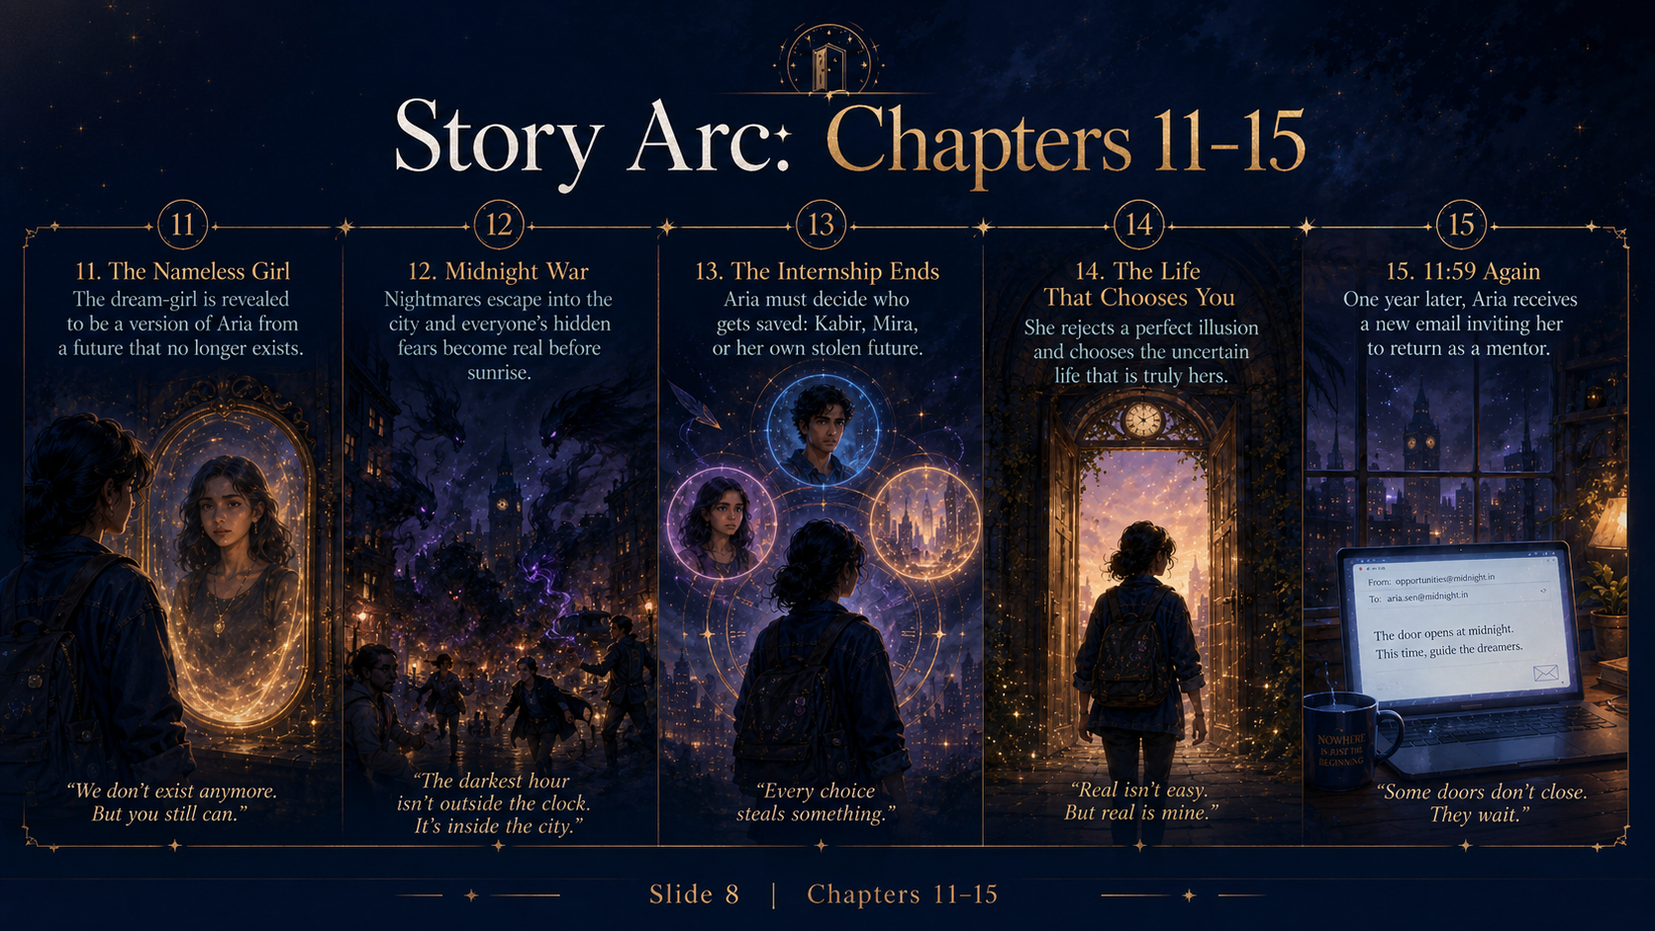

Slide 62
Chapter 12
Midnight War
Nightmares escaped like smoke with teeth. They poured from broken mirrors, file drawers, elevator shafts, and every memory that had been edited too gently for too long. The Midnight Office shook around Aria as interns ran through corridors carrying dream jars and emergency forms no one had time to fill. A nightmare shaped like a rejection email chased three trainees down a staircase. Another, wearing Mira’s smile, whispered failure statistics into the walls. Outside the office doors, the city flickered. People asleep in apartments began dreaming the same bad dream: that they were too late, too ordinary, too loved only when useful.
Part 1 of 4
Illustrated Story Edition
62

Slide 63
Chapter 12
Midnight War
Aria, Kabir, and Mira met at Platform 0 because of course Mira had shown up after Aria accidentally told her too much during a panic call. You said magical unpaid internship and city-destroying nightmares, Mira said, holding a cricket bat she had apparently brought from her office. I assumed you needed backup. Aria wanted to hug her and yell at her simultaneously, which was basically friendship. Kabir handed Mira a charm made of folded time. Stay inside the gold lines. Mira looked at the chaos behind him. Bro, I have run investor meetings with six percent battery. This is manageable.
Part 2 of 4
Illustrated Story Edition
63

Slide 64
Chapter 12
Midnight War
The nightmares were not random monsters. They were personalized. Aria’s took the shape of every person who had ever called her talented with disappointment in their voice. Mira’s became a pitch room where everyone laughed before she spoke. Kabir’s was a ringing phone he could never reach. The city streets turned into rooms from people’s private fears. Aria realized fighting them like monsters only made them stronger. Fear loved being treated as proof. She climbed onto the roof of the auto-rickshaw and shouted into the storm, You are not prophecy. You are pain asking for attention. The words sounded ridiculous. They also worked.
Part 3 of 4
Illustrated Story Edition
64

Slide 65
Chapter 12
Midnight War
Across the city, nightmares faltered as people inside their dreams looked back. A student facing an exam monster said, I am scared, not stupid. A founder in an empty boardroom said, I can fail and still be real. A boy chased by his father’s silence said, I wanted you to be proud, but I am allowed to breathe. Light spread through the streets, messy and uneven. Mr. Vale appeared beneath the clock tower, furious for the first time. You will break the system, he shouted. Aria jumped down from the auto, rain streaking her face. Good, she said. Systems that need stolen futures deserve to break. Behind her, the Nameless Girl’s light began to rise from the cracks in the road.
Part 4 of 4
Illustrated Story Edition
65

Slide 66
CHAPTER 13
The Internship Ends
Every choice steals something.
✦
The Midnight Internship
66

Slide 67
Chapter 13
The Internship Ends
The heart of the Midnight Office was not in the building. It was under Platform 0, beneath the clock that never moved, inside a chamber where thousands of withheld futures burned like small suns in glass cages. Aria reached it with Kabir and Mira while the office groaned above them. Mr. Vale stood beside the central machine, one hand on a lever made of black gold. If you release them all, he said, countless repairs will undo themselves. Samar may never play. Mira may collapse. Kabir may repeat forever. Aria felt the truth of it. Magic never offered clean exits. It only revealed the cost tags everyone had hidden.
Part 1 of 4
Illustrated Story Edition
67

Slide 68
Chapter 13
The Internship Ends
Three cages opened before her. One held Kabir’s final year, the chance to free him from the loop. One held Mira’s repaired courage, fragile as a candle. One held Aria’s stolen future, bright and familiar, reaching toward her like a younger self asking to be chosen. The machine could fully restore only one before it failed. Mira saw the choice and immediately said, Take yours. Kabir said, Free Mira. Aria said, Both of you shut up. The fact that she loved them in different ways made the decision worse. Love, she was learning, did not simplify sacrifice. It made every option human.
Part 2 of 4
Illustrated Story Edition
68

Slide 69
Chapter 13
The Internship Ends
The Nameless Girl appeared beside Aria, faint but smiling. You keep asking which future to save, she said. Ask what a future is for. Aria looked at the cages again. A future was not a trophy. It was not a prize for being brave early enough. It was a direction. A living thing. It needed motion, not ownership. She stepped to the machine and did the one thing no intern was supposed to do: she split her own restored light into three imperfect pieces. Kabir gasped. Mira shouted her name. Mr. Vale lunged, but the Nameless Girl held him back with one transparent hand.
Part 3 of 4
Illustrated Story Edition
69

Slide 70
Chapter 13
The Internship Ends
The machine cracked. Kabir’s loop broke, not cleanly but enough. Mira’s courage returned, not as confidence but as honesty. Aria’s stolen future poured back into her, not as London, not as guaranteed success, but as permission. Permission to want. To try. To submit. To fail without making failure a god. The cages shattered across the chamber. Withheld futures flew upward through the city like lanterns. Mr. Vale fell to his knees among the broken glass. What have you done? he whispered. Aria was crying and laughing at the same time. Something unfinished, she said. The clock above Platform 0 finally moved. One minute passed.
Part 4 of 4
Illustrated Story Edition
70

Slide 71
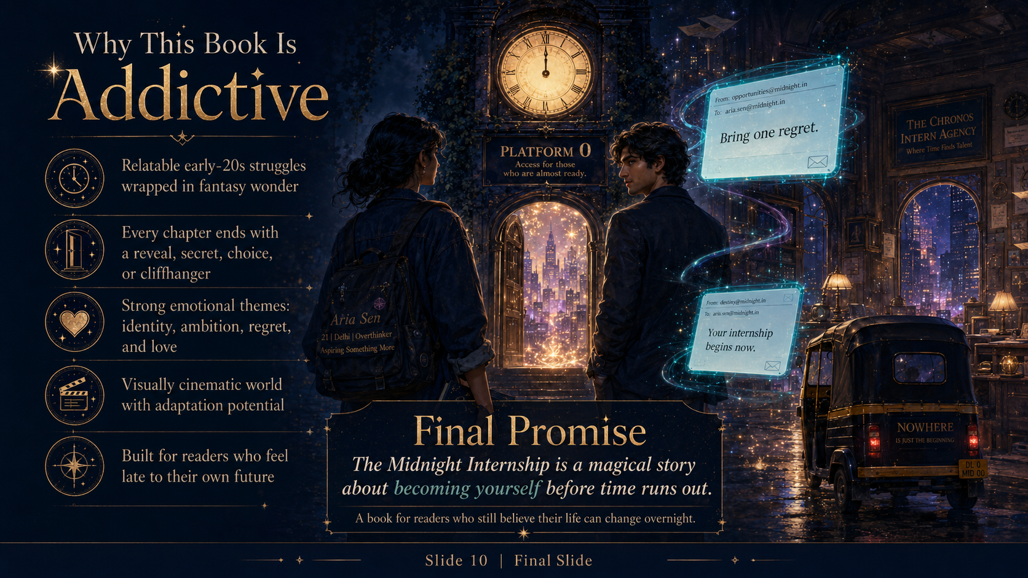

Slide 72
Chapter 14
The Life That Chooses You
Sunrise found the Midnight Office smaller. Without stolen futures powering its endless corridors, whole wings folded away into dust: the Department of Convenient Excuses, the Hall of Perfect Alternatives, the cafeteria that served coffee tasting exactly like your best memory. What remained was a simple office under Platform 0, still magical, still strange, but no longer pretending miracles were free. Mr. Vale was gone. Or hidden. Or becoming whatever people become when they spend too long confusing control with care. The interns gathered in the lobby, waiting to learn if they had jobs, punishments, or both.
Part 1 of 4
Illustrated Story Edition
72

Slide 73
Chapter 14
The Life That Chooses You
Kabir’s badge changed first. The word Temporary vanished. In its place appeared: Released. He stared at it for a long time. Aria did not touch him until he reached for her hand. I do not know what tomorrow looks like, he said. Aria smiled. That is kind of the point. Mira’s phone buzzed with a message from her team. No miracle funding. No instant rescue. Just people saying they wanted to rebuild honestly. Mira wiped her eyes and pretended it was allergies, despite being underground. I hate growth, she said. Character development is so inconvenient.
Part 2 of 4
Illustrated Story Edition
73

Slide 74
Chapter 14
The Life That Chooses You
Aria went home at 8:12 a.m. Her room looked the same: laundry, mugs, tired laptop, stupid poster on the floor. But the room did not feel like proof against her anymore. It felt like a place she could leave from. She opened her laptop and did not search for jobs first. She opened a blank document. At the top she typed: The Midnight Internship. Then she laughed because apparently surviving a magical bureaucracy had made her dramatic. Maa called. Aria answered. Did you sleep? Maa asked. Not exactly. Did you eat? Also no. Beta. I know. But Maa? I am trying. Seriously.
Part 3 of 4
Illustrated Story Edition
74

Slide 75
Chapter 14
The Life That Chooses You
Weeks passed. Aria applied to real internships and got rejected by three, shortlisted by one, ghosted by two, and weirdly praised by a professor who had ignored her emails for months. She submitted a new scholarship application, not because it would fix her life, but because clicking Submit was its own kind of spell. Kabir visited sometimes, usually at midnight, always pretending not to bring snacks specifically for her. Mira rebuilt Mira Labs slowly, publicly, badly, honestly. Nothing became perfect. That was the mercy. Aria kept writing. Every page felt like a future returning in pieces. One evening, she found her old motivational poster and put it back on the wall. YOUR FUTURE STARTS TODAY. Under it, she wrote in pen: And again tomorrow.
Part 4 of 4
Illustrated Story Edition
75

Slide 76
CHAPTER 15
11:59 Again
Some doors do not close. They wait.
✦
The Midnight Internship
76

Slide 77
Chapter 15
11:59 Again
One year later, at 11:58 p.m., Aria Sen was awake for a better reason. Her room was still messy, but now it was messy with evidence: notebooks, drafts, paid work, unpaid dreams, train tickets, coffee stains, and a wall calendar full of deadlines she had chosen instead of inherited. Her inbox was no longer a graveyard. It was a city: chaotic, loud, full of strange possibilities and occasional spam. She had learned that becoming yourself did not feel like transformation most days. It felt like answering one honest email, taking one small risk, resting before resentment turned holy, and refusing to turn fear into an identity.
Part 1 of 4
Illustrated Story Edition
77

Slide 78
Chapter 15
11:59 Again
At 11:59, her laptop opened by itself. Aria smiled before the screen even lit. A new email appeared. No sender name. No profile picture. Subject line: Congratulations, Aria Sen. She clicked. Dear Aria Sen, you have been invited to return to the Midnight Office as a mentor. Report tonight at 11:59 p.m. Bring one lesson. Do not be late. Someone else’s future has already been delayed enough. Aria leaned back in her chair. On her desk sat the notebook she had once carried into Platform 0. Its cover was worn now, the gold moons scratched, the pages fat with drafts.
Part 2 of 4
Illustrated Story Edition
78

Slide 79
Chapter 15
11:59 Again
A black auto-rickshaw waited below her window. Its meter glowed with a familiar word: MIDNIGHT. The driver looked up, silver hair shining under the streetlight. He tapped his wrist. Aria grabbed her backpack. This time, there was no panic. Only nerves, which she had learned were not always warnings. Sometimes they were the body’s way of saying, This matters. As she locked her room, her phone buzzed. Kabir: If you are going where I think you are going, bring coffee. Mira: Tell the office their user onboarding is terrible. Maa: Sleep early beta. Aria laughed so loudly the hallway light flickered.
Part 3 of 4
Illustrated Story Edition
79

Slide 80
Chapter 15
11:59 Again
At Platform 0, the clock still read 11:59, but now its hands trembled with life. A new group of interns stood before the archway: tired, defensive, hopeful, pretending not to be scared. Aria saw herself in all of them. One boy clutched a failed exam result. One girl held a resignation letter. Another kept staring at her phone like a message might save her. Aria stepped forward, badge glowing at her collar: Mentor, Almost Futures. The door opened behind her. Welcome, she said. Your future is not late. It is waiting for you to stop apologizing before you arrive. The interns stared. Somewhere in the city, a thousand unsent dreams took one small breath. Then midnight began again.
Part 4 of 4
Illustrated Story Edition
80

