Slide 1

Computational Physics (PHYS6350)
Lecture 19: Problems in statistical physics
Markov chain and Metropolis algorithm
Ising model
Reference: Chapter 10 of Computational Physics by Mark Newman
Instructor: Volodymyr Vovchenko (vvovchenko@uh.edu)
Course materials: https://github.com/vlvovch/PHYS6350-ComputationalPhysics
Online textbook: https://vovchenko.net/computational-physics/

Slide 2





Thermodynamic averages
For a system in statistical equilibrium at given temperature, the probability that the system is
in microstate i is given by the Boltzmann formula:
Main interest typically lies in calculating the average of various physical observables.
For an arbitrary quantity X it reads
How to calculate $\left\langle X\right\rangle$?

Slide 3
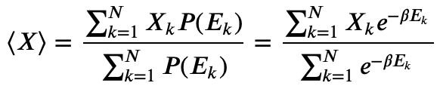


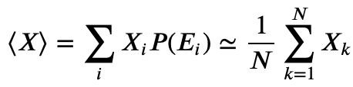
Thermodynamic averages and importance sampling
One possible way to estimate $\left\langle X\right\rangle$is to sample each microstate uniformly at random, calculate X_{i} and accept with a weight proportional to P(E_{i}). If we have N samples, the estimate for $\left\langle X\right\rangle$reads
This method does not require the evaluation of the partition function Z.
However, the method is not very efficient because it will typically sample states that do not contribute much to the result due large penalty from the Boltzmann factor
Importance sampling: Sample the microstates directly from the Boltzmann distribution

Slide 4


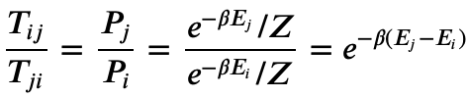

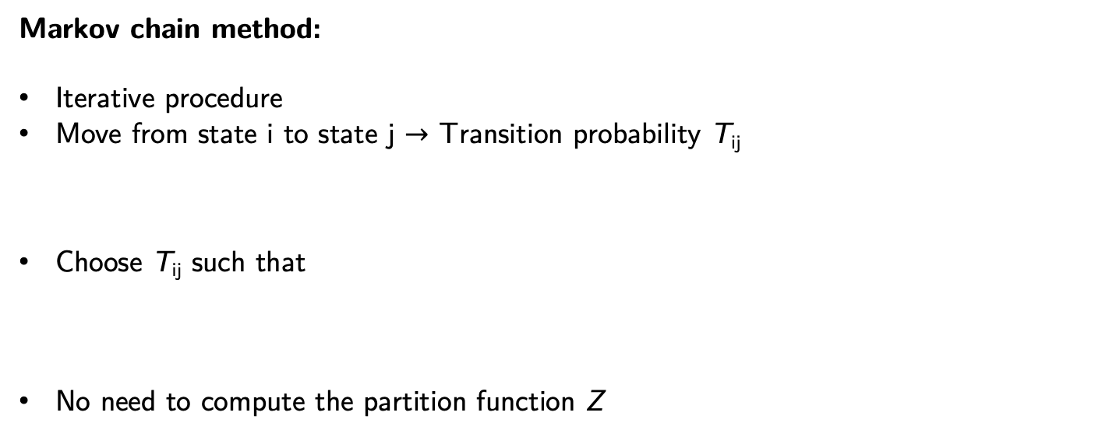
Markov chain method
How to pick states from
Markov chain method:
Iterative procedure
Move from state i to state j $→$ Transition probability T_{ij}
Choose T_{ij} such that
No need to compute the partition function Z
If state i is drawn from Boltzmann distribution the probability to have state j in next step is
also follows Boltzmann distribution

Slide 5



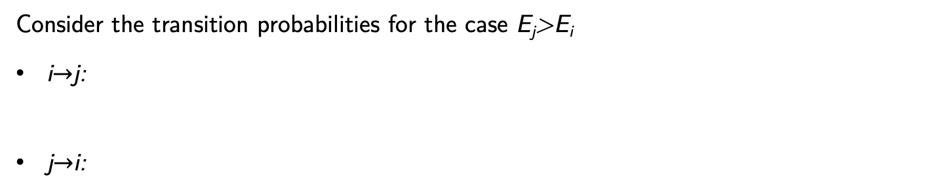
Metropolis algorithm (a.k.a. Metropolis-Hastings algorithm)
Metropolis algorithm is a way to simulate the Markov chain such that
Suppose we can make M moves from state i to a new state j – a move set.
Pick a candidate next state j uniformly at random (the probability is 1/M).
Calculate the energy E_{j} of the candidate state j and compare it to the energy E_{i} of the current step i
  If E_{j}<E_{i}, the move is unconditionally accepted.
  If E_{j}>E_{i}, the move is accepted with a probability
Consider the transition probabilities for the case E_{j}>E_{i}
i$→$j:
j$→$i:
therefore

Slide 6


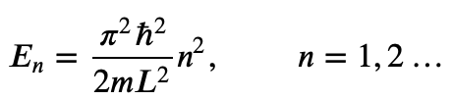

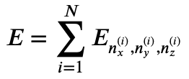


Ideal gas in a finite volume
Recall the energy states of a particle in box of length L
Solving the Schroedinger equation
with boundary conditions
Energy levels:
3D:
Ideal gas:
enumerate the microstates
The probability to have a particular state is given by the Boltzmann distribution
Metropolis algorithm: pick a random particle and change one of its energy indices by $±1$

Slide 7
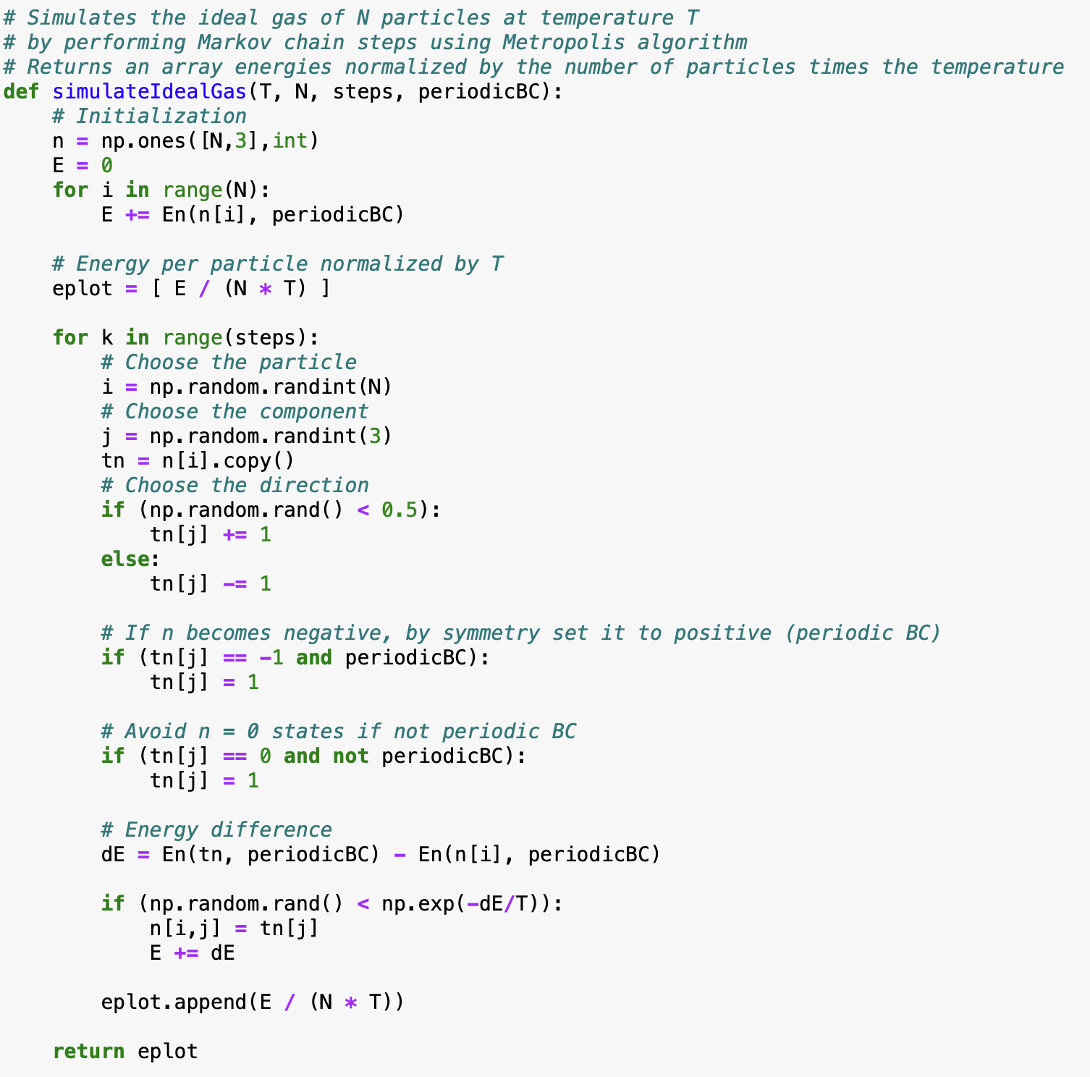
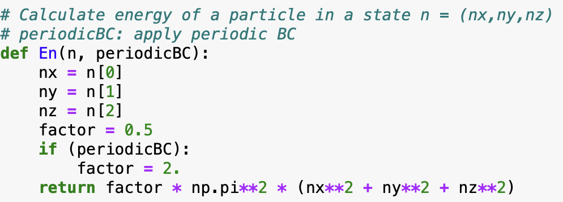
Ideal gas in a finite volume

Slide 8
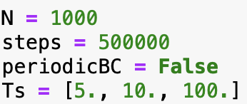
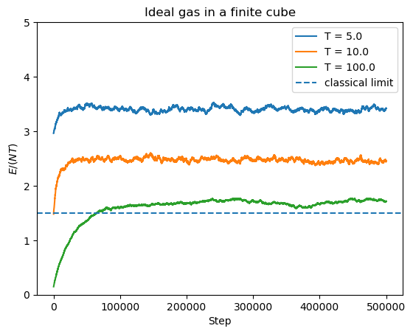
Ideal gas in a finite volume

Slide 9


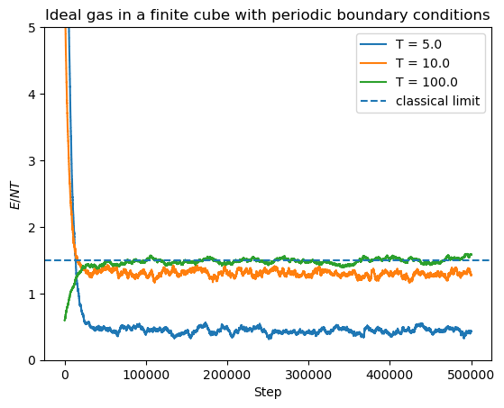
Ideal gas in a finite volume with periodic boundary conditions
Periodic boundary conditions:

Slide 10
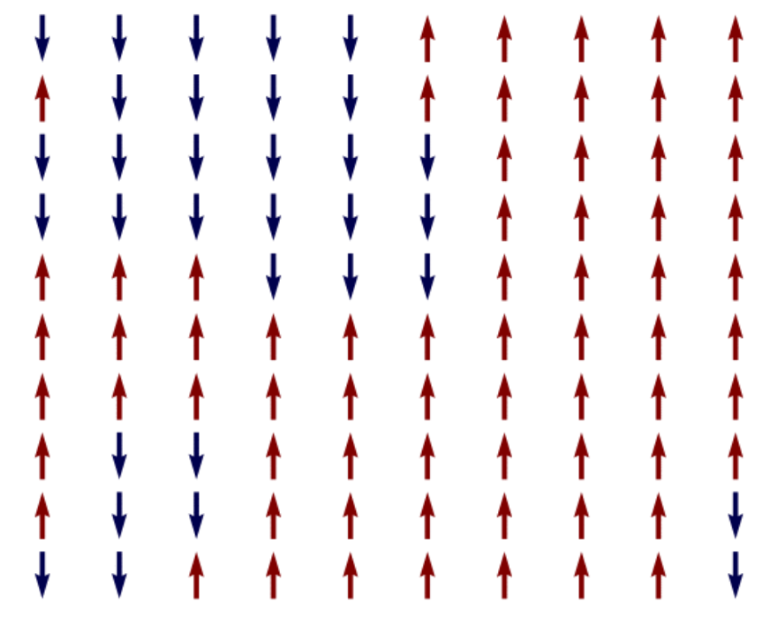


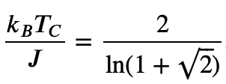
2D Ising model
Ising model represents a system of spins (magnetic dipoles) on a lattice.
Without external magnetic field, the energy reads
J > 0: ferromagnetic, sum over neighbors only
Magnetisation:
Below the Curie temperature
= 2.27
exhibits spontaneous magnetization |M|>0

Slide 11


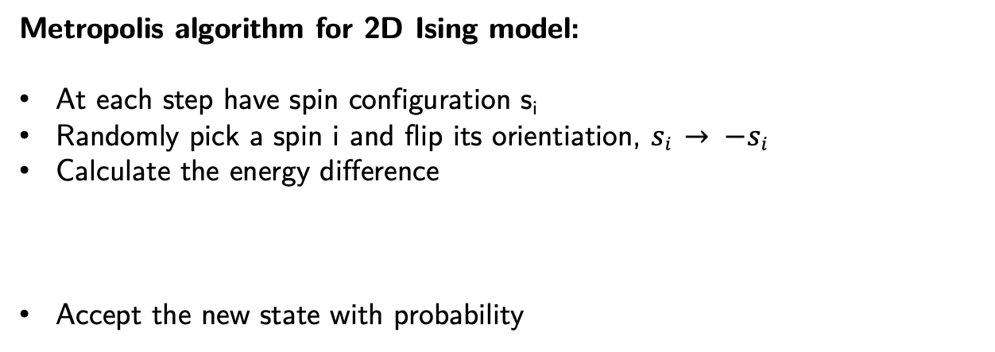
2D Ising model
Metropolis algorithm for 2D Ising model:
At each step have spin configuration s_{i}
Randomly pick a spin i and flip its orientiation, $si → −si$
Calculate the energy difference
Accept the new state with probability

Slide 12
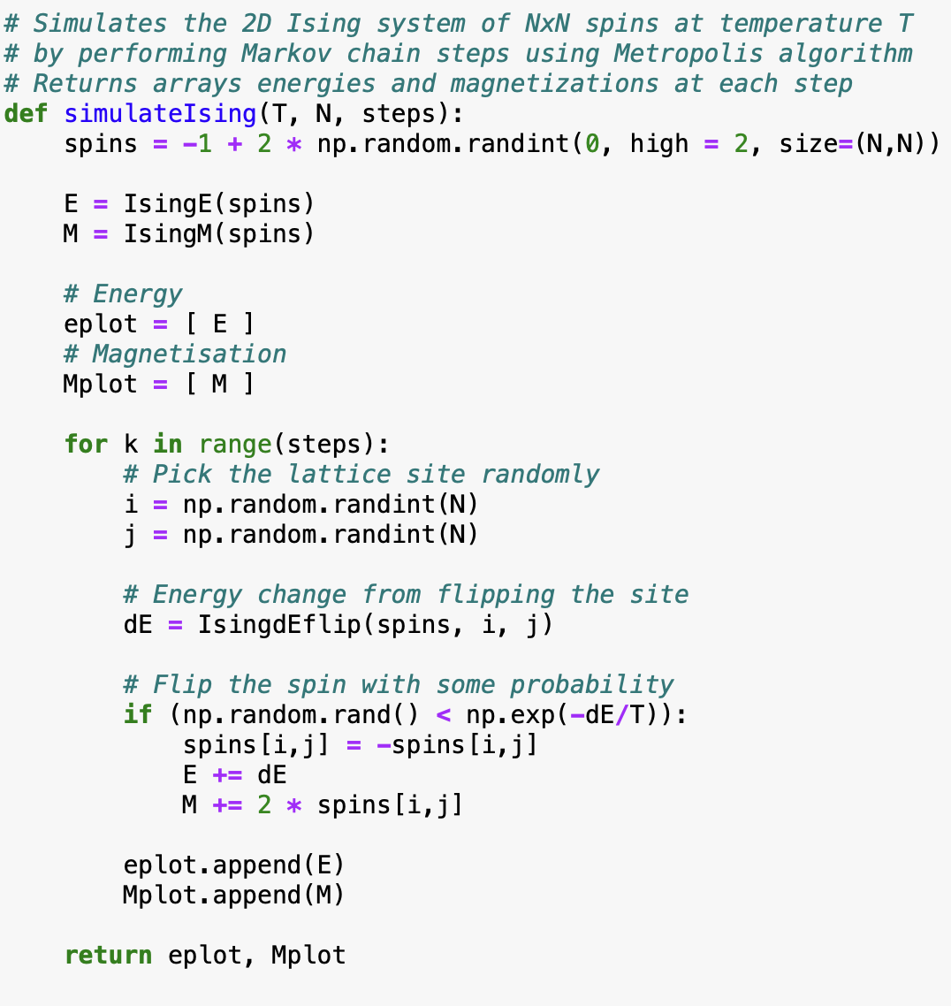
2D Ising model
Metropolis algorithm for 2D Ising model:
At each step have spin configuration s_{i}
Randomly pick a spin i and flip its orientiation, $si → −si$
Calculate the energy difference
Accept the new state with probability

Slide 13
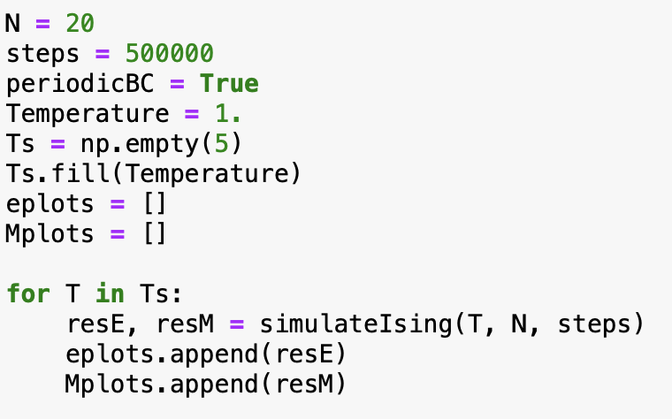
2D Ising model
Simulate T = 1 < T_{C} several times
20x20 system

Slide 14
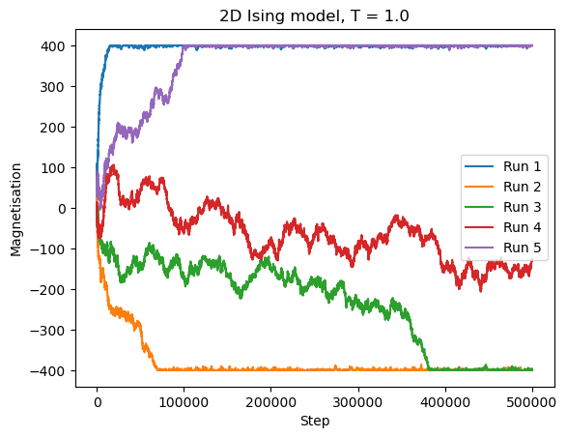
2D Ising model
Simulate T = 1 < T_{C} several times
20x20 system
Spontaneous magnetization!

Slide 15
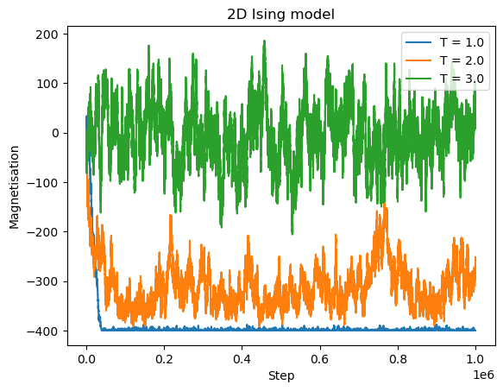
2D Ising model
Try different temperatures

Slide 16
2D Ising model
Simulate T = 1 < T_{C} several times
20x20 system
Spontaneous magnetization!

Slide 17
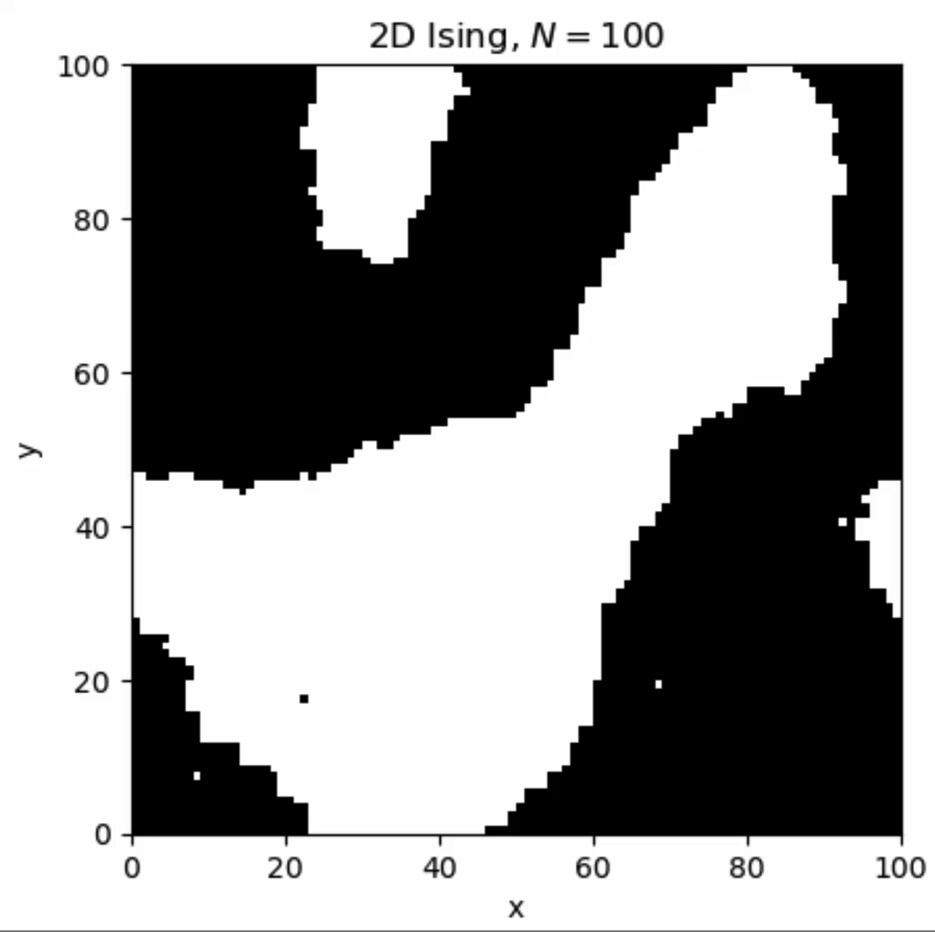
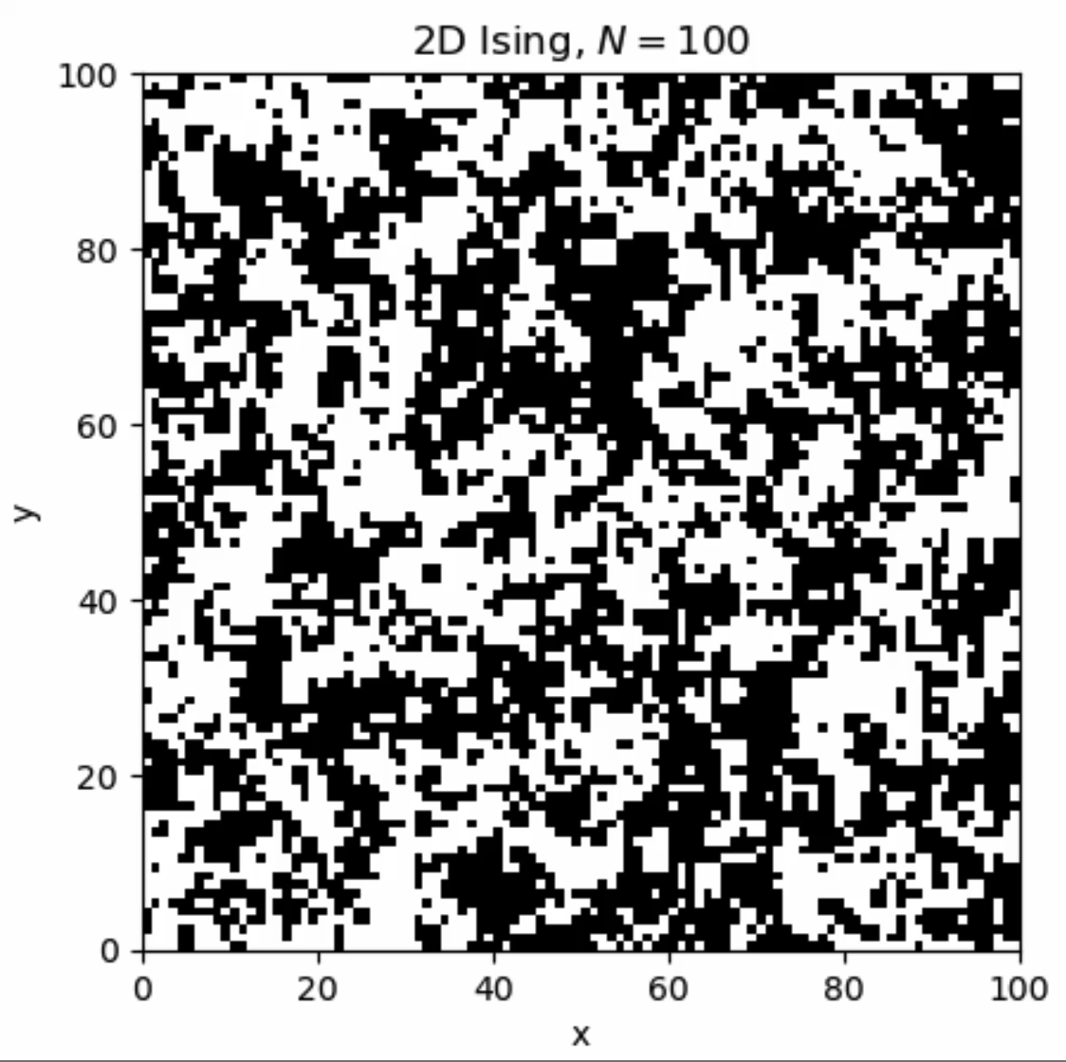
2D Ising model
T < T_{C}
T > T_{C}

Slide 18
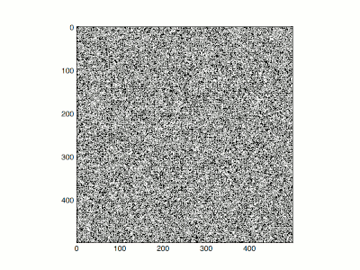
2D Ising model
Large system (500x500)
Credit: Wikipedia

