Slide 1

Energy & CO2 Emission Aggregation Using Project SusQL
Updated Sept 12, 2024

Slide 2
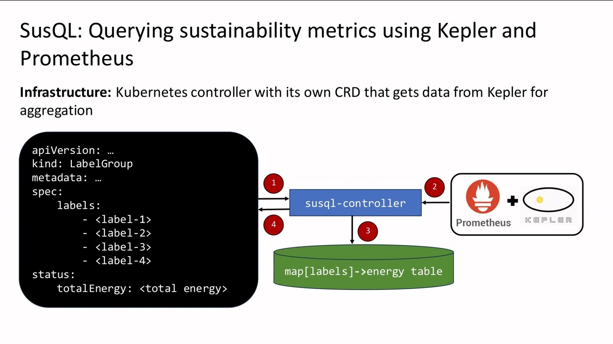
SusQL – Easily Track Total Energy Consumption & CO2 Emission
SusQL aggregates energy consumption monotonically increasing Joules from resources tagged with specific LabelGroups, using energy measurements obtained from Kepler, and calculates estimated CO2 emission.
  https://github.com/sustainable-computing-io/susql-operator
Infrastructure: Kubernetes controller with its own CRD that gets data from Kepler for aggregation

Slide 3


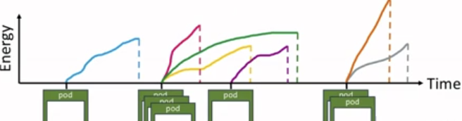
High Level View
Labeled Workloads
With SusQL Labels
Collects Energy data
for all workloads
Time Series Database
such as Prometheus
Selects energy consumption for the labeled workloads
kind: PyTorchJob
spec:
template:
metadata:
labels:
susql.label/1: pytorch-job
susql.label/2: run-1
spec:
- name: pytorch
image: docker.io/pytorch-image
Kepler DB
SusQL DB
….
SusQL can be deployed with its own database
kind: SparkApplication
spec:
template:
metadata:
labels:
susql.label/1: spark-job
susql.label/2: run-1
type: Scala
image: "gcr.io/spark-operator/spark"
Other Workloads
workload…
workload…
workload…
workload…
workload…
WORKLOAD…

Slide 4
SusQL Motivation
User 1: “I run lots of AI jobs, but it is hard to aggregate the energy my jobs are using. How can I easily do this?”
User 2: “I need to report exactly how much energy my AI training jobs consume for government regulators. How can I do this reliably? I need to restart jobs frequently.”
Administrator: “I manage lots of users and projects and want to summarize energy used by different departments and work loads. How can I easily do this?”
Although this data is available from Kepler, filtering the data and writing queries is complicated and time consuming.
SusQL can remove these user pain points!

Slide 5
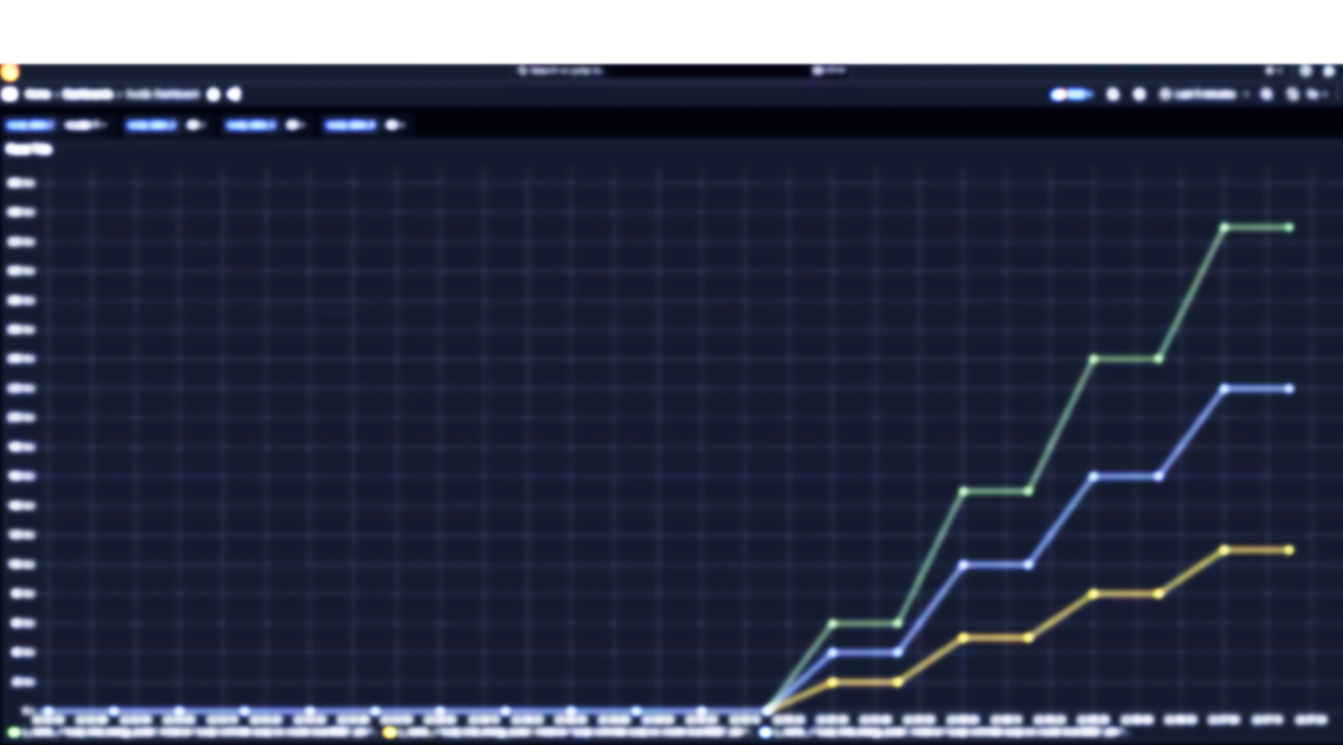
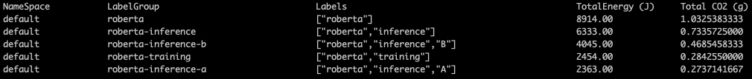
Relevance
Easy to understand total energy usage for resources of interest.
  Don’t have to bother with Prometheus queries or Kepler data extraction.
  Easy to focus on resources of interest. Don’t have to worry at all about other pods, jobs, resources, restarts, etc.

Slide 6
Four Steps to Use SusQL
Install from OperatorHub (both default OpenShift catalog and OperatorHub.io)
Deploy labelgroups
Deploy labeled workloads
Observe aggregated data through either:
  susqltop command
  OpenShift->Observe->Metrics query

Slide 7
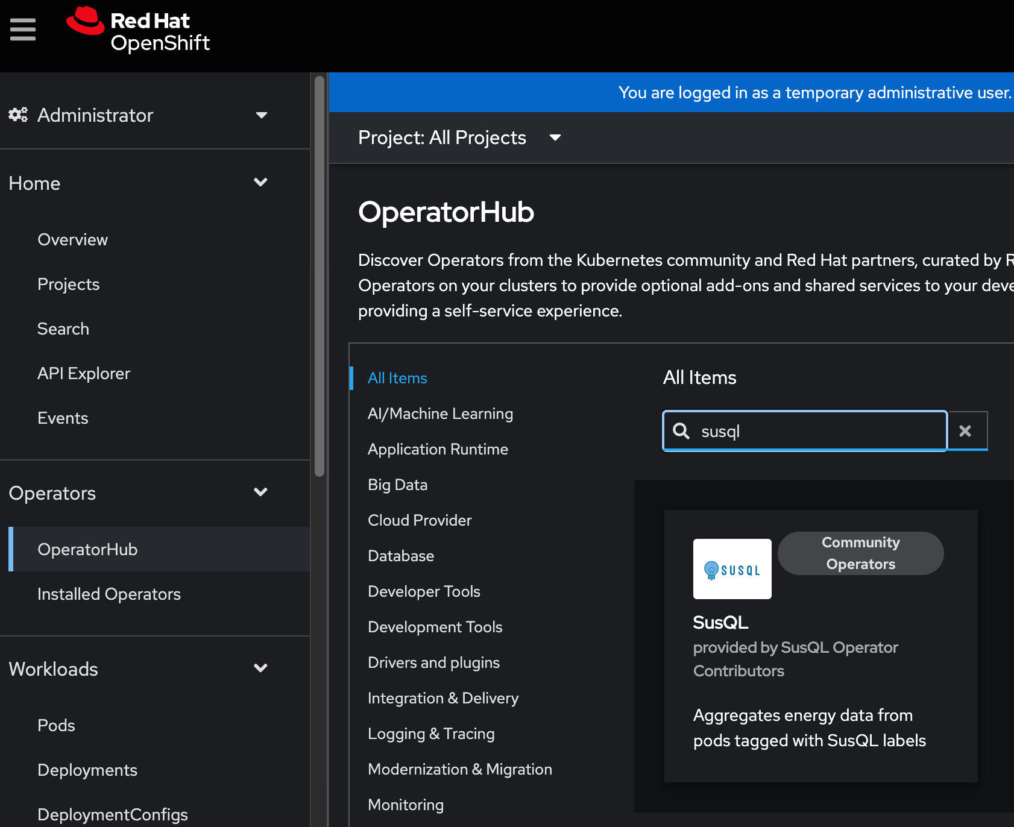
1. Install from OperatorHub

Slide 8
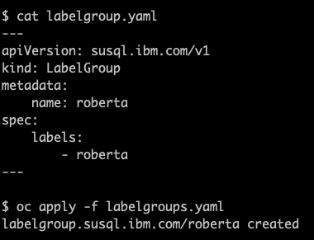
2. Create labelgroup(s)

Slide 9
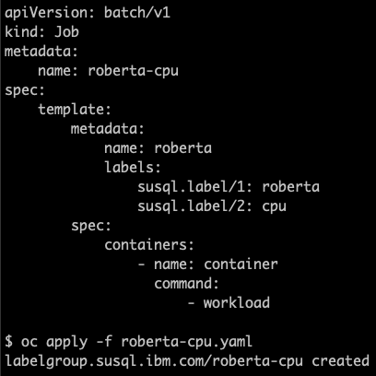
3. Create Workload

Slide 10
4a. Observing energy & CO2 from command line

Slide 11
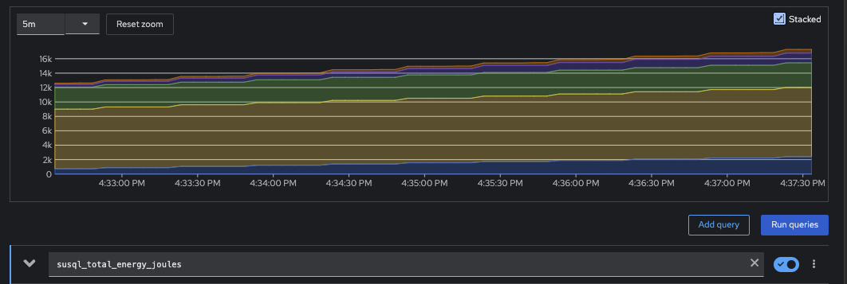
4b. Observing energy from Observe tab

Slide 12
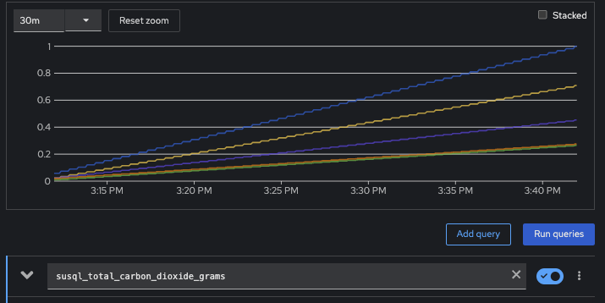
4c. Observing CO2 from Observe tab

Slide 13
Current SusQL Capabilities
Gather & aggregate energy consumption data from Kepler
Calculate estimated CO2 emissions
Store aggregated data in Prometheus database
Visualize/query aggregated data with OpenShift Observe Metric query, Prometheus dashboard, & command line
Long-term monitoring of cluster workgroups labeled by labelgroups
Function on a single Kubernetes cluster including OpenShift
Function on multiple independent Kubernetes clusters including OpenShift

Slide 14
Currently Customizable SusQL Capabilities
Use non-Prometheus databases through Thanos
Gather energy data from compatible sources other than Kepler
Provide energy/CO2 data to 3rd party applications through Prometheus query

Slide 15
Capability Plan Summary
Capability | Current Default | Customizable? | Future Work
Energy data source | Kepler | Yes | Easier customization
Database | Prometheus | Yes, if Thanos protocol. | Easier customization. Non-Thanos Protocol support.
Platforms | Kubernetes cluster (such as OpenShift) | No | Support non-Kubernetes environments such as RHEL AI on Steps 1 and 2.
Multi-Cluster | Single cluster | No | Support aggregating and visualizing multiple clusters.
OpenShift AI Support | Yes | Yes | Improve integration.
RHEL AI Support | Step 3 running on OpenShift supportable. | Step 1 in compatible container on OpenShift. | Support step 2 running on hybrid cloud.
CO2 Estimation | Calculation with static and dynamic carbon intensity | Yes | Green Software Foundation Carbon Aware SDK Integration

Slide 16
Ongoing Roadmap
Improve reliability and accuracy
  SusQL resource utilization analysis, potential double counting bug, functional verification during CI
SusQL with OpenShift AI Support
  Improve SusQL Operator integration with OpenShift AI
Multi-cluster items
  Add Cluster ID. Include in logged data tuples.
  Verify and document Thanos accessible database interactivity.
  Enable access to and visualization of data from the entire multi-clusterverse. (Use KubeStellar?)
SusQL on RHEL AI Support for Steps 1-3
Support metrics useful for inference and fine tuning
  Such as energy/CO2 per token, energy/CO2 per request, etc.
  Support modular input from other platforms
Continue Kepler decoupling
  Refactor descriptions, variable naming, documentation, etc.
  Use CRD rather than configmaps for operator level configuration.
Improve compatibility within ecosystem
  Integration with Green Software Foundation’s Carbon Aware SDK
  Integration with resource schedulers including ODH & MCAD
  Improved output including custom output metrics, multiple metrics, and interval queries.
Enable fine grained user permission support
Additional label tagging functionality
  Namespace rules, annotation rules, RE support
Details and additional tasks @ github.com/sustainable-computing-io/susql-operator

